Slide 1
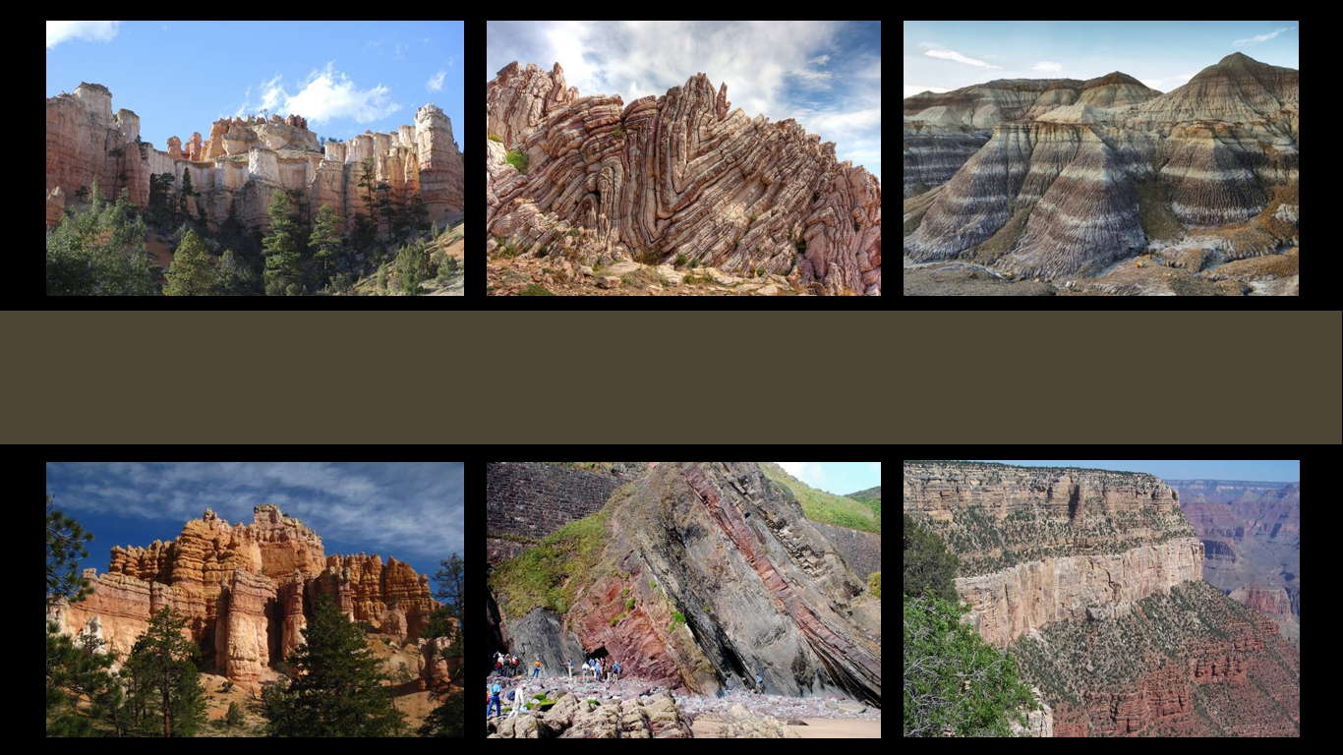
The Geologic Column
Comparison of Conventional & Short-Age Geology
Notes:
A comparison of conventional and short-age geology.

Slide 2

Faith, Reason, and Earth History
Chapter 14 by Dr. Leonard Brand
Conventional
Geology
Short-age
Geology
Assumptions
Interpretations
Challenges
Notes:
This comparison is drawn from chapter 14 of the book Faith, Reason, and Earth History by Dr. Leonard Brand. / It will explore the assumptions, / interpretations, / and challenges of both conventional geology and short-age geology.

Slide 3
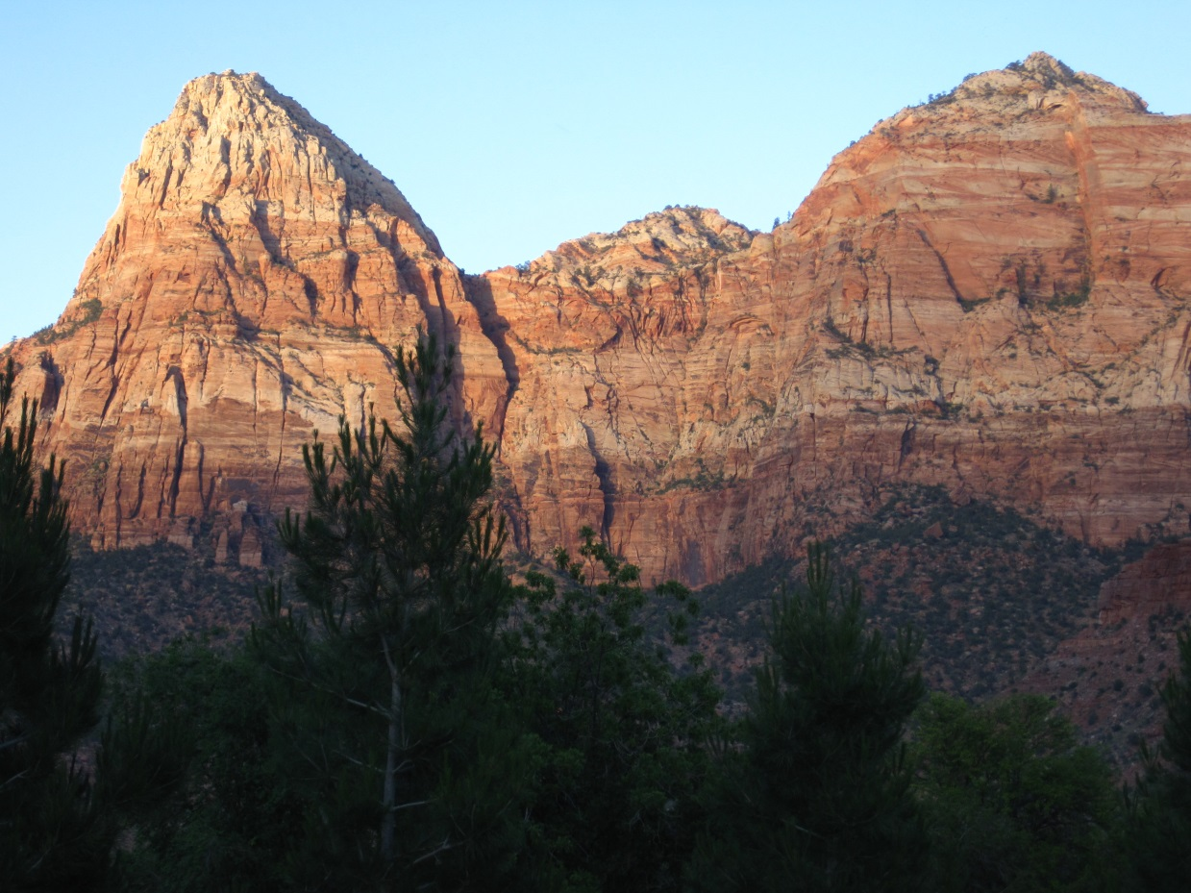
Notes:
The rock layers and the fossils found in them provide us with observable data. But when geologists study these data, they often come up with very different interpretations.

Slide 4

Starting Assumptions
Affect how scientists interpret data
Notes:
This is because the assumptions scientists accept to begin with affect how they interpret the data.

Slide 5
Assumptions
Things that are assumed or taken for granted
Notes:
Assumptions are things that are assumed or taken for granted.

Slide 6
Background & Definitions
Catastrophism
  Geological formations resulted from catastrophe
Uniformitarianism
  Charles Lyell
  Geological formations formed gradually by regular geological processes
Notes:
Before we compare two different theories of earth history, let’s review a little background and some definitions. / Catastrophism is the idea that many geological formations were formed as a result of a catastrophe. Many of the earliest geologists worked from this assumption. / In 1830 Charles Lyell made famous a different idea that was originally suggested by a man named James Hutton. Uniformitarianism is the idea that geological formations formed gradually by the regular geological processes we see around us today.

Slide 7
Background & Definitions
Uniformitarianism (Charles Lyell)
  Uniformity of law
  Uniformity of process
  Uniformity of rates
  Uniformity of conditions
Notes:
Lyell believed that natural laws…

Slide 8
Background & Definitions
Uniformitarianism (Charles Lyell)
  Uniformity of law
  Uniformity of process
  Uniformity of rates
  Uniformity of conditions
Notes:
…and geological processes…

Slide 9
Background & Definitions
Uniformitarianism (Charles Lyell)
  Uniformity of law
  Uniformity of process
  Uniformity of rates
  Uniformity of conditions
Notes:
…as well as the rate at which they happen…

Slide 10
Background & Definitions
Uniformitarianism (Charles Lyell)
  Uniformity of law
  Uniformity of process
  Uniformity of rates
  Uniformity of conditions
Notes:
…and the conditions under which they happen have always been the same.

Slide 11
Background & Definitions
Uniformitarianism (Charles Lyell)
  Uniformity of law
  Uniformity of process
  Uniformity of rates
  Uniformity of conditions
Notes:
Conventional geology today continues to accept the first two,

Slide 12
Background & Definitions
Uniformitarianism (Charles Lyell)
  Uniformity of law
  Uniformity of process
  Uniformity of rates
  Uniformity of conditions
Notes:
while moving away from the idea that the rate of geological processes and the conditions under which they happened have always been the same.

Slide 13
Assumptions
Notes:
With that background, let’s compare the assumptions of conventional and short-age geology.

Slide 14
Conventional Geology | Short-Age Geology
Uniformity of Law The laws of nature have always been the same. Some of natural law is not yet understood.
Notes:
According to Lyell and conventional geology today, the laws of nature have always been the same and some of that natural law is not yet understood.

Slide 15
Conventional Geology | Short-Age Geology
Uniformity of Law The laws of nature have always been the same. Some of natural law is not yet understood. | Uniformity of Law Accepts this assumption Emphasizes that more of natural law is yet to be understood Will not reject a hypothesis just because it implies events in the past that are outside of naturalistic science
Notes:
Short-age geology accepts this assumption and especially emphasizes that more of natural law is yet to be understood. But unlike conventional geology, short-age geology will not reject a hypothesis just because it implies events in the past that are outside of naturalistic science.

Slide 16
Conventional Geology | Short-Age Geology
Uniformity of Process When possible, explain past results as the outcome of causes that are still operating today
Notes:
The second principle of conventional geology—the uniformity of process—says that when possible, past results should be explained as the outcome of causes that are still operating today.

Slide 17
Conventional Geology | Short-Age Geology
Uniformity of Process When possible, explain past results as the outcome of causes that are still operating today | Uniformity of Process Accepts this assumption Whether or not God initiated the flood is not testable. Processes before, during, and after the flood are assumed to have operated according to known or potentially knowable laws of nature.
Notes:
Short-age geology accepts this assumption. Whether or not God initiated the global flood is not testable, but processes before, during, and after the flood are assumed to have operated according to known or potentially knowable laws of nature.

Slide 18
Conventional Geology | Short-Age Geology
Non-Uniformity of Rates Rates of geological processes have NOT always been uniform. Whether individual formations formed slowly or catastrophically must be determined by evidence. Does not deny billions of years.
Notes:
Unlike Lyell, who believed that the rates of geological processes were constant, conventional geology today no longer believes that the rates have always been uniform. Whether individual formations formed slowly or catastrophically must be determined separately using the available evidence. Even though conventional geology accepts that some things formed rapidly, it does not deny the conventional billions of years of geologic time.

Slide 19
Conventional Geology | Short-Age Geology
Non-Uniformity of Rates Rates of geological processes have NOT always been uniform. Whether individual formations formed slowly or catastrophically must be determined by evidence. Does not deny billions of years. | Non-Uniformity of Rates Accepts this assumption Agrees DOES deny billions of years
Notes:
Short-age geology agrees that rates have not always been uniform, agrees that the history of formations must be determined individually, but does deny the billions of years of geologic time.

Slide 20
Conventional Geology | Short-Age Geology
Non-Uniformity of Conditions Does NOT assume that conditions have always been the same. The concept of non-uniformity of conditions can be tested. The evidence is believed to indicate a progression in the development of landforms, plate tectonics, etc.
Notes:
In a similar way, conventional geology does not assume that conditions have always been the same. This is testable, and the evidence is believed to indicate a progression in the development of landforms, plate tectonics, etc.

Slide 21
Conventional Geology | Short-Age Geology
Non-Uniformity of Conditions Does NOT assume that conditions have always been the same. The concept of non-uniformity of conditions can be tested. The evidence is believed to indicate a progression in the development of landforms, plate tectonics, etc. | Non-Uniformity of Conditions Agrees Predicts even more differences in conditions The geologic record is the result of a specific sequence of events beginning before the creation of life and leading up to the present day.
Notes:
Short-age geology agrees with the non-uniformity of conditions and predicts even more differences in conditions than conventional geology. Short-age geology believes that the geologic record is the result of a specific sequence of events beginning before the creation of life and leading up to the present day.

Slide 22
Interpretations
Notes:
Next, let’s compare the interpretations resulting from conventional and short-age geology,

Slide 23
 | Conventional Geology | Short-Age Geology
Origins
Geologic Record
Time
Notes:
…Specifically how each looks at origins, the geologic record, and the issue of time.

Slide 24
 | Conventional Geology | Short-Age Geology
Origins | Evolution over millions of years
Geologic Record
Time
Notes:
Conventional geology says that life evolved over millions of years...

Slide 25
 | Conventional Geology | Short-Age Geology
Origins | Evolution over millions of years | Major groups of animals and plants were created
Geologic Record
Time
Notes:
… while short-age geology says that major groups of animals and plants were created.

Slide 26
 | Conventional Geology | Short-Age Geology
Origins | Evolution over millions of years | Major groups of animals and plants were created
Geologic Record | Regular geologic processes over several billion years & Catastrophes
Time
Notes:
Conventional geology explains the existence of the geologic record by a combination of regular geologic processes generally like those observable today, combined with some catastrophes.

Slide 27
 | Conventional Geology | Short-Age Geology
Origins | Evolution over millions of years | Major groups of animals and plants were created
Geologic Record | Regular geologic processes over several billion years & Catastrophes | World-wide catastrophe Afterward, geological processes slowed to current rates
Time
Notes:
Short-age geology explains the geologic record as the result of a world-wide catastrophe, after which geologic processes slowed to their current rates.

Slide 28
 | Conventional Geology | Short-Age Geology
Origins | Evolution over millions of years | Major groups of animals and plants were created
Geologic Record | Regular geologic processes over several billion years & Catastrophes | World-wide catastrophe Afterward, geological processes slowed to current rates
Time | Phanerozoic formed during 545 million years
Notes:
Conventional geology estimates that the Phanerozoic portion of the geologic column was formed in about 545 million years

Slide 29
 | Conventional Geology | Short-Age Geology
Origins | Evolution over millions of years | Major groups of animals and plants were created
Geologic Record | Regular geologic processes over several billion years & Catastrophes | World-wide catastrophe Afterward, geological processes slowed to current rates
Time | Phanerozoic formed during 545 million years | Phanerozoic formed in thousands, not millions of years
Notes:
Short-age geology suggests that it formed in thousands, not millions of years.

Slide 30
Short-Age Geology Proposes
At some time in the past, a disturbance in the earth’s crust temporarily disrupted the normal relationships between land and water bodies, initiating a period of rapid geologic activity on a worldwide scale.
Notes:
Short-age geology proposes that at some time in the past, a disturbance in the earth’s crust temporarily disrupted the normal relationships between land and water bodies, initiating a period of rapid geologic activity on a worldwide scale.

Slide 31
Short-Age Geology Proposes
This period of rapid erosion and sedimentation produced some significant portion of the geologic column.
Notes:
This period of rapid erosion and sedimentation produced some significant portion of the geologic column.

Slide 32
Short-Age Geology Proposes
The geological and geophysical processes occurring during that event
  Determined the characteristics of the rock formations formed at that time
  Determined the distribution of fossils in the rocks
  Influenced the distribution of radioactive elements in those minerals used in radiometric dating.
Notes:
The geological and geophysical processes occurring during that event / determined the characteristics of the rock formations formed at that time / determined the distribution of fossils in the rocks / and influenced the distribution of radioactive elements in those minerals used in radiometric dating.

Slide 33
Short-Age Geology
Descriptive statements
Can be used to develop testable hypotheses about individual formations
Notes:
Notice that the propositions of short-age geology can be stated as descriptive statements / and they can be used to develop testable hypotheses about individual formations

Slide 34
Challenges
Notes:
The fossil record poses difficulties for both models of earth’s history.

Slide 35
Difficulties Posed by Fossil Record
Conventional Geology
Short-Age Geology
Cambrian Explosion
Most body plans appear without apparent ancestors in the Cambrian system
Notes:
For example / the Cambrian Explosion has challenged evolutionists ever since the time of Darwin. / The fact that most body plans appear without apparent ancestors in the Cambrian system is difficult to explain using the paradigm of conventional geology.

Slide 36
Difficulties Posed by Fossil Record
Conventional Geology
Short-Age Geology
Cambrian Explosion
Most body plans appear without apparent ancestors in the Cambrian system
Radiometric Dating
Radiometric dating methods calculate millions of years instead of the thousands of years indicated in Scripture
Notes:
In the same way, short-age geology is challenged by the radiometric dates of volcanic rocks within the geologic column that are measured in millions instead of thousands of years

Slide 37
Short-Age Geology Predicts
Significant phenomena have yet to be discovered
Much of the geologic column was deposited in a short time
Notes:
Short-age geology predicts, that significant phenomena have yet to be discovered, and that when the data are all in, / it will be determined that much of the geologic column was deposited in a short time.

Slide 38
Summary
Assumptions influence interpretations
Both accept many of the same assumptions
Short-age geologists are willing to consider a broader range of possibilities
Both can suggest testable hypotheses
Both face challenges from scientific data
Notes:
To summarize: The assumptions a scientist accepts influences how he or she interprets the data. Conventional and short-age geologists accept many of the same assumptions. Because short-age geologists will not reject a hypothesis just because it implies events in the past that are outside of naturalistic science, they actually consider a broader range of possibilities. Both conventional and short-age geology can suggest testable hypotheses. Both conventional and short-age geology face challenges from scientific data.

Slide 39
Recorded at
Chattanooga Public RadioSM
Classical 90.5 WSMC

Slide 40
Images By
Images may appear on more than one slide. Citation is given on the first slide where each image appears.
[1a] Zion National Park 489588635, kaiborder, Thinkstock, Thinkstock Image Subscription Agreement
[1b] Folded rocks 24286621 Matauw, Getty Images (US), Inc. Subscription Agreement
[1c] Blue Mesa Petrified Forest National Park 479232619, estivillml, Thinkstock, Thinkstock Image Subscription Agreement
[1d] Bryce Canyon National Park, Keith Snyder
[1e] Folded rocks, Raul Esperante, used with permission
[1f] Grand Canyon, taken by Ed Chatelain, used with permission
[3] Zion National Park, Keith Snyder

Slide 41
Special Thanks
Leonard Brand, PhD
Loma Linda University
and the
Foundation for Adventist Education

Slide 42

© Origins Curriculum Resources 2015

Slide 43

© Southern Adventist University 2015

Slide 44

© Seventh-day Adventist North American Division 2015

Slide 45

© General Conference of Seventh-day Adventists 2015

Slide 46

© SCORE Southern Center for Origins Research & Education 2015

