Slide 1
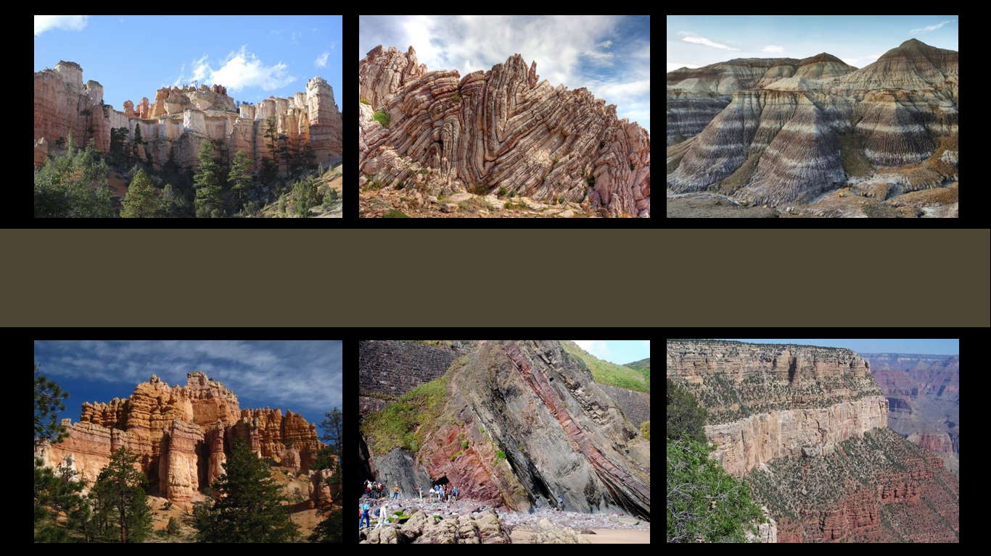
The Geologic Column
Discovery and Contents of the Cenozoic
Notes:
The Geologic Column—the Discovery and Contents of the Cenozoic

Slide 2

Cenozoic
Cenozoic
Mesozoic
Phanerozoic
Paleozoic
Precambrian
Notes:
In this presentation we will explore the Cenozoic erathem--learning how its layers were first discovered and what kinds of fossils are found in them.

Slide 3
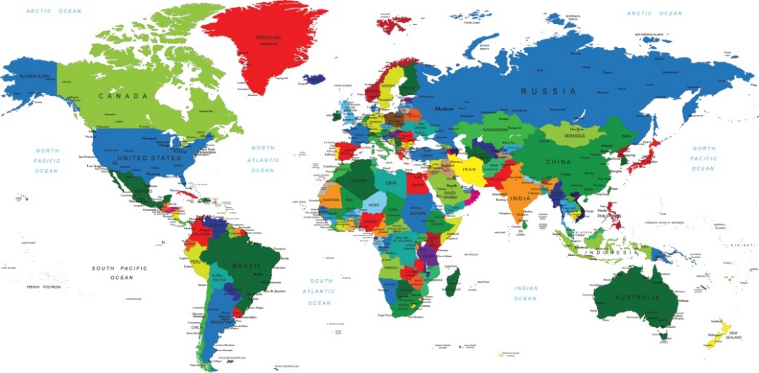
Quaternary
Cenozoic
Neogene
Named for
Paleogene
Characteristics
Places
Cretaceous
Tribes
Mesozoic
Jurassic
Triassic
Phanerozoic
Permian
Pennsylvanian
Mississippian
Paleozoic
Devonian
Silurian
Ordovician
Cambrian
Precambrian
Notes:
Recall how the various systems of the Paleozoic and Mesozoic erathems were named for places, tribes, or characteristics of the rocks. There was nothing evolutionary connected with these sections of the geologic column at first.

Slide 4
1795
1800
1822
1831
1834
1840s
1879
Jurassic
Silurian
Pennsylvanian
Triassic
Mississippian
Permian
Terrace Cretace
Cretaceous (later)
Lower Silurian Renamed Ordovician
Notes:
Some of the layers and fossils were studied throughout much of the 19th century by people who believed in the Bible.

Slide 5
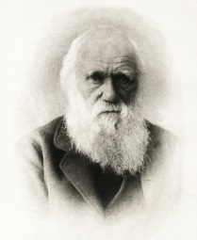
1795
1800
1822
1831
1834
1840s
1879
Jurassic
Silurian
Pennsylvanian
Triassic
Mississippian
Permian
Terrace Cretace
Cretaceous (later)
Lower Silurian Renamed Ordovician
Notes:
It was not until after most of these systems were named that Darwin’s theory of evolution was published in 1859…

Slide 6
Evolution influential
Cenozoic
Mesozoic
Phanerozoic
Paleozoic
Precambrian
Notes:
But even though some of the lower systems were named by scientists who believed in the Bible, / evolutionary ideas were influential in the naming of the various subdivisions of the Cenozoic erathem.

Slide 7
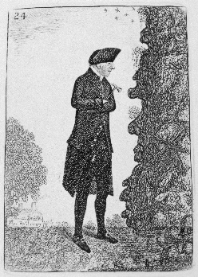
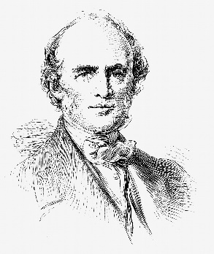
1795
1800
1822
1831
1834
1840s
1879
Jurassic
Silurian
Pennsylvanian
Triassic
Mississippian
Permian
Terrace Cretace
Cretaceous (later)
Lower Silurian Renamed Ordovician
Notes:
Near the end of the 18th century, a geologist named James Hutton published a book introducing uniformitarianism—the idea that earth’s history can be best explained by looking at the geological processes happening around us in the present. / Several decades later, this idea was popularized by a geologist named Charles Lyell.

Slide 8


Uniformitarianism
James Hutton
Charles Lyell
Notes:
These men, and this idea, are responsible for the idea that the geologic column formed over many millions of years instead of during the biblical flood.
(pictures from thinkstock)

Slide 9

Uniformitarianism
Charles Lyell
Notes:
Charles Lyell suggested subdivisions of the Cenozoic—which was called the Tertiary at the time--to directly challenge the Biblical flood and to advance the idea of uniformitarianism.

Slide 10
Lyell’s Epochs
Pleistocene
Neogene
Pliocene
Miocene
Cenozoic
Oligocene
Paleogene
Eocene
Paleocene
Notes:
This enlarged diagram of the Cenozoic erathem shows the subdivisions suggested by Lyell. He called these subdivisions epochs, which expressed his desire to show that geological processes happened slowly over long time intervals.

Slide 11
1795
1800
1822
1831
1834
1840s
1879
Jurassic
Silurian
Pennsylvanian
Triassic
Mississippian
Permian
Terrace Cretace
Cretaceous (later)
Lower Silurian Renamed Ordovician
Notes:
It is interesting that he suggested these subdivisions to discredit belief in the Bible / before he published his work on uniformitarianism, / and well before Darwin’s proposal of evolution.

Slide 12
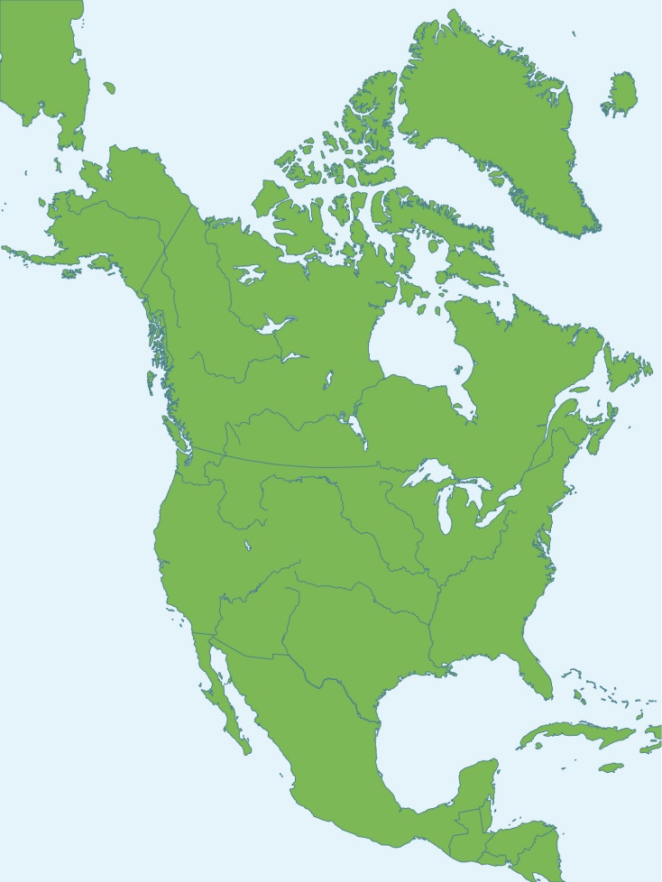
Lyell’s Epochs
Pleistocene
1940s
Neogene
Pliocene
Miocene
Cenozoic
Oligocene
Paleogene
Eocene
Paleocene
Notes:
Many decades later, in the 1940’s, when belief in evolution had become nearly universal, / vertebrate paleontologists working in North America subdivided Lyell’s epochs into even smaller units

Slide 13
Lyell’s Epochs
North American Land Mammal Ages
Pleistocene
Neogene
Pliocene
Miocene
Cenozoic
Oligocene
Paleogene
Eocene
Paleocene
Notes:
…which they called the North American Land Mammal Ages. The idea of the land mammal ages was based on the belief of these scientists in evolution.

Slide 14

Important Terminology
Chronostratigraphic (layers)
  Eonothem
  Erathem
  System
  Series
  Stage
Geochronologic (time)
  Eon
  Era
  Period
  Epoch
  Age
Notes:
Remember the difference between chronostratigraphic and geochronologic terms?

Slide 15
Important Terminology
Chronostratigraphic (layers)
  Eonothem
  Erathem
  System
  Series
  Stage
Geochronologic (time)
  Eon
  Era
  Period
  Epoch
  Age
Notes:
The term “age” is a geochronologic term, which includes both the layers themselves and the inferred time associated with them.

Slide 16
Important Terminology
Chronostratigraphic (layers)
  Eonothem
  Erathem
  System
  Series
  Stage
Geochronologic (time)
  Eon
  Era
  Period
  Epoch
  Age
Notes:
Referring to these divisions as stages instead, means we are talking just about the layers, without the inferred millions of years of time associated with them.

Slide 17
Lyell’s Epochs
North American Land Mammal Ages
Pleistocene
Neogene
Pliocene
Miocene
Cenozoic
Oligocene
Paleogene
Eocene
Paleocene
Notes:
Even though the idea of the land mammal ages was based on a belief evolution, the layers were still named the same way as the Paleozoic and Mesozoic--based on fossil communities from a specific place and in a specific sequence.

Slide 18
Lyell’s Epochs
North American Land Mammal Ages
Pleistocene
Irvingtonian
Irvington, CA
Neogene
Pliocene
Miocene
Cenozoic
Oligocene
Paleogene
Eocene
Paleocene
Notes:
For example, one of the two ages within the Pleistocene epoch was named the Irvingtonian for fossils discovered in Irvington, CA

Slide 19
Lyell’s Epochs
North American Land Mammal Ages
Pleistocene
Neogene
Pliocene
Blancan
Mt. Blanco, TX
Miocene
Cenozoic
Oligocene
Paleogene
Eocene
Paleocene
Notes:
The Blancan age is named for fossils found in Mt. Blanco, TX

Slide 20
Lyell’s Epochs
North American Land Mammal Ages
Pleistocene
Neogene
Pliocene
Miocene
Barstovian
Barstow Formation
Barstow, CA
Cenozoic
Oligocene
Paleogene
Eocene
Paleocene
Notes:
One of the four ages in the Miocene got its name from the Barstow Formation in CA

Slide 21
Lyell’s Epochs
North American Land Mammal Ages
Pleistocene
Neogene
Pliocene
Miocene
Cenozoic
Oligocene
Whitneyan
Whitney, NE
Paleogene
Eocene
Paleocene
Notes:
And one of the four ages in the Oligocene got its name from fossils found in Whitney, NE

Slide 22
Lyell’s Epochs
North American Land Mammal Ages
Pleistocene
Neogene
Pliocene
Miocene
Cenozoic
Oligocene
Paleogene
Eocene
Bridgerian
Bridger Formation
Wyoming
Paleocene
Notes:
The name Bridgerian came from the Bridger Formation in Wyoming and is the name of one of four different ages in the Eocene epoch.

Slide 23
Lyell’s Epochs
North American Land Mammal Ages
Pleistocene
Neogene
Pliocene
Miocene
Cenozoic
Oligocene
Paleogene
Eocene
Paleocene
Clarksforkian
Clark’s Fork Basin, WY
Notes:
The Paleocene includes four different land mammal ages as well, one of which was named for fossils found in Clark’s Fork Basin, WY

Slide 24
Lyell’s Epochs
North American Land Mammal Ages
Pleistocene
Irvingtonian
Irvington, CA
Neogene
Pliocene
Blancan
Mt. Blanco, TX
Miocene
Barstovian
Barstow Formation
Barstow, CA
Cenozoic
Oligocene
Whitneyan
Whitney, NE
Paleogene
Eocene
Bridgerian
Bridger Formation
Wyoming
Paleocene
Clarksforkian
Clark’s Fork Basin, WY
Notes:
As you can see, the names for the various “ages” are based on a succession of fossil communities, or biomes, preserved at specific places. They do not necessarily mean evolution.

Slide 25
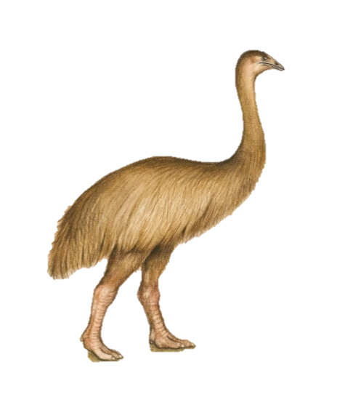
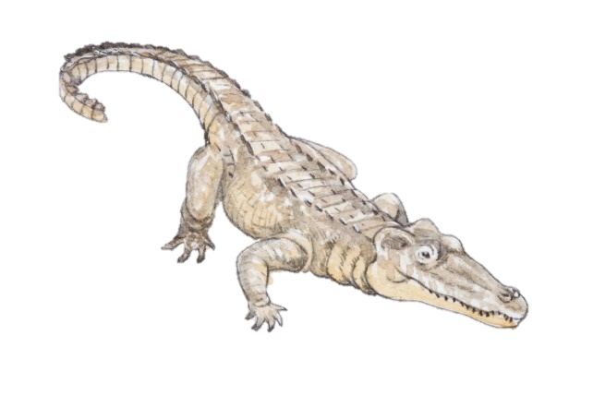
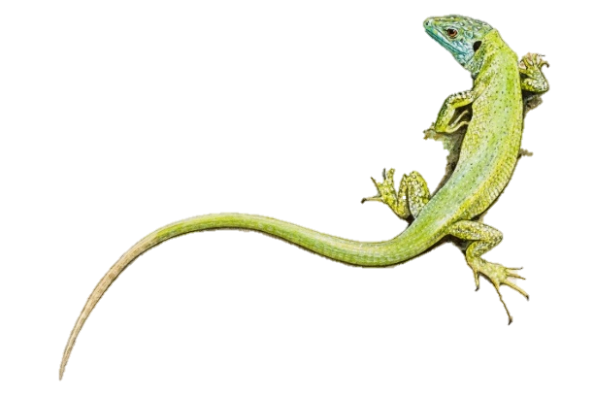
Quaternary
Cenozoic
Neogene
Paleogene
Cretaceous
Mesozoic
Jurassic
Triassic
Phanerozoic
Permian
Pennsylvanian
Mississippian
Paleozoic
Devonian
Silurian
Ordovician
Cambrian
Precambrian
Notes:
What kinds of fossils are found in these Cenozoic fossil communities? A wide variety of creatures including invertebrates, fish, reptiles, and birds.

Slide 26
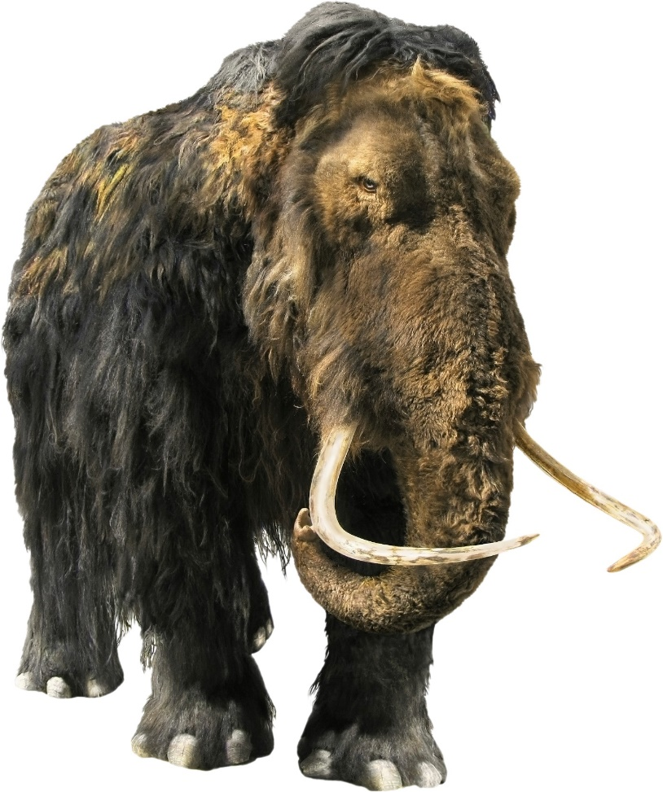
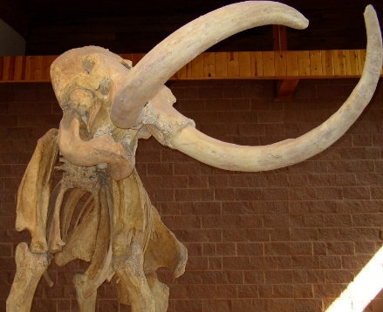
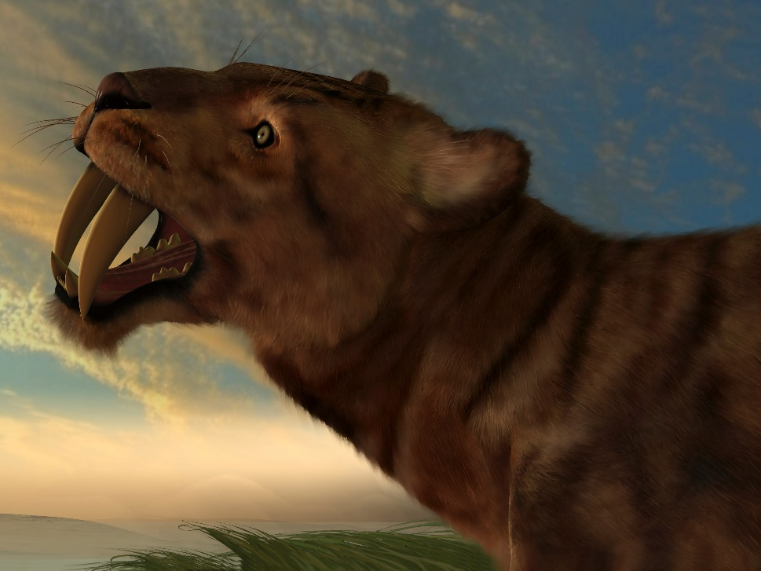
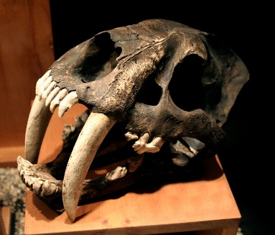
Quaternary
Cenozoic
Neogene
Paleogene
Cretaceous
Mesozoic
Jurassic
Triassic
Phanerozoic
Permian
Pennsylvanian
Mississippian
Paleozoic
Devonian
Silurian
Ordovician
Cambrian
Precambrian
Notes:
But the most well known creatures from the Cenozoic layers are mammals--/ like woolly mammoths / and saber-toothed tigers. Because of the variety and number of mammal fossils found there, the Cenozoic has been called the age of mammals.
Both mammoth pics and cat pic from iStock (not sure about cat bones, but it has been used before)

Slide 27
Quaternary
Cenozoic
Neogene
Paleogene
Cretaceous
Mesozoic
Jurassic
Triassic
Phanerozoic
Permian
Pennsylvanian
Mississippian
Paleozoic
Devonian
Silurian
Ordovician
Cambrian
Precambrian
Notes:
We have spent some time learning about the geologic column—how the various systems got their names…

Slide 28

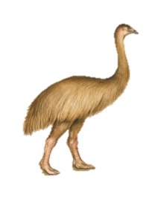

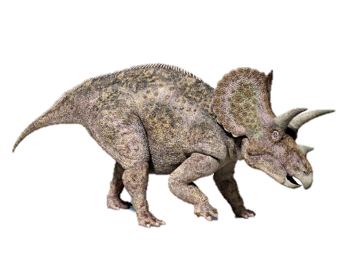
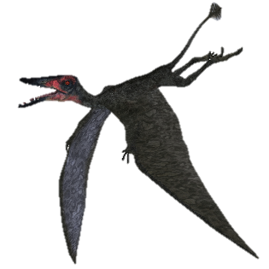
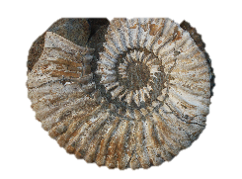
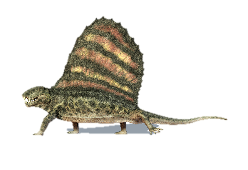
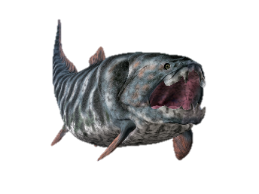
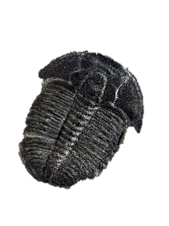
Quaternary
Cenozoic
Neogene
Paleogene
Cretaceous
Mesozoic
Jurassic
Triassic
Phanerozoic
Permian
Pennsylvanian
Mississippian
Paleozoic
Devonian
Silurian
Ordovician
Cambrian
Precambrian
Notes:
… and a little bit about what kinds of fossils are found in them. Why is this important?

Slide 29
Summary
The sequence of fossils in the geologic column is real, observable data.
The evolutionary interpretation of the geologic column was added later.
Notes:
It’s important to understand that the sequence of fossils in the geologic column is real, observable data. / It is also important to understand that the evolutionary interpretation of the geologic column was added later. But is evolution the best explanation for the fossil record?

Slide 30
The Geologic Column
Does It Show Evolution?
Notes:
In our next presentation, we will talk about whether or not there is actually evidence within the geologic column for evolution.

Slide 31
Images By
Images may appear on more than one slide. Citation is given on the first slide where each image appears.
[1a] Zion National Park 489588635, kaiborder, Thinkstock, Thinkstock Image Subscription Agreement
[1b] Folded rocks 24286621 Matauw, Getty Images (US), Inc. Subscription Agreement
[1c] Blue Mesa Petrified Forest National Park 479232619, estivillml, Thinkstock, Thinkstock Image Subscription Agreement
[1d] Bryce Canyon National Park, Keith Snyder
[1e] Folded rocks, Raul Esperante, used with permission
[1f] Grand Canyon, taken by Ed Chatelain, used with permission
[3] World Map 164786370, bogdanserban, Thinkstock, Thinkstock Image Subscription Agreement
[5] Charles Darwin 16835919, picture, Getty Images (US), Inc. Subscription Agreement
[7a] James Hutton 92846333, Photos.com, Thinkstock, Thinkstock Image Subscription Agreement
[7b] Charles Lyell 92822906, Photos.com, Thinkstock, Thinkstock Image Subscription Agreement
[9a] Noah's Ark 12550737, jgroup, Getty Images (US), Inc. Subscription Agreement
[12] North America 469783859m /Alexander Zam, Thinkstock, Thinkstock Image Subscription Agreement

Slide 32
Images By
[25a] Flightless Moa bird 98193400, Elaine Anderson, Thinkstock, Thinkstock Image Subscription Agreement
[25b] Illustration of a crocodile 102115724, Dorling Kindersley, Thinkstock Image Subscription Agreement
[25c] Green lizard (Lacerta bilineata) 79711088, Dorling Kindersley, Thinkstock Image Subscription Agreement
[26a] Woolly Mammoth 52619872 aleks1949, Getty Images (US), Inc. Subscription Agreement
[26b] Mammoth skeleton 186043 Escaflowne, Getty Images (US), Inc. Subscription Agreement
[26c] Saber-toothed cat skull 825334 pixeldigits, Getty Images (US), Inc. Subscription Agreement
[26d] Smilodon cat 22991262 CoreyFore, Getty Images (US), Inc. Subscription Agreement
[28d] Triceratops dinosaur 178188198, leonello, Thinkstock, Thinkstock Image Subscription Agreement
[28e] Nautilus 2 101401226, Andrey Davidenko, Thinkstock, Thinkstock Image Subscription Agreement
[28f] Dorygnathus Pterosaur 187006507, CoreyFord, Thinkstock, Thinkstock Image Subscription Agreement
[28g] Dimetrodon 178583890, leonello, Thinkstock, Thinkstock Image Subscription Agreement
[28h] Dunkleosteus 180176590, MR1805, Thinkstock, Thinkstock Image Subscription Agreement
[28i] Elrathia kingii Trilobite 144970604, Russell Shively, Thinkstock, Thinkstock Image Subscription Agreement

Slide 33
Special Thanks
Foundation for Adventist Education

Slide 34

© Origins Curriculum Resources 2015

Slide 35

© Southern Adventist University 2015

Slide 36

© Seventh-day Adventist North American Division 2015

Slide 37

© General Conference of Seventh-day Adventists 2015

Slide 38

© SCORE Southern Center for Origins Research & Education 2015

