Slide 1
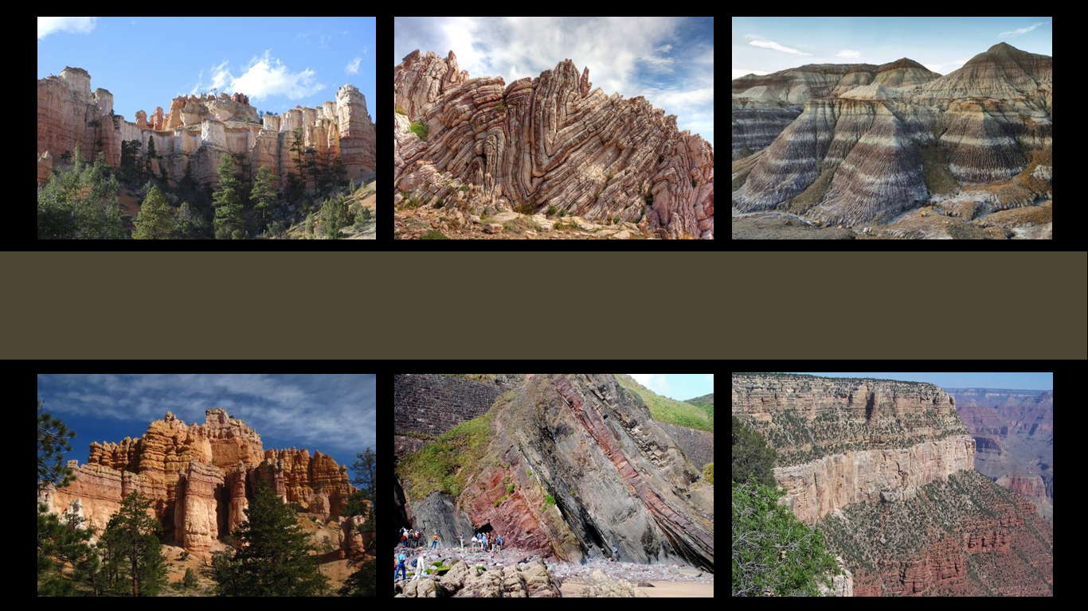
The Geologic Column
Discovery and Contents of the Paleozoic
Notes:
The Geologic Column—the discovery and contents of the Paleozoic

Slide 2
Cenozoic
Mesozoic
Phanerozoic
Paleozoic
Precambrian
Notes:
In this presentation we will explore the Paleozoic erathem—learning how its layers were first discovered and what kinds of fossils are found in them.

Slide 3

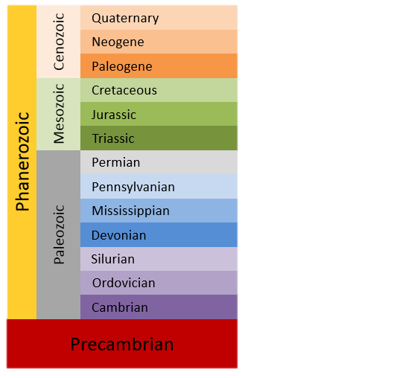
Geologic Time Scale
65 Ma
252 Ma
541 Ma
Notes:
Today the geologic column is often equated with the geologic time scale of millions of years of evolutionary history, but it didn’t start out that way. Several decades before Darwin’s theory of evolution was published, the geologic column was first studied by people who believed in the Bible and thought the geologic column was formed during worldwide flood.

Slide 4
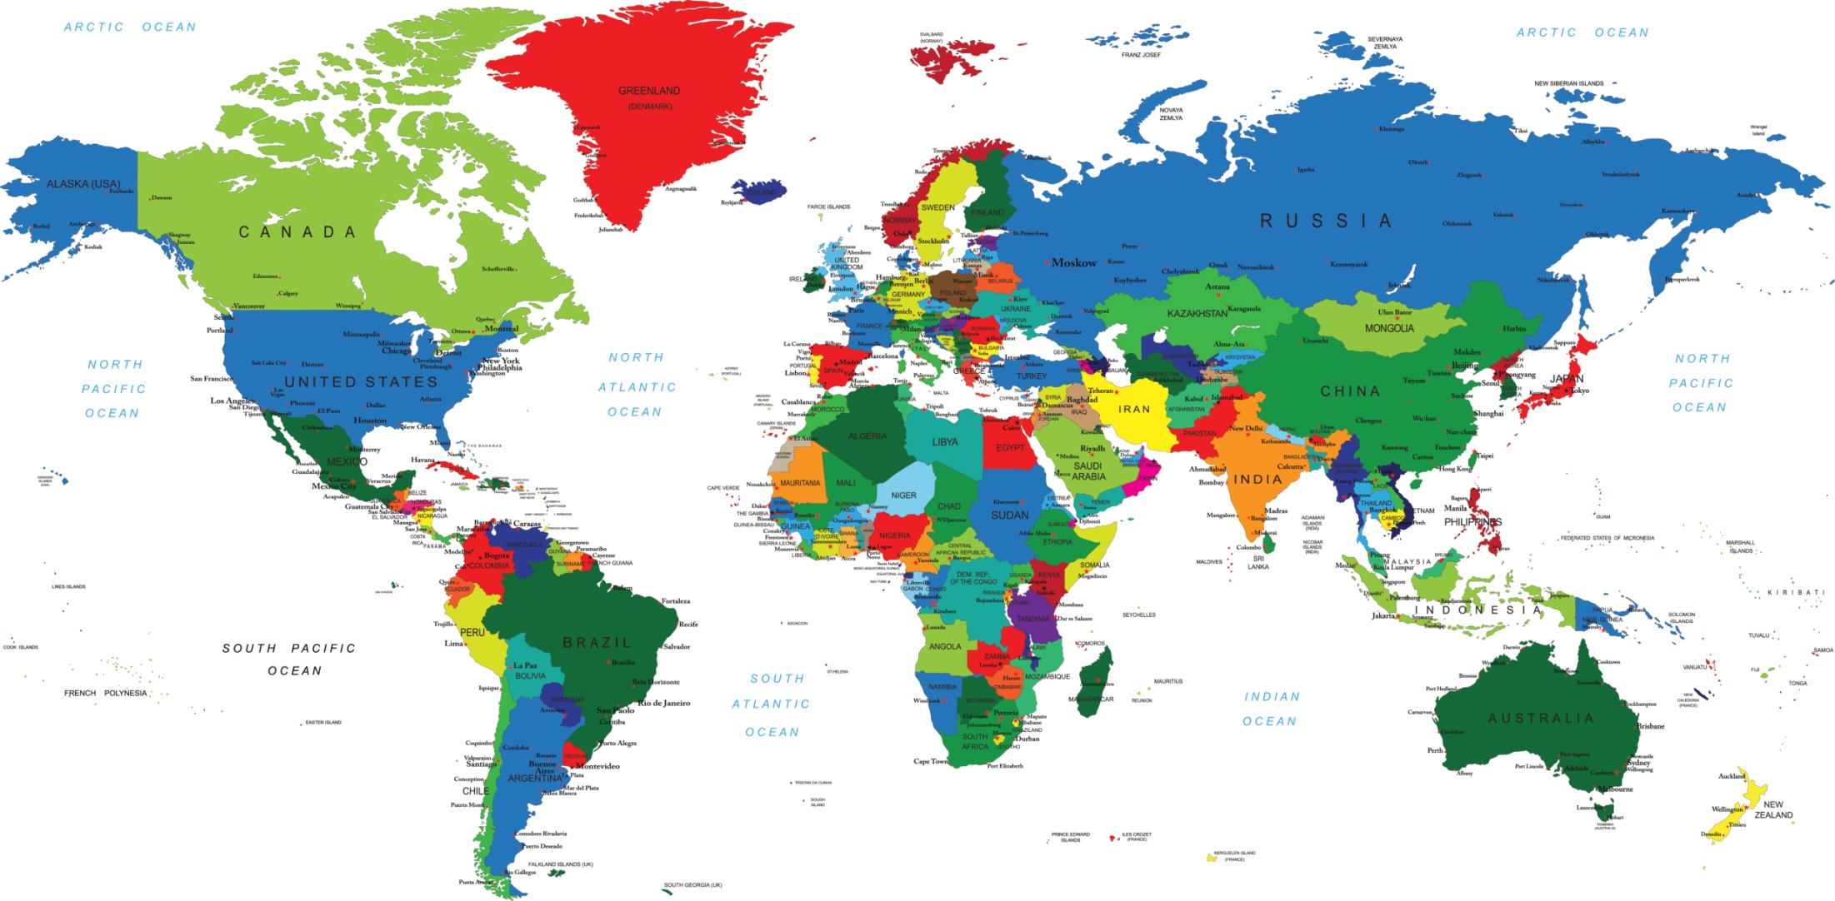
United Kingdom
Notes:
Our story begins in the United Kingdom, which includes England, Scotland, Wales, and part of Ireland

Slide 5
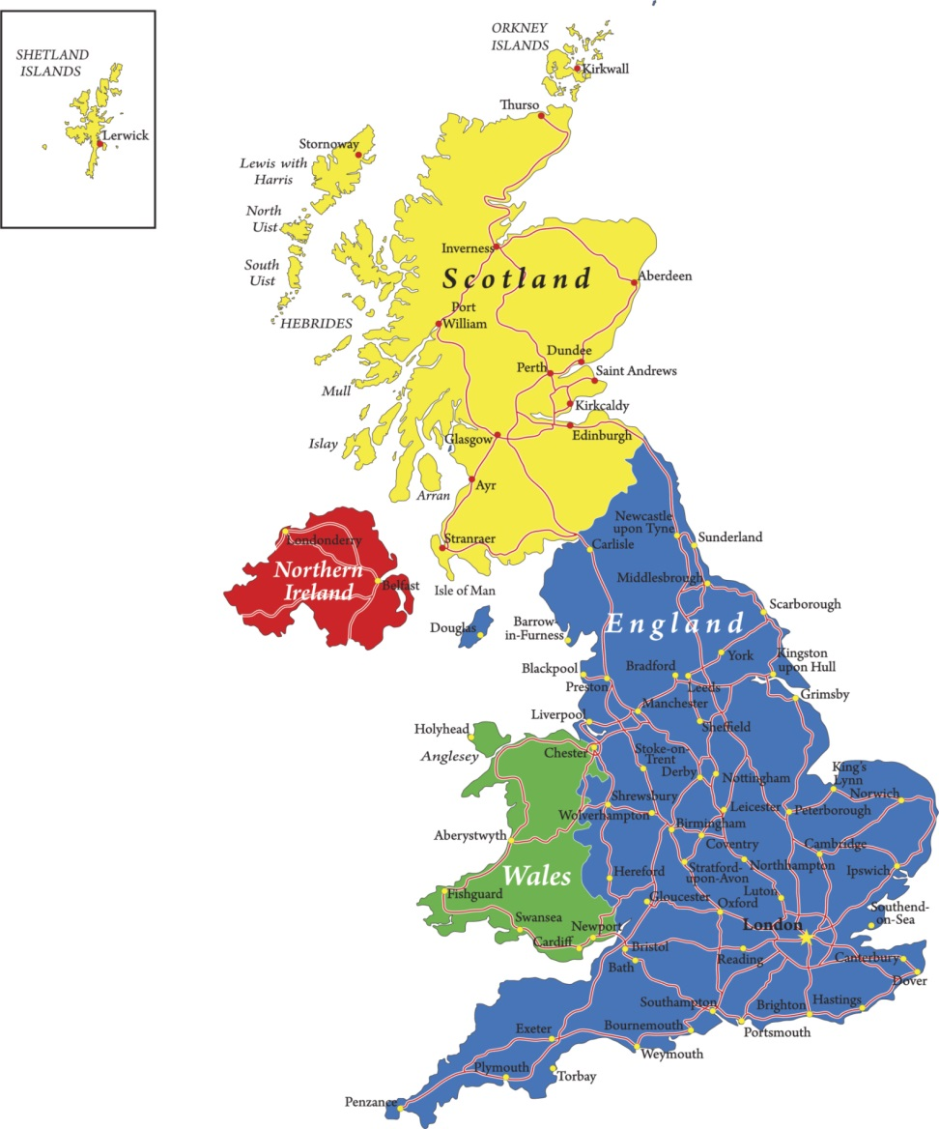
Somerset, England
Notes:
This map shows the United Kingdom up close. The blue part is England, (click) and the red ring shows you about where Somerset is located.

Slide 6

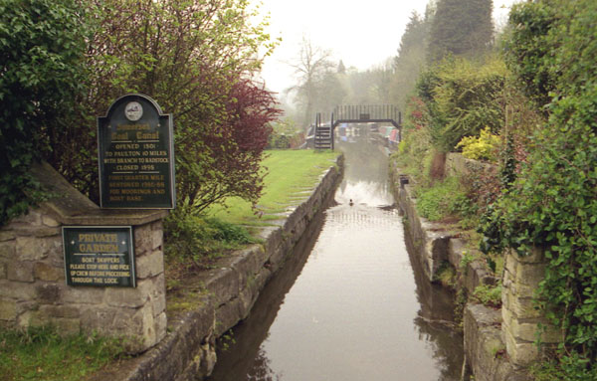
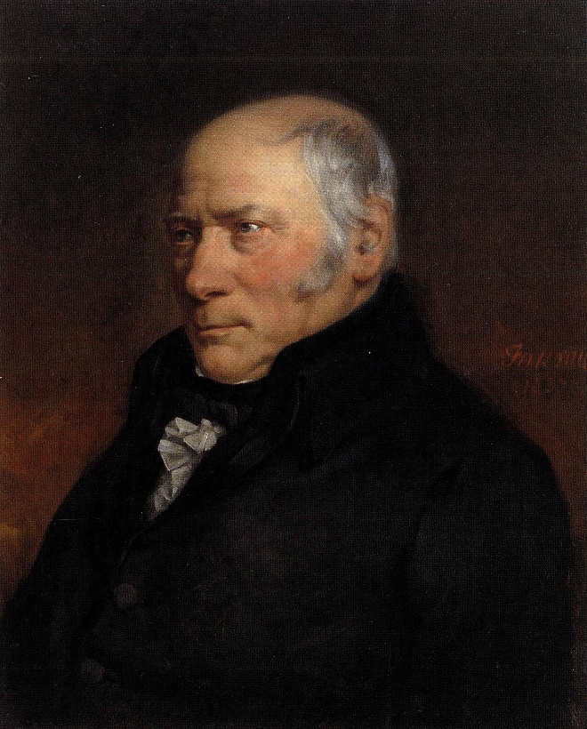
Somerset (circa 1800)
Washington Imaging, used with permission
Notes:
Around the year 1800 the English were mining coal in Somerset England. To make it easier to transport the coal after it was mined, they built a canal between there and London. / While a man named William Smith was working on the project, he began to notice the fossils they found while digging the canal.

Slide 7
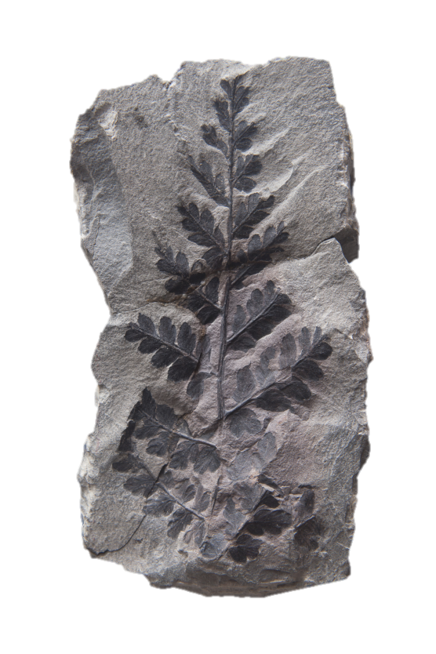
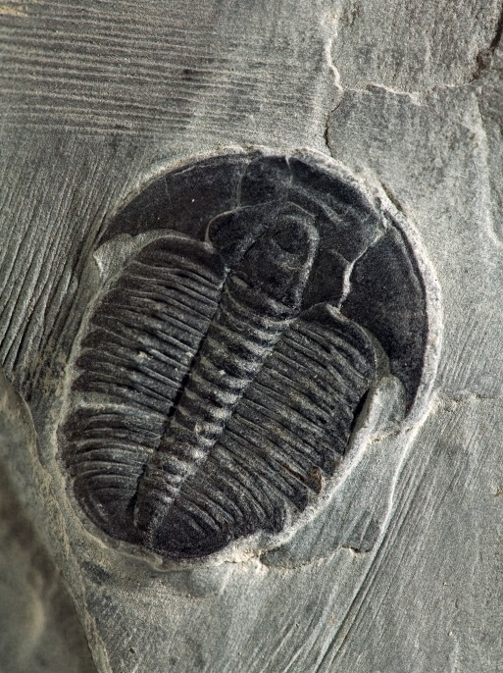
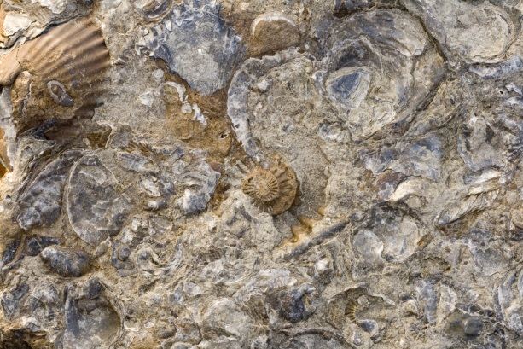
Law of Faunal Succession
Certain kinds of fossils always occurred in the same layers of rocks
In a specific sequence
Notes:
He observed that the same kinds of fossils always occurred in the same layers of rocks and always in a specific sequence. Once he noticed that the fossils appeared in the same order, he could study the fossils where they were digging and then predict what kind of fossils he would find in the next layer. (click) This predictable order of fossils came to be known as the Law of Faunal Succession

Slide 8
Law of Faunal Succession
Fauna—a name for the animals found in a certain place
Succession—things that come one after the other in a certain order
Notes:
The word fauna is the name for the animals found in a certain place. / Succession refers to things that come one after the other in a certain order. In this context the words refer to a succession of fossil faunas.

Slide 9

Quaternary
Cenozoic
Neogene
The coal-bearing layers near the Somerset Canal became known as the Carboniferous system.
Coal contains carbon
Paleogene
Cretaceous
Mesozoic
Jurassic
Triassic
Phanerozoic
Permian
Pennsylvanian
Carboniferous
Mississippian
Paleozoic
Devonian
Silurian
Ordovician
Cambrian
Precambrian
Notes:
The coal-bearing layers near the Somerset Canal / became known as the Carboniferous system.

Slide 10
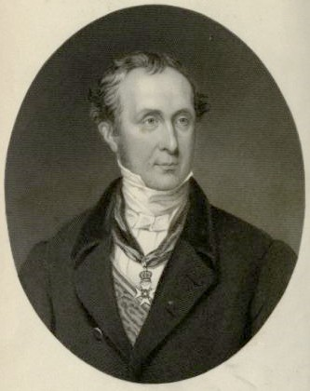
Quaternary
Cenozoic
Neogene
Paleogene
Cretaceous
Mesozoic
Jurassic
Triassic
Phanerozoic
Permian
Pennsylvanian
Carboniferous
Mississippian
Paleozoic
Devonian
Silurian
Ordovician
Sir Roderick Murchison
Cambrian
Precambrian
Notes:
Sir Roderick Murchison used the principles of William Smith to work out the sequence of fossils that lie below the coal bearing layers in Wales.

Slide 11
Quaternary
Cenozoic
Neogene
Paleogene
Cretaceous
Mesozoic
Jurassic
Different fossil communities
Triassic
Phanerozoic
Permian
Pennsylvanian
Carboniferous
Mississippian
Paleozoic
Devonian
Silurian
Ordovician
Cambrian
Precambrian
Notes:
As he collected fossils from the different layers, he discovered specific fossil communities. These communities contained different plants and animals that were similar to, yet distinct from, the communicates found in the layers above and below.

Slide 12
Quaternary
Cenozoic
Neogene
Paleogene
Cretaceous
Mesozoic
Jurassic
Triassic
Phanerozoic
Permian
Pennsylvanian
Mississippian
Paleozoic
Devonian
Ludlow Formation
Silurian
Wenlock Formation
Ordovician
Caradoc Formation
Cambrian
Precambrian
Notes:
For example, there could be trilobites in three successive rock formations, but the trilobites in one formation / would be different than the trilobites in the formation above or below. (click for other arrows; then click for next slide)

Slide 13
Quaternary
Cenozoic
Neogene
Paleogene
Cretaceous
Mesozoic
Jurassic
Triassic
Phanerozoic
Permian
Pennsylvanian
Mississippian
Paleozoic
Devonian
Silurian
Upper Silurian
Lower Silurian
Ordovician
Cambrian
Precambrian
Notes:
Murchison grouped the fossils into systems he called Lower Silurian / and Upper Silurian. / The Lower Silurian / was later re-named the Ordovician in 1879.

Slide 14

Quaternary
Cenozoic
Named after Celtic tribes
Neogene
Paleogene
Cretaceous
Mesozoic
Jurassic
Triassic
Phanerozoic
Permian
Pennsylvanian
Mississippian
Paleozoic
Silures—tribe of Celts from southern Wales
Devonian
Silurian
Ordovician
Ordovices—tribe of Celts from northern Wales
Cambrian
Precambrian
Notes:
These systems of rock layers were given the names of Celtic tribes from Wales, which is the green part of this map of the United Kingdom. / The Silurian system was named after a tribe from southern Wales, / and the Ordovician system was named after a tribe from northern Wales.

Slide 15

Quaternary
Cenozoic
Neogene
Paleogene
Cretaceous
Mesozoic
Jurassic
Triassic
Phanerozoic
Permian
Pennsylvanian
Mississippian
Paleozoic
Devonian
Devonian
Silurian
Ordovician
Cambrian
Devonshire, England
Precambrian
Notes:
In Devonshire, England, which was right next to Somerset… Murchison found the same fossils had had found in the Upper Silurian / as well as additional fossil communities in the layers above. / He called this newest system the Devonian, after the place where he had discovered the newest fossils.

Slide 16

Quaternary
Cenozoic
Neogene
Paleogene
Cretaceous
Mesozoic
Jurassic
Triassic
Phanerozoic
Permian
Pennsylvanian
Mississippian
Paleozoic
Devonian
Silurian
Ordovician
Cambrian
Precambrian
Notes:
Fossil communities similar to the ones found in these layers were found in the same order all over Europe

Slide 17
Notes:
Eventually Murchison was invited by the Czar to come study fossil communities in Russia.

Slide 18
Notes:
In the Ural Mountains near the town of Perm, Russia…

Slide 19

Quaternary
Cenozoic
Neogene
Paleogene
Cretaceous
Mesozoic
Jurassic
Triassic
Phanerozoic
Permian
Pennsylvanian
Carboniferous
Mississippian
Paleozoic
Devonian
Silurian
Ordovician
Cambrian
Precambrian
Notes:
…he found fossil communities like those from the Coal Measure in Great Britain, but he found new communities above them.

Slide 20
Quaternary
Cenozoic
Neogene
Paleogene
Cretaceous
Mesozoic
Jurassic
Triassic
Phanerozoic
Permian
Permian
Pennsylvanian
Carboniferous
Mississippian
Perm, Russia
Paleozoic
Devonian
Silurian
Ordovician
Cambrian
Precambrian
Notes:
He named this new system Permian for the town of Perm.

Slide 21

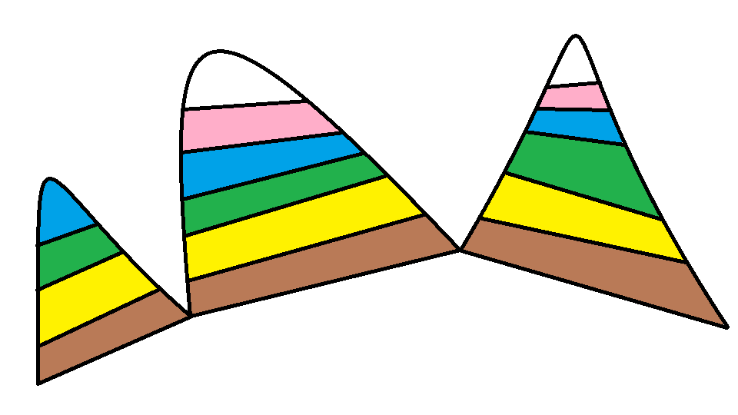


Quaternary
Cenozoic
Neogene
Paleogene
Cretaceous
Mesozoic
Jurassic
Triassic
Phanerozoic
Permian
Pennsylvanian
Law of Faunal Succession
Mississippian
Paleozoic
Devonian
Silurian
Ordovician
Cambrian
Precambrian
Correlation
Notes:
Murchison believed that the same sequence of fossil communities was preserved throughout the world. / He firmly established the Law of Faunal Succession as a way to correlate rock layers worldwide. / That means that when he found a certain kind of fossil in rock layers in different places around the world, he could determine which system he was digging in by the presence of that particular fossil.

Slide 22

Phanerozoic
Permian
Permian
Pennsylvanian
Mississippian
Paleozoic
Devonian
Silurian
Ordovician
Cambrian
Precambrian
Notes:
Except for the Permian which was named for a town in Russia,…

Slide 23
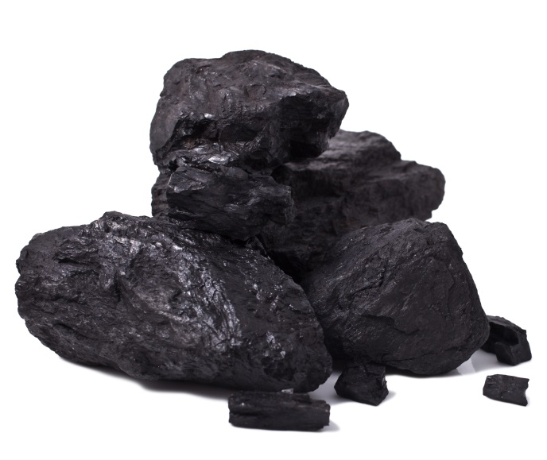
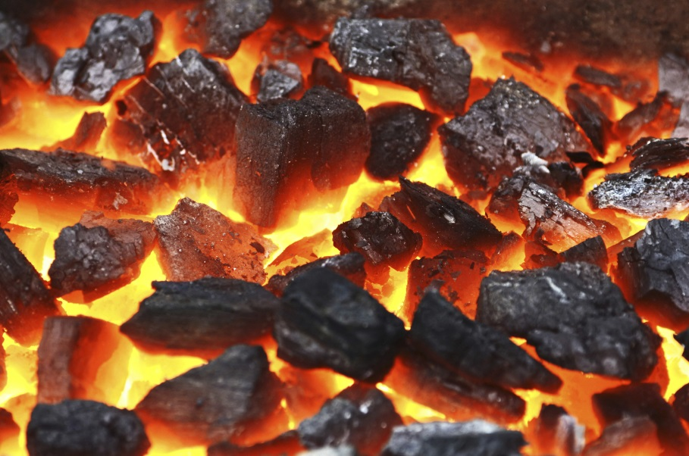
Phanerozoic
Permian
Pennsylvanian
Carboniferous
Mississippian
Paleozoic
Devonian
Coal
Silurian
Ordovician
Cambrian
Precambrian
Notes:
And carboniferous, which refers to the coal content of the layers,…All the other subdivisions of the Paleozoic erathem were named for places or tribes in England or Wales.

Slide 24

Devonian
Devon County, England
(Devonshire)
Phanerozoic
Permian
Pennsylvanian
Carboniferous
Mississippian
Paleozoic
Devonian
Devonian
Silurian
Ordovician
Cambrian
Precambrian
Notes:
The Devonian system got its name from Devonshire England

Slide 25
Silurian
Tribe from
southern Wales
Phanerozoic
Permian
Pennsylvanian
Carboniferous
Mississippian
Paleozoic
Devonian
Silurian
Silurian
Ordovician
Cambrian
Precambrian
Notes:
The Silurian system was named after a Celtic tribe in southern Wales

Slide 26
Ordovician
Tribe from
northern Wales
Phanerozoic
Permian
Pennsylvanian
Carboniferous
Mississippian
Paleozoic
Devonian
Silurian
Ordovician
Ordovician
Cambrian
Precambrian
Notes:
The Ordovician system was named for another Celtic tribe in northern Wales

Slide 27
Cambrian
Cambria is the old Roman name for Wales
Phanerozoic
Permian
Pennsylvanian
Carboniferous
Mississippian
Paleozoic
Devonian
Silurian
Ordovician
Cambrian
Cambrian
Precambrian
Notes:
And the Cambrian system, which was named by Adam Sedgewick, got its name from the old Roman name for Wales

Slide 28
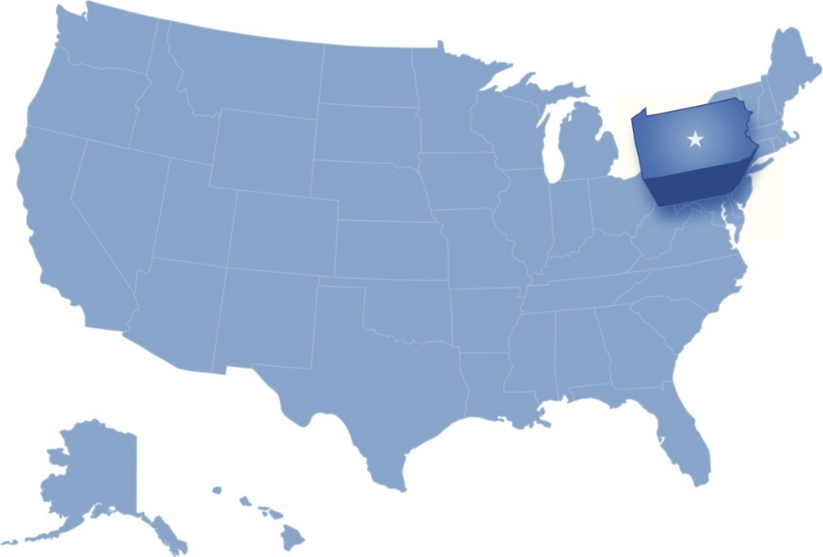
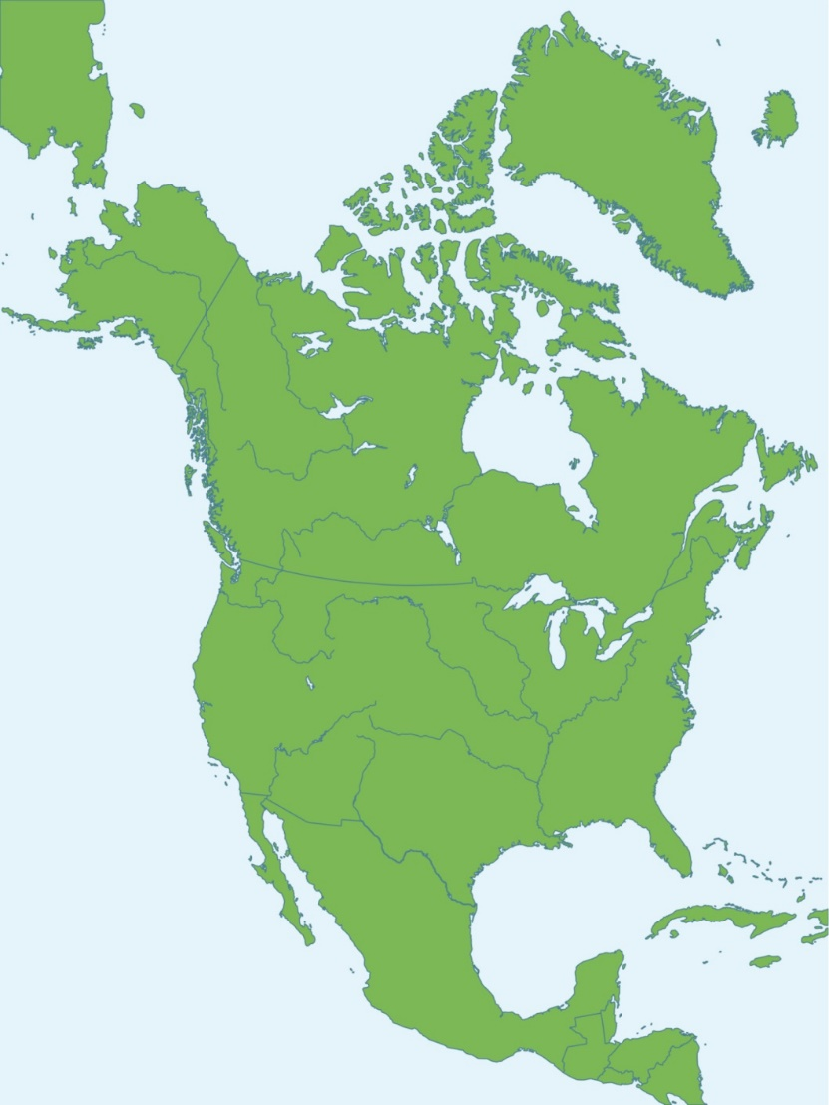
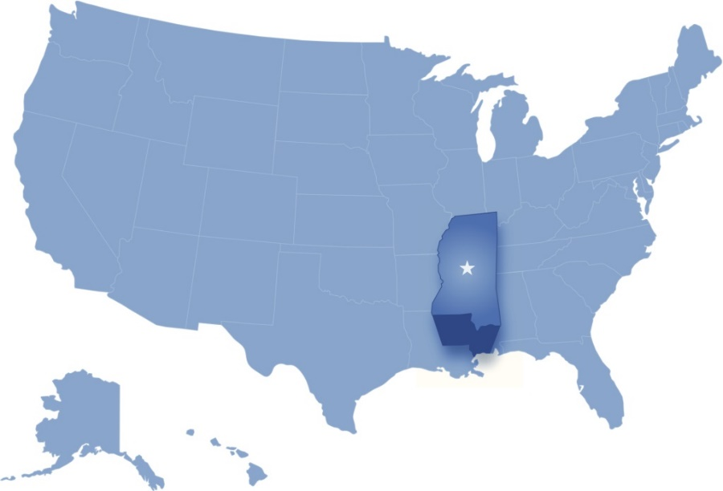
Quaternary
Cenozoic
Neogene
Paleogene
Pennsylvania
Cretaceous
Mesozoic
Jurassic
Triassic
Phanerozoic
Permian
Pennsylvanian
Carboniferous
Mississippian
Paleozoic
Devonian
Mississippi
Silurian
Ordovician
Cambrian
Precambrian
Notes:
In North America, the Carboniferous has been divided into the Mississippian and Pennsylvanian, which are not recognized in Europe. They were named for sedimentary rocks in the Mississippi River Valley and the state of Pennsylvania.

Slide 29
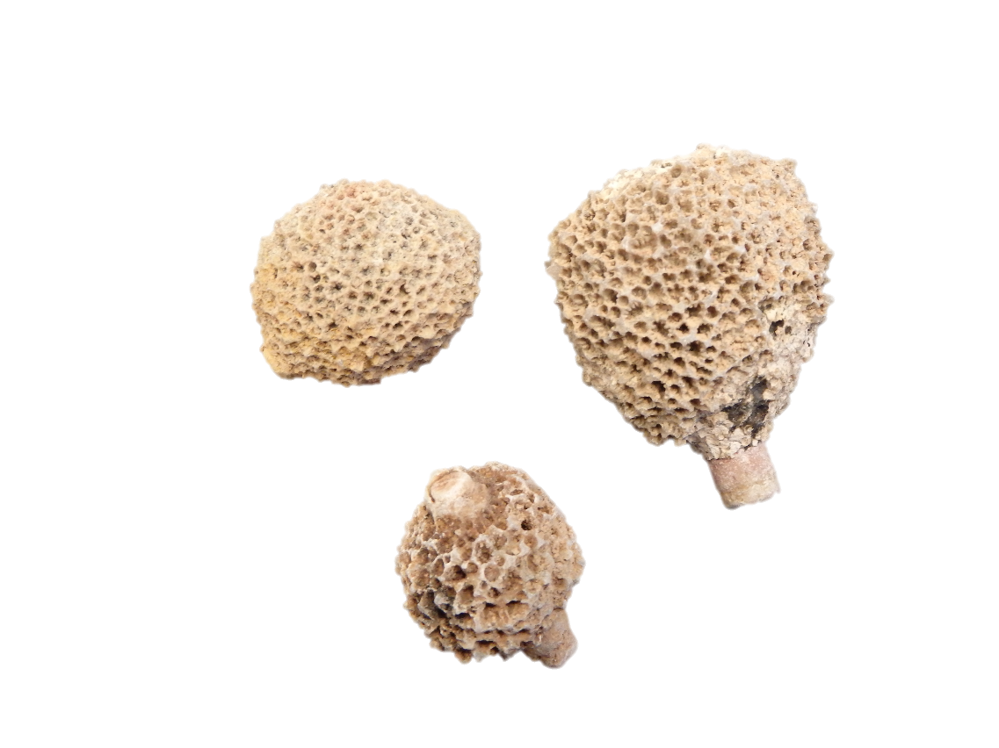
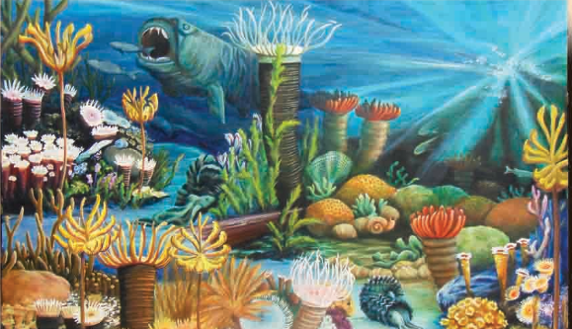
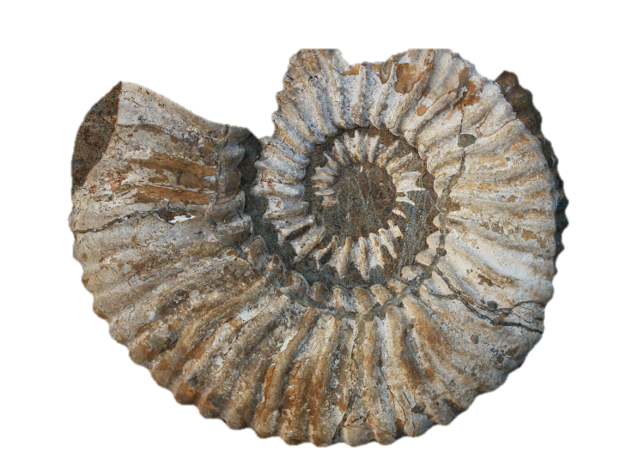
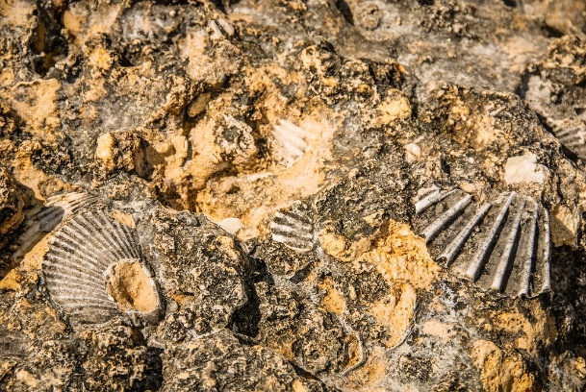
Paleozoic Creatures
Sponges
Shells
Notes:
What kinds of creatures are found in these changing communities?
Most creatures found in the Paleozoic layers lived in or near the water.
Sponges and various kinds of sea shells appear throughout these layers.

Slide 30
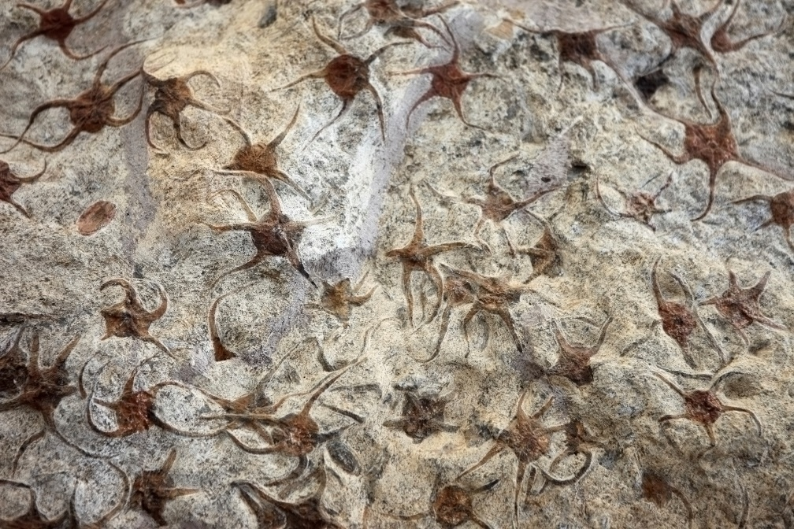
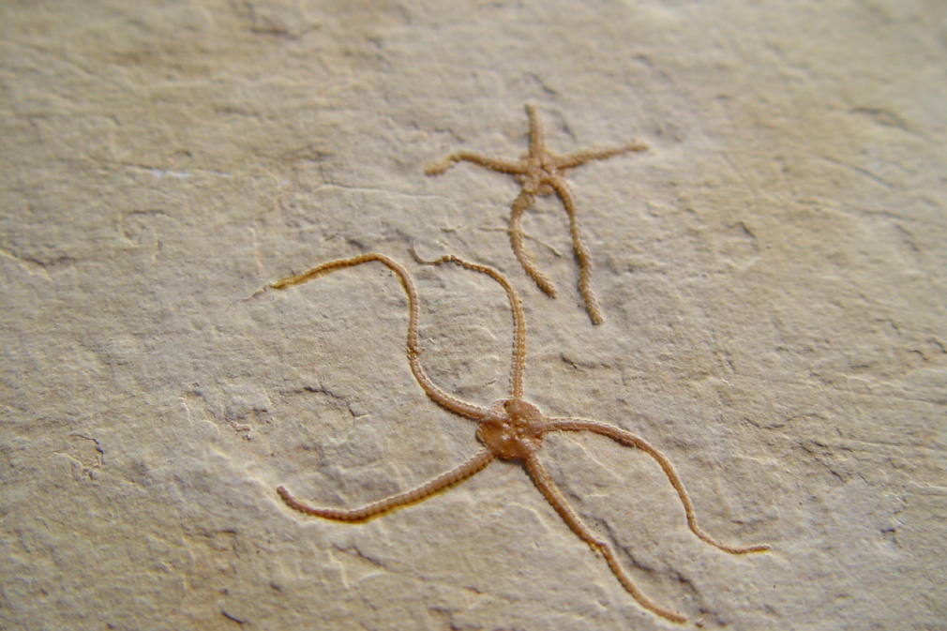
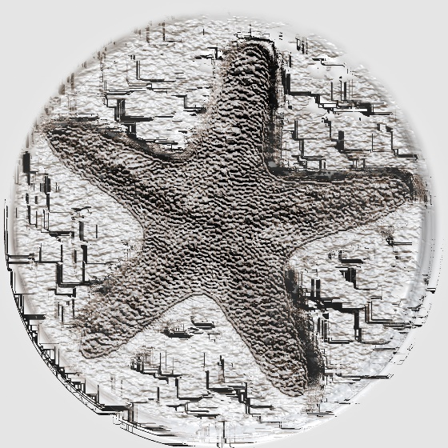
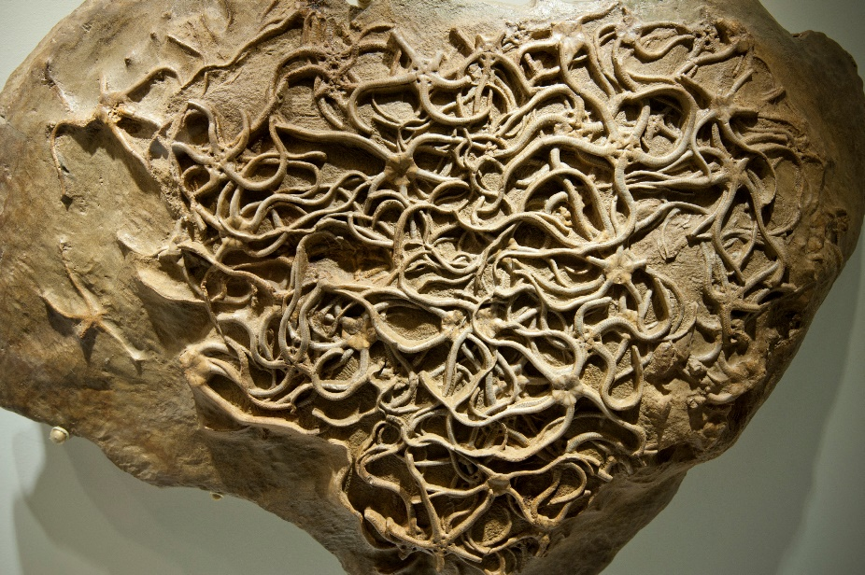
Paleozoic Creatures
Brittle Stars
Starfish
Notes:
So do starfish…

Slide 31
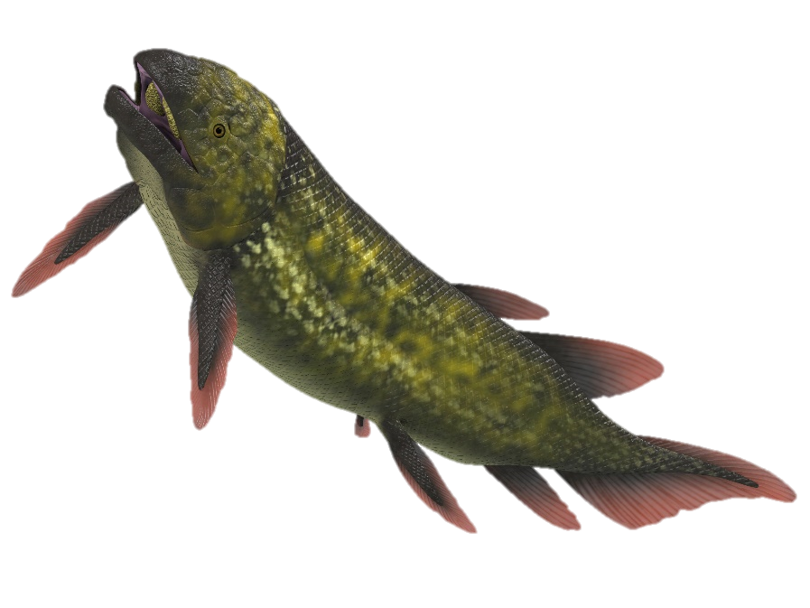
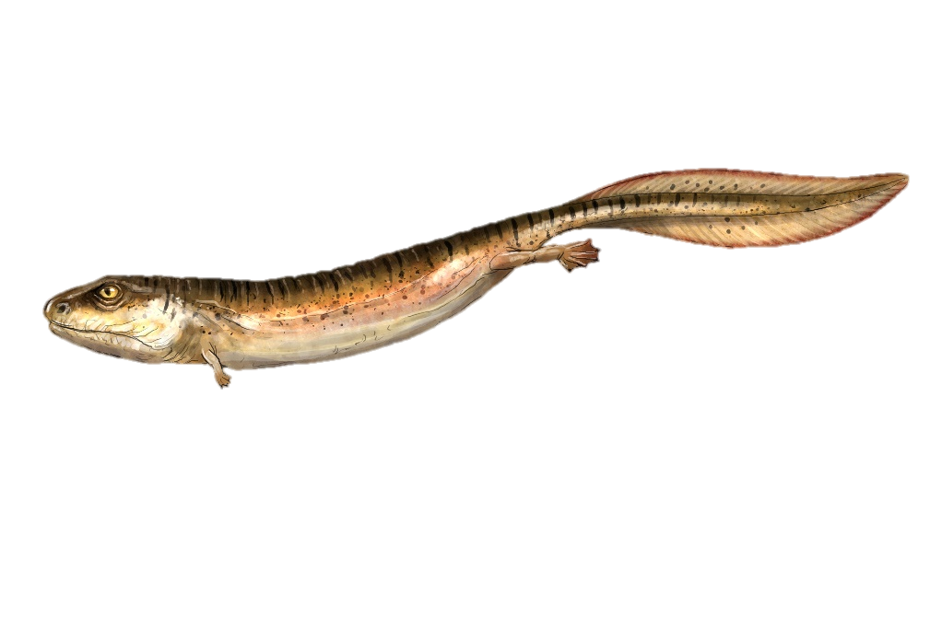
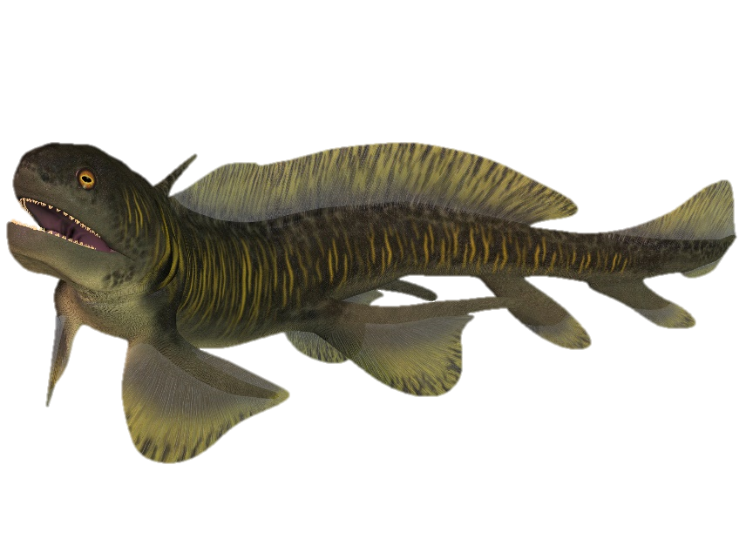
Paleozoic Creatures
Fish
Notes:
…and various kinds of fish, and sharks
(pictures from iStock)

Slide 32
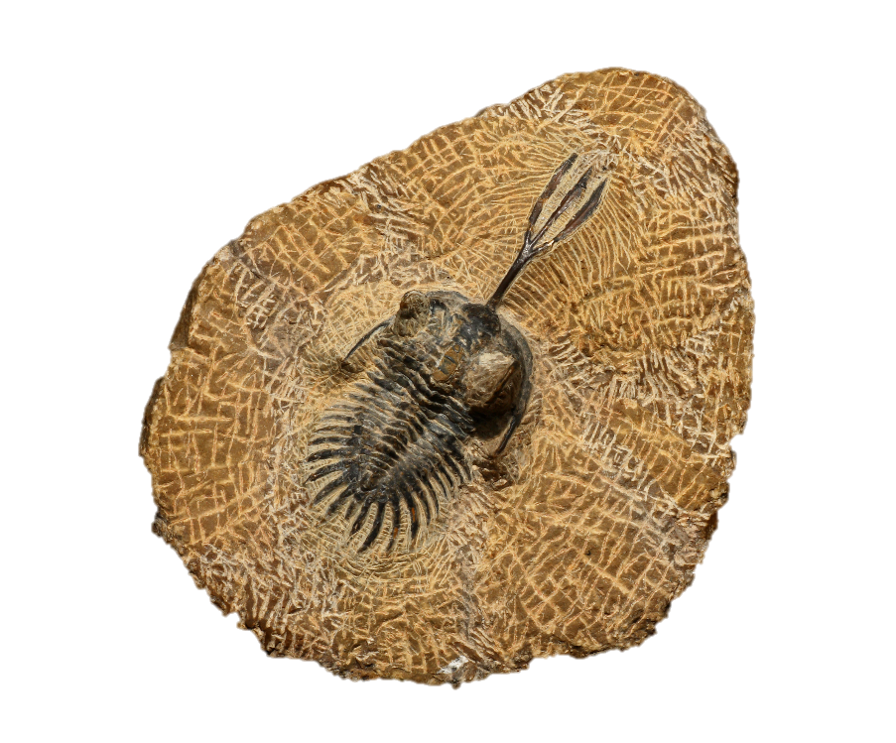

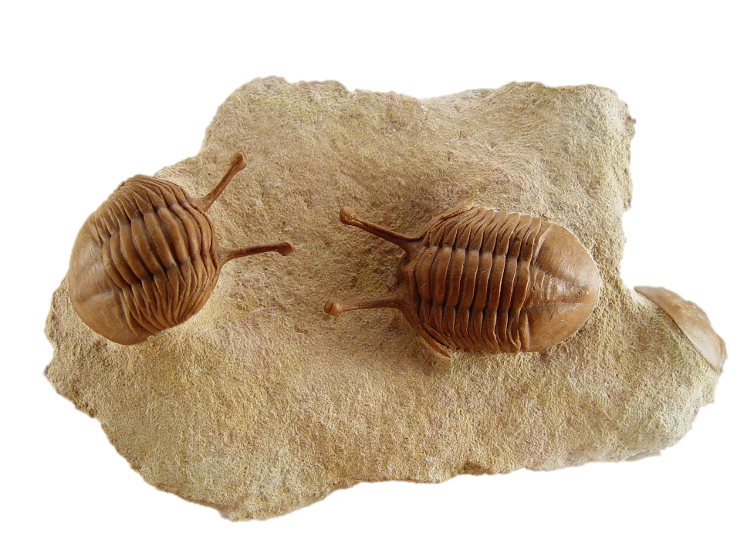
Paleozoic Creatures
Trilobites
Notes:
Many different kinds of Trilobites are common throughout the Paleozoic layers.

Slide 33
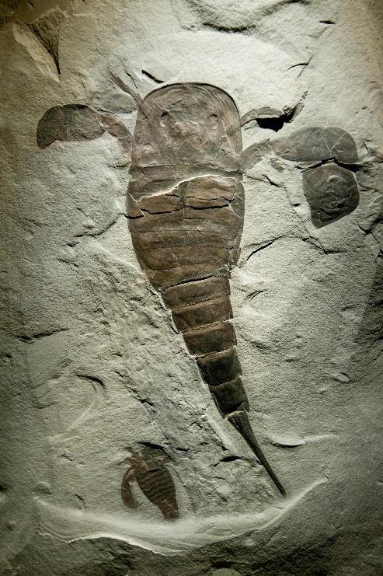
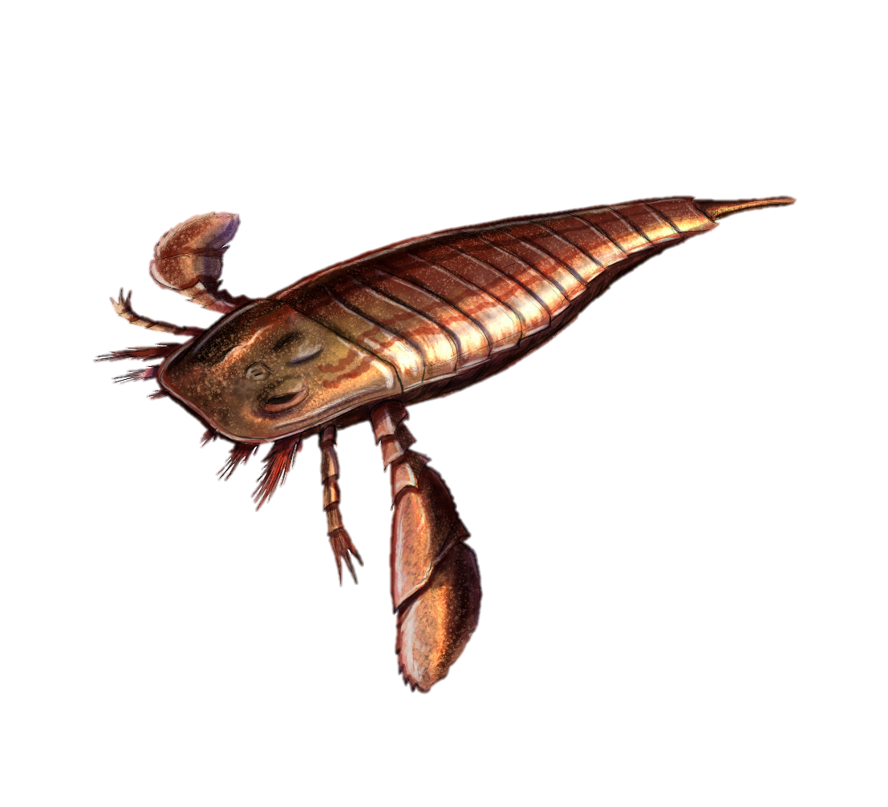
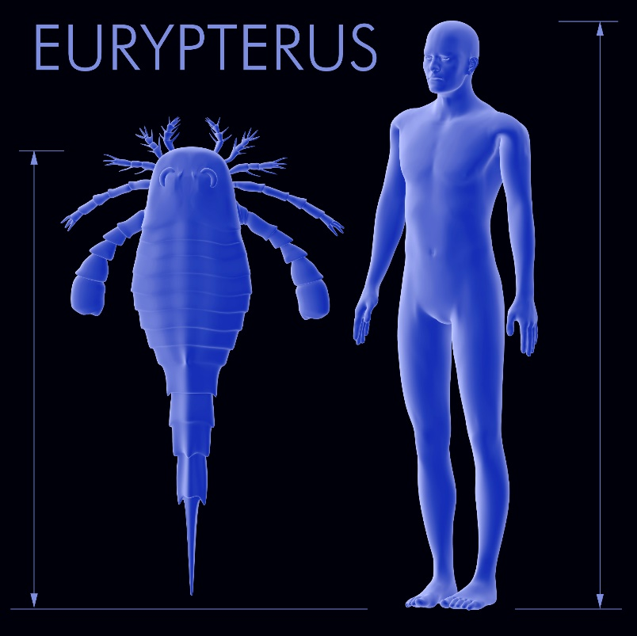
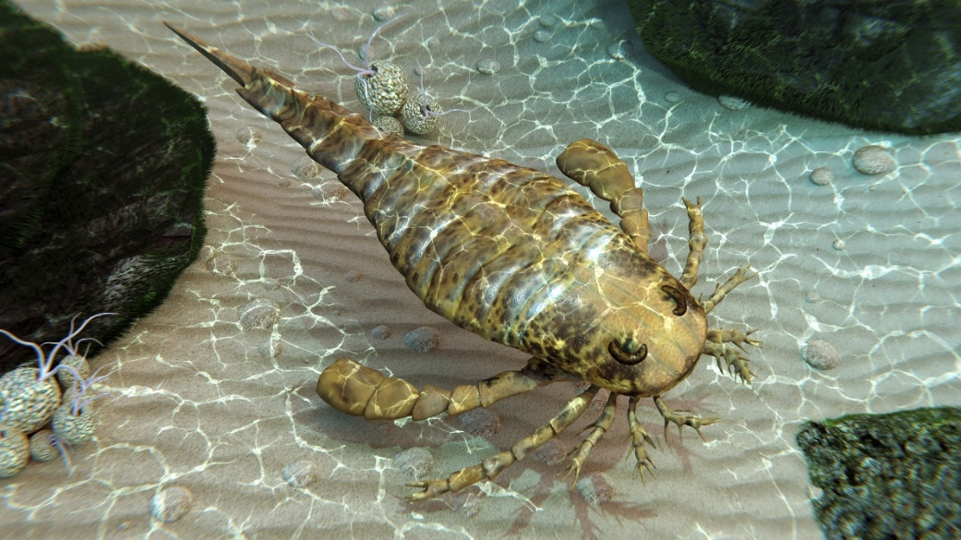
Paleozoic Creatures
Sea
Scorpions
Notes:
These layers also include sea scorpions. Most kinds were less than 8 inches long, but the largest one found was over 8 feet long.

Slide 34
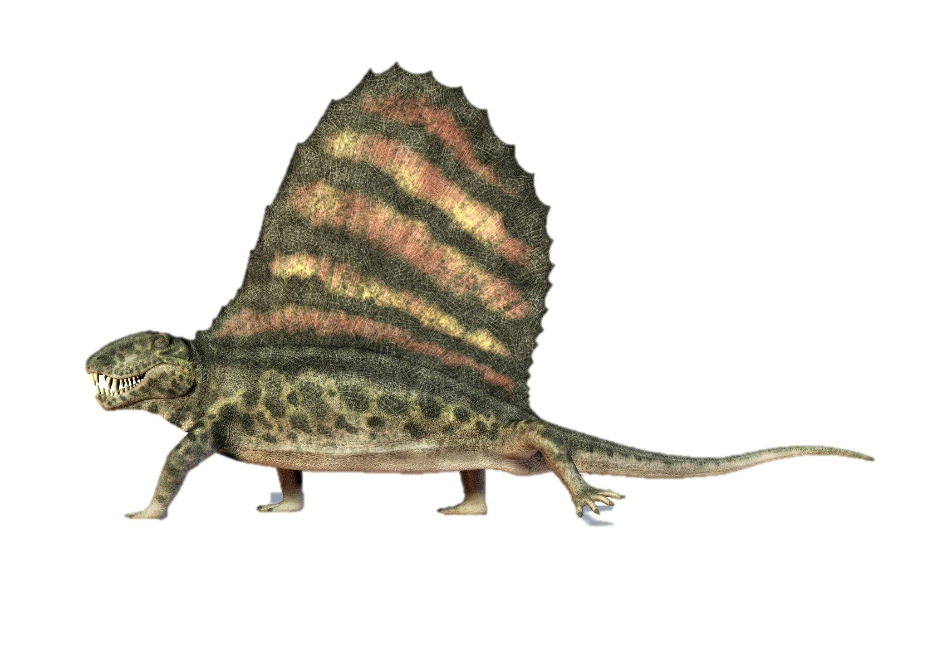
Paleozoic Creatures
Notes:
Amphibians and some reptiles appear in these layers. Dimetrodon is a reptile from the Permian that actually has a lot in common with mammals. It is easily recognizable by the prominent fan on its back. Often people think Dimetrodon was a dinosaur, but it wasn’t.

Slide 35
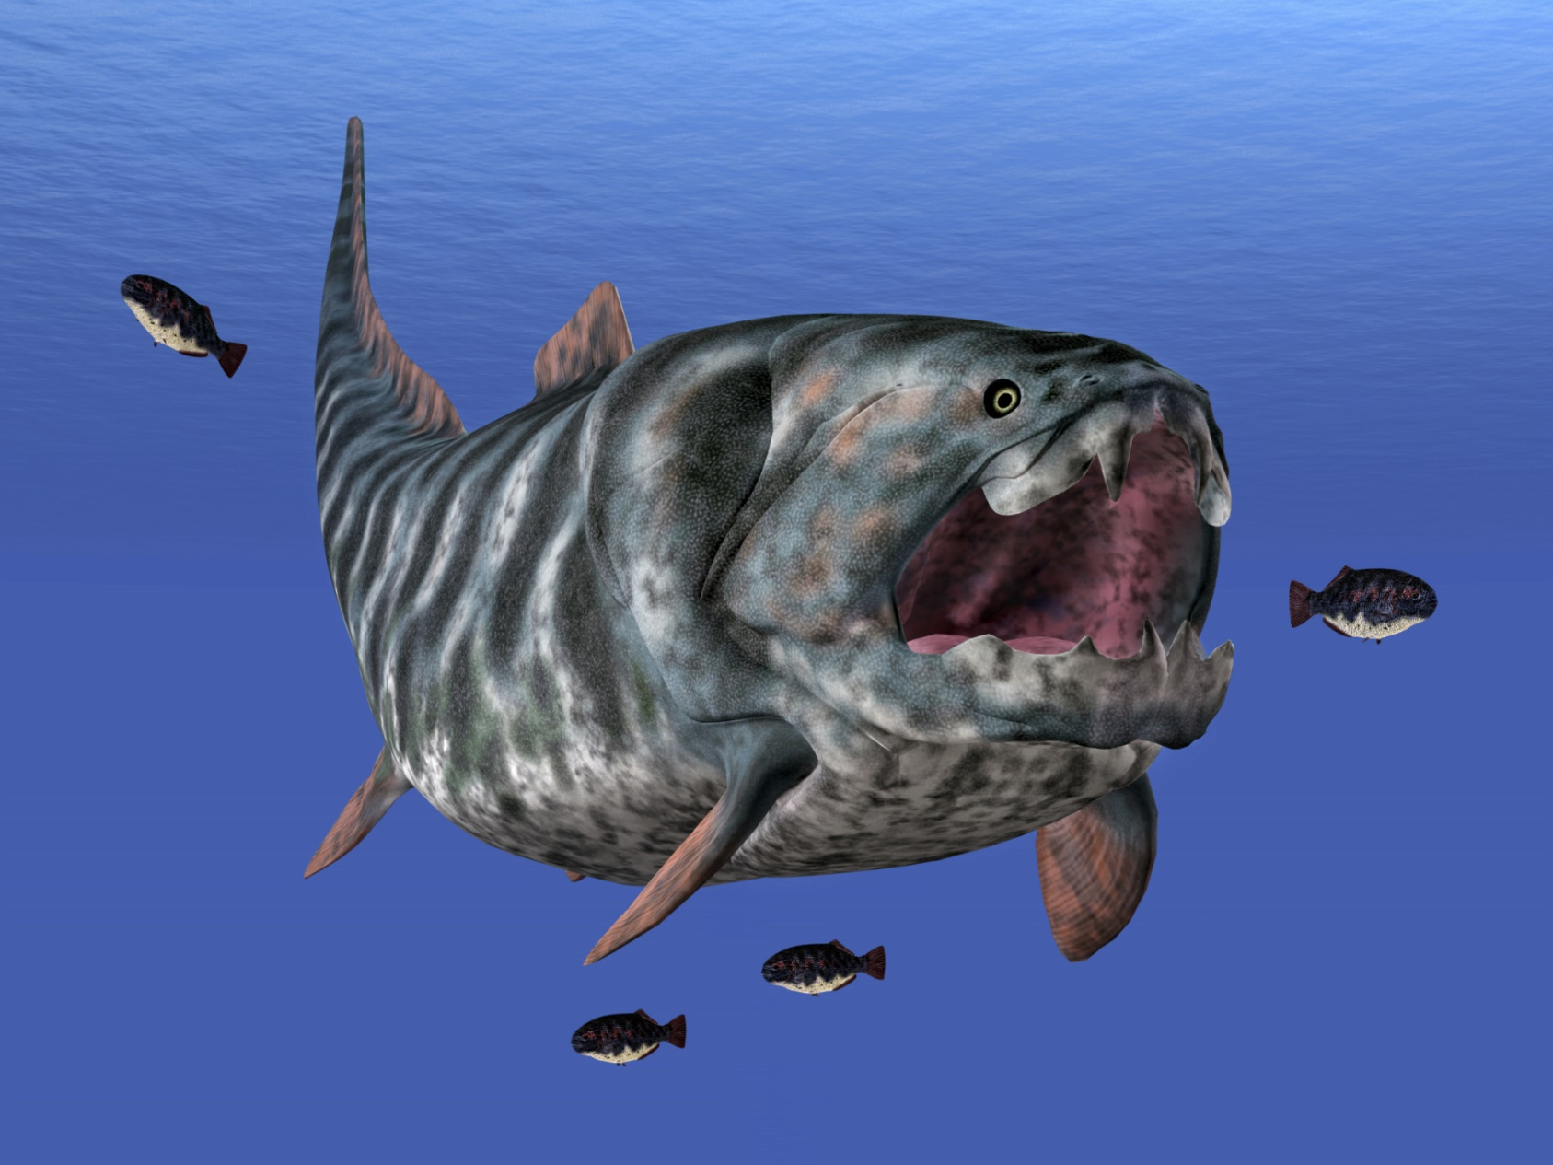
Dunkleosteus
Notes:
One of the most exciting fossils found in the upper Paleozoic layers is the Dunkleosteus, a huge predator at the top of the food chain. It could grow to be as long as 33 feet!

Slide 36
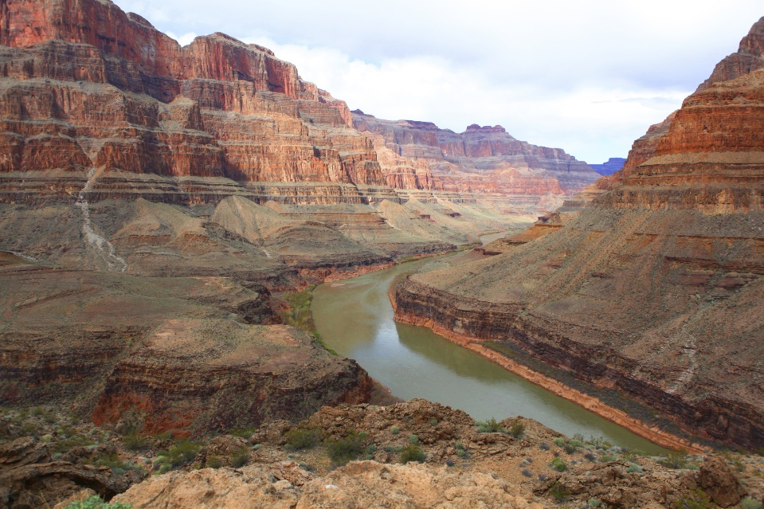
Quaternary
Cenozoic
Neogene
Paleogene
Cretaceous
Mesozoic
Jurassic
Triassic
Phanerozoic
Permian
Pennsylvanian
Mississippian
Paleozoic
Devonian
Silurian
Ordovician
Cambrian
Precambrian
Notes:
Both the rock layers themselves…

Slide 37
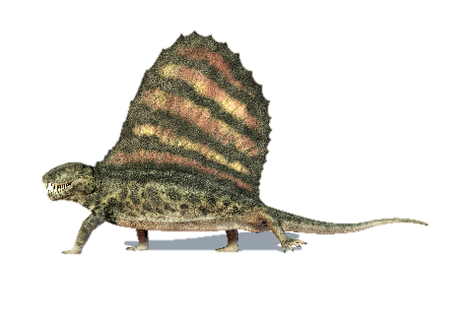
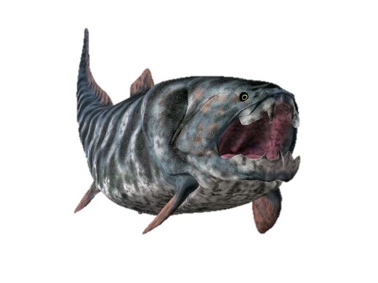
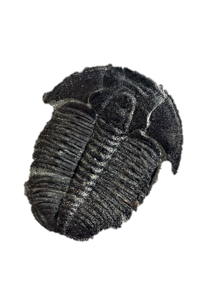
Quaternary
Cenozoic
Neogene
Paleogene
Cretaceous
Mesozoic
Jurassic
Triassic
Phanerozoic
Permian
Pennsylvanian
Mississippian
Paleozoic
Devonian
Silurian
Ordovician
Cambrian
Precambrian
Notes:
…and the fossils found in them provide us with observable data. This data was first studied by people who believed in the Bible and interpreted the data in ways that were consistent with what the Bible teaches.

Slide 38
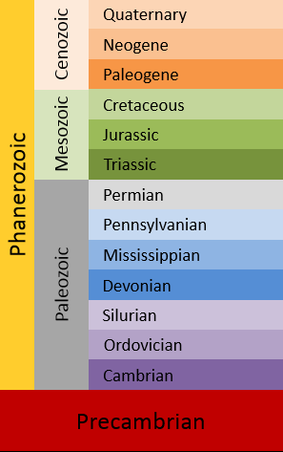
Geologic Time Scale
65 Ma
252 Ma
541 Ma
Notes:
So even though the geologic column has come to be associated with millions of years of evolution,

Slide 39
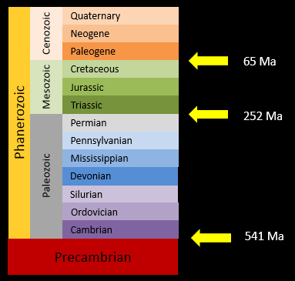
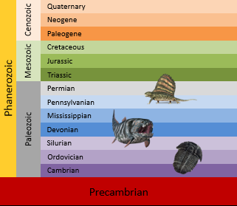
Data
Interpretation
Notes:
it’s important to distinguish between the data / and the interpretation of that data. By itself, there’s nothing evolutionary about the geologic column—it is just a bunch of rock layers that are identified by their fossil contents and were mostly named for the places where the fossils were discovered and described.

Slide 40
The Geologic Column
Does it Show Evolution?
Discovery and Contents of the Mesozoic
Discovery and Contents of the Cenozoic
Notes:
In a later presentation we will explore the question of whether or not there is evidence within the fossil record for evolution. / But first we’ll explore the discovery and contents of the Mesozoic and the Cenozoic.

Slide 41
Recorded at
Chattanooga Public RadioSM
Classical 90.5 WSMC

Slide 42
Images By
Images may appear on more than one slide. Citation is given on the first slide where each image appears.
[1a] Zion National Park 489588635, kaiborder, Thinkstock, Thinkstock Image Subscription Agreement
[1b] Folded rocks 24286621 Matauw, Getty Images (US), Inc. Subscription Agreement
[1c] Blue Mesa Petrified Forest National Park 479232619, estivillml, Thinkstock, Thinkstock Image Subscription Agreement
[1d] Bryce Canyon National Park, Keith Snyder
[1e] Folded rocks, Raul Esperante, used with permission
[1f] Grand Canyon, taken by Ed Chatelain, used with permission
[4] World Map 164786370, bogdanserban, Thinkstock, Thinkstock Image Subscription Agreement
[5] United Kingdom map 178541866, bogdanserban, Thinkstock, Thinkstock Image Subscription Agreement
[6a] Somerset Canal, Bryan Attewell, Washington Imaging, used with permission
[6b] William Smith, Hugues Fourau, http://commons.wikimedia.org/wiki/File:William_Smith_(geologist).jpg, Public Domain
[7a] Rocks with embeded fossils in Whitby 5822161, pdtnc, Getty Images (US), Inc. Subscription Agreement
[7b] Plant Leaf fossil in stone 465246143, alice-photo, Thinkstock, Thinkstock Image Subscription Agreement
[7c] Elrathia kingii Trilobite 4974845, Tyrannosaur, Getty Images (US), Inc. Subscription

Slide 43
Images By
[10] Roderick Murchison, Archibald Geikie, http://en.wikipedia.org/wiki/Roderick_Murchison#/media/File:Murchison_Roderick.jpg, Public Domain
[16] Focus on Europe 163711435, RomoloTavani, Thinkstock, Thinkstock Image Subscription Agreement
[21b] Correlation graphic, Thomas Bartlett
[23a] Black coal 476094129, multik7, Thinkstock, Thinkstock Image Subscription Agreement
[23b] Live coals 467807161, dmitrydesign, Thinkstock, Thinkstock Image Subscription Agreement
[28a] Map of the US with Pennsylvania pulled out 462241559, Benguhan, Thinkstock, Thinkstock Image Subscription Agreement
[28b] Map of the US with Mississippi pulled out 459951539, Benguhan, Thinkstock, Thinkstock Image Subscription Agreement
[29a] Sponges, Keith Snyder
[29b] Paleozoic community, Katherine Holder
[29c] Nautilus 2 101401226, Andrey Davidenko, Thinkstock, Thinkstock Image Subscription Agreement
[29d] Shell fossils 000047613124 titoslack, Getty Images (US), Inc. Subscription Agreement
[30a] Starfish fossil 000011242118 tunart, Getty Images (US), Inc. Subscription Agreement
[30b] Starfish fossil 68706, floop, Getty Images (US), Inc. Subscription Agreement
[30c] Starfish fossil 177769305, icholakov, Thinkstock, Thinkstock Image Subscription Agreement
[30d] Fossil of Ophiuroids 20981997, markchentx Getty Images (US), Inc. Subscription Agreement

Slide 44
Images By
[31a] Dipterus 000056433018 CoreyFord, Getty Images (US), Inc. Subscription Agreement
[31b] Crassigyrinus 54720282 nicolasprimola, Getty Images (US), Inc. Subscription Agreement
[31c] Orthacanthus 000026677829 CoreyFord, Getty Images (US), Inc. Subscription Agreement
[32a] Trilobite 000035519138 demarfa, Getty Images (US), Inc. Subscription
[32b] Elrathia kingii Trilobite 4974845, Tyrannosaur, Getty Images (US), Inc. Subscription
[32c] Trilobites Russian (Ordovician) 000000596507 bobainsworth, Getty Images (US), Inc. Subscription
[33a] Eurypterus fossil 000020981832 markchentx, Getty Images (US), Inc. Subscription
[33b] Eurypterid 000054721100 nicolasprimola, Getty Images (US), Inc. Subscription
[33c] Eurypterid exploring sea floor (Sea scorpion) 504740193, Aunt_Spray, Thinkstock, Thinkstock Image Subscription Agreement
[33d] Euryptus 000054131366 Aunt_Spray, Getty Images (US), Inc. Subscription
[34] Dimetrodon 178583890, leonello, Thinkstock, Thinkstock Image Subscription Agreement
[35] Dunkleosteus 180176590, MR1805, Thinkstock, Thinkstock Image Subscription Agreement
[36] Colorado river in the Grand Canyon 33169492, OlegBogdan, Getty Images (US), Inc. Subscription

Slide 45
Special Thanks
Foundation for Adventist Education

Slide 46

© Origins Curriculum Resources 2015

Slide 47

© Southern Adventist University 2015

Slide 48

© Seventh-day Adventist North American Division 2015

Slide 49

© General Conference of Seventh-day Adventists 2015

Slide 50

© SCORE Southern Center for Origins Research & Education 2015

