Slide 1
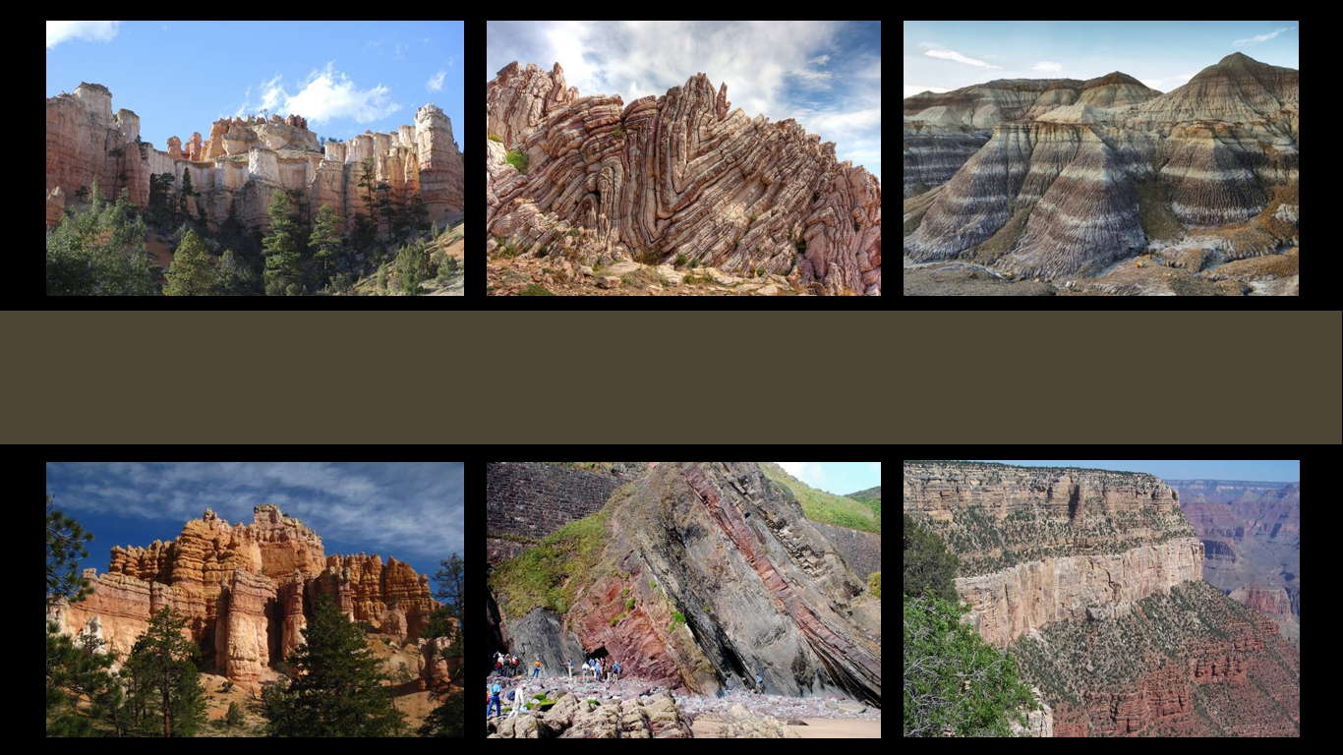
The Geologic Column
Radiocarbon Dating
Notes:
Radiocarbon dating

Slide 2

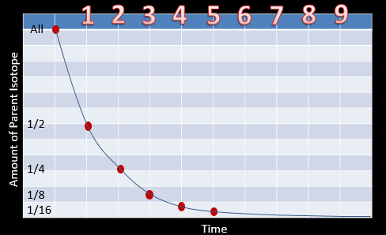
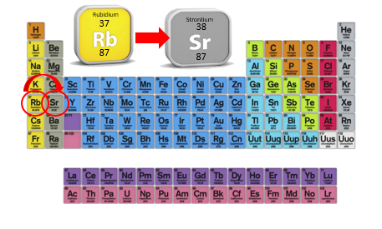
Radiometric Dating
Notes:
We have already learned how scientists measure parent and daughter isotopes and use known half-lives to calculate the age of rocks.

Slide 3
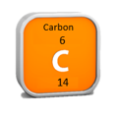
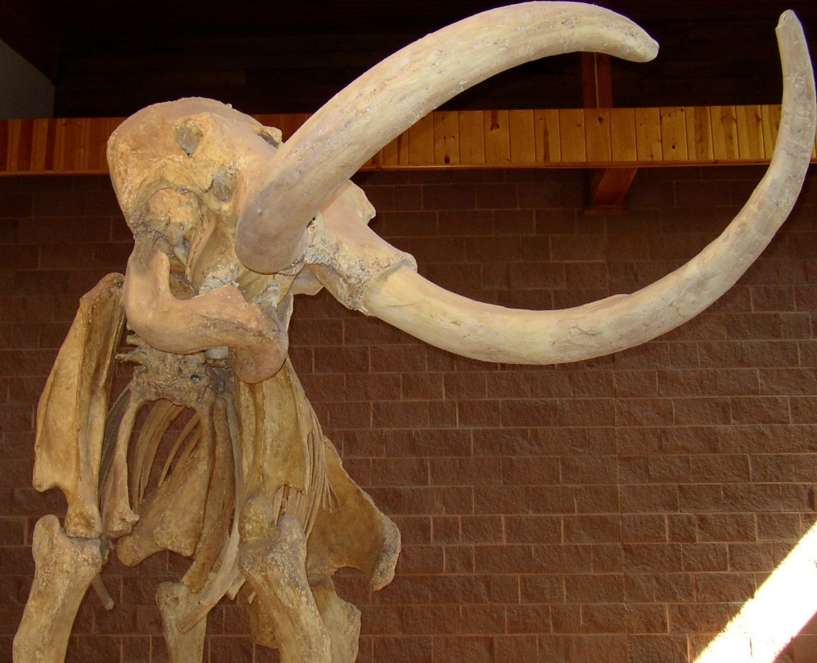
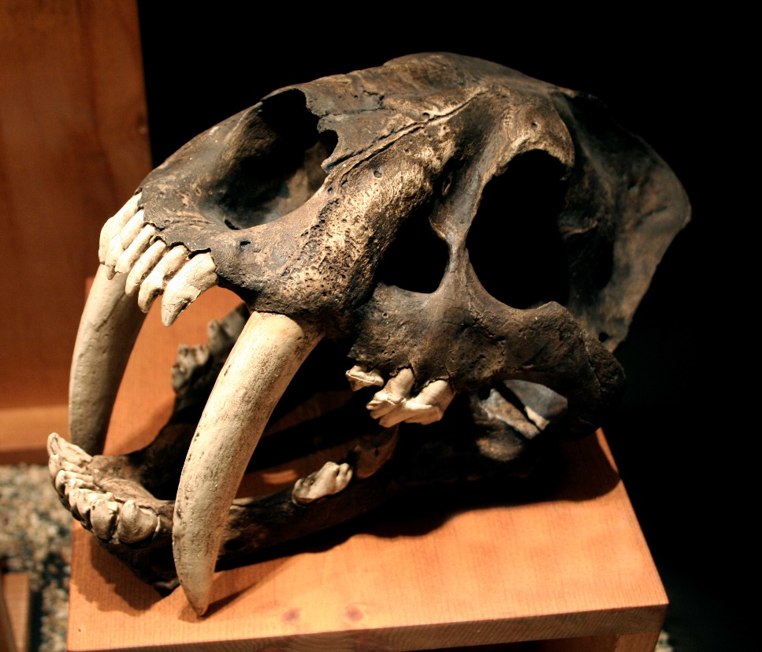
Radiocarbon Dating
Used to calculate the age of things that used to be alive
Notes:
In this presentation, we will learn about one specific kind of radiometric dating called radiocarbon dating, which is used to calculate the age of things that used to be alive—like fossils.

Slide 4
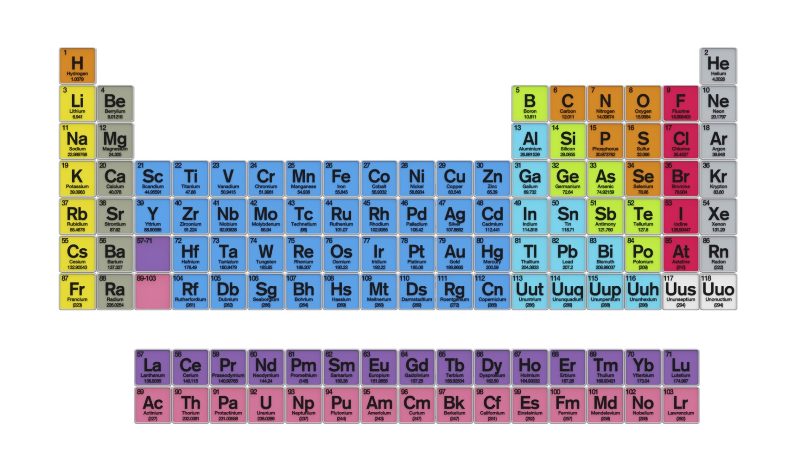
Periodic Table of the Elements
Notes:
Remember that this chart represents all the elements that have been discovered so far.

Slide 5
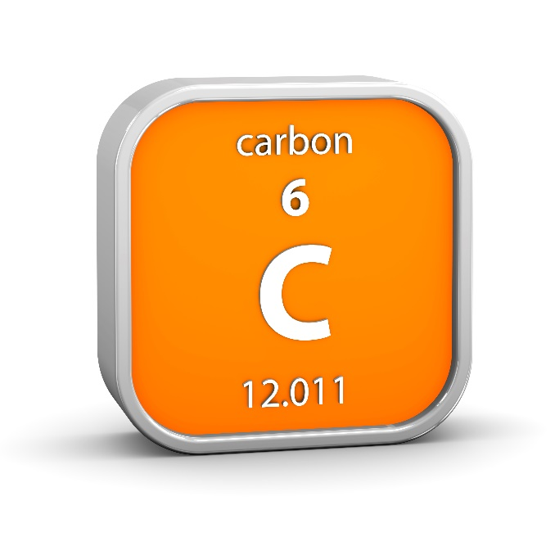
Notes:
Each element is made up of protons and neutrons. The top number tells how many protons are in an atom of the element.

Slide 6
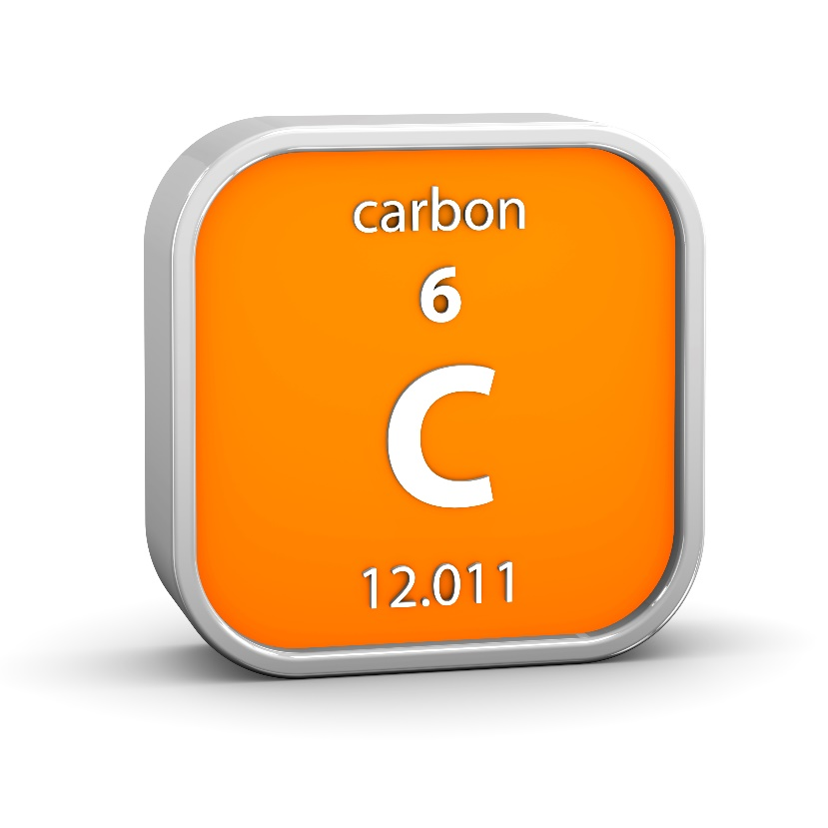
Isotopes
C-12
6 protons & 6 neutrons
C-14
6 protons & 8 neutrons
Notes:
Different isotopes of the same element have the same number of protons…

Slide 7
Isotopes
C-12
6 protons & 6 neutrons
C-14
6 protons & 8 neutrons
Notes:
…but different numbers of neutrons.

Slide 8
Carbon Isotopes
C-12
Amount does NOT change
C-14
Amount decreases
Notes:
Two different carbon isotopes—carbon 12 and carbon 14 are involved in the carbon dating process. / Carbon 14 is involved in the process because its amount decreases. / Carbon 12 serves as the standard because its amount does not change.

Slide 9

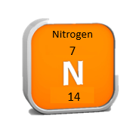
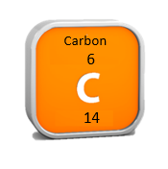
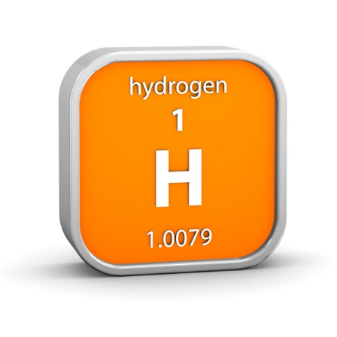
6 protons
8 neutrons
7 protons
7 neutrons
N
N
P
P
N
P
N
N
P
N
P
P
N
P
N
Notes:
Take a look at this nitrogen-14 atom. It has 7 protons (click) and 7 neutrons (click). In our atmosphere, when a neutron produced by a cosmic ray reaction (click) collides with a nitrogen atom, (click) it displaces a proton. Because the atom now has 6 protons and 8 neutrons, it is no longer a nitrogen-14 atom. It is now an atom of carbon-14. The lone displaced proton is an atom of hydrogen. This process explains why carbon-14 exists in our atmosphere.

Slide 10
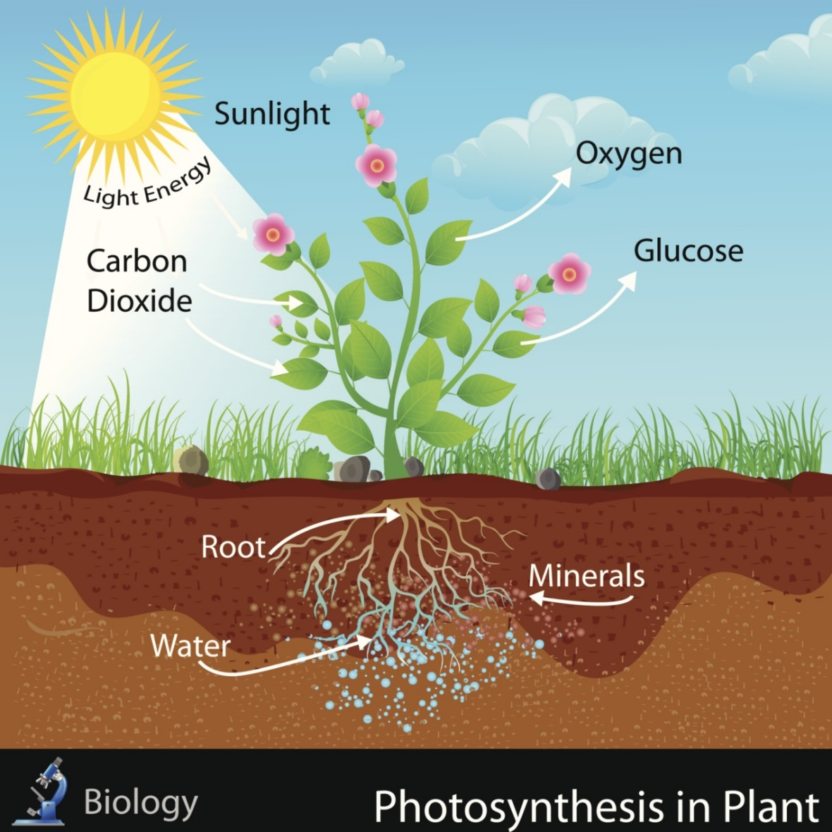
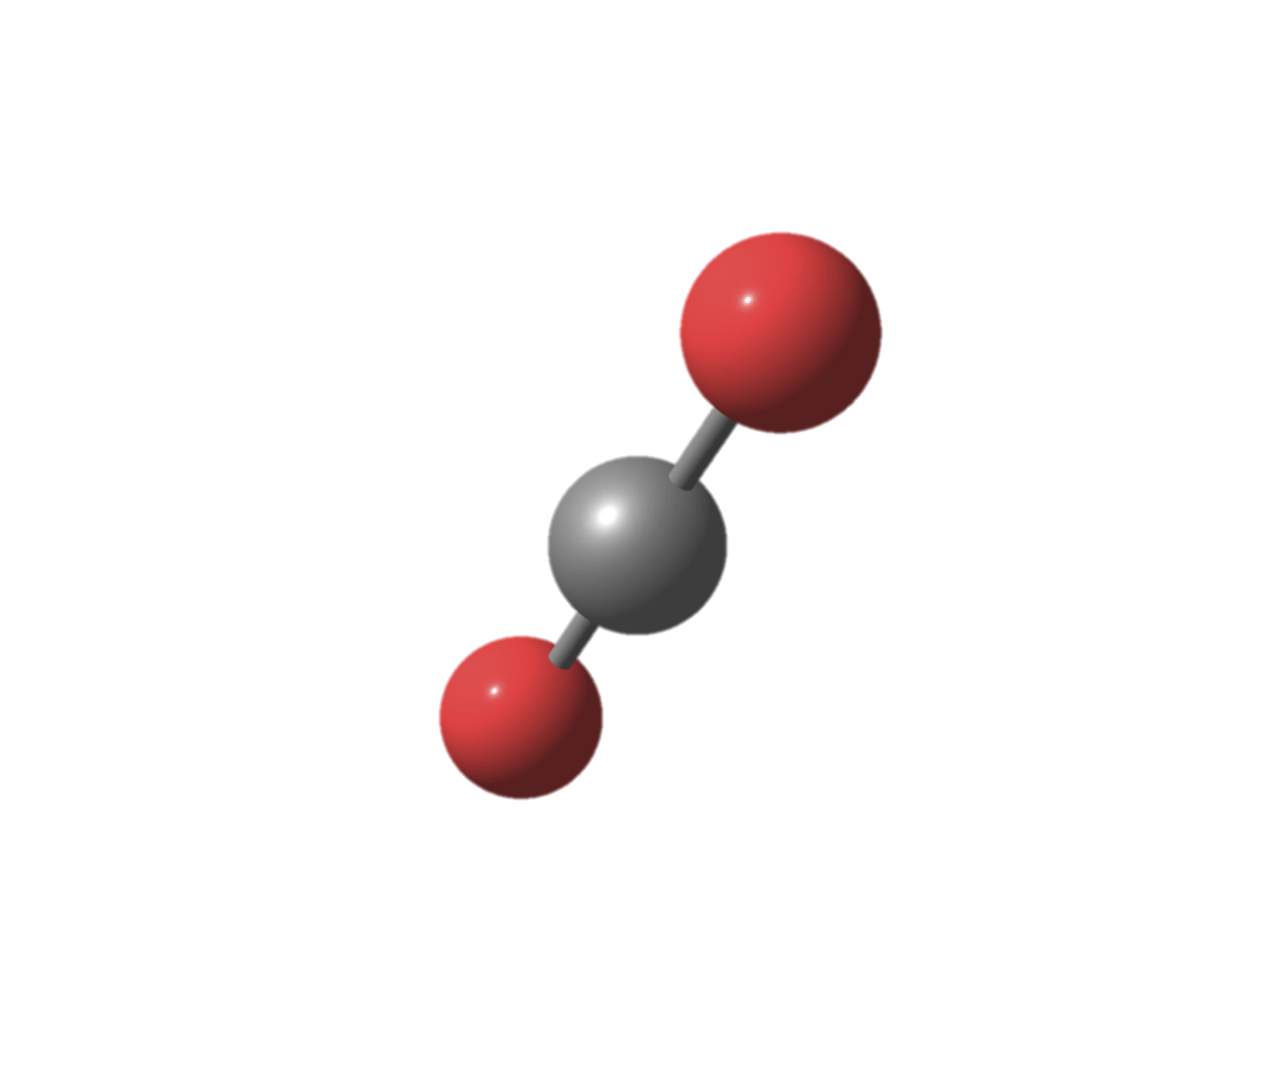
Photosynthesis
C-14 + Oxygen = Carbon dioxide
Notes:
Just like carbon 12, the carbon 14 combines with oxygen to form carbon dioxide which is absorbed by plants during photosynthesis.
(graphic is from thinkstock)

Slide 11

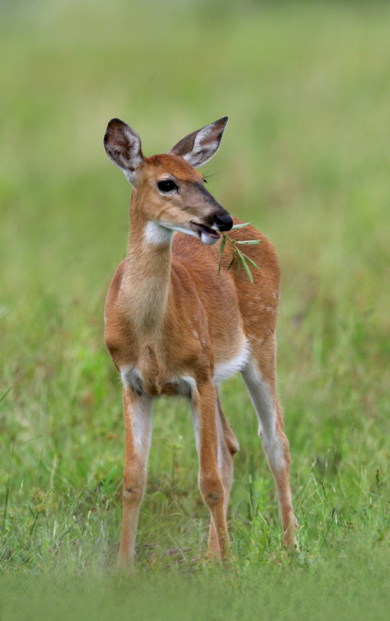

C-14
Notes:
Animals and people who eat the plants take in C-14.

Slide 12

C-12 : C-14
1
trillion
:
1
Notes:
Carbon-14 is only a tiny fraction of the carbon found in the atmosphere. For every trillion atoms of carbon-12, there is only 1 atom of carbon-14. This ratio of C-12 to C-14 in the air and all living things is nearly constant, but after they die, living things no longer take in new carbon.

Slide 13
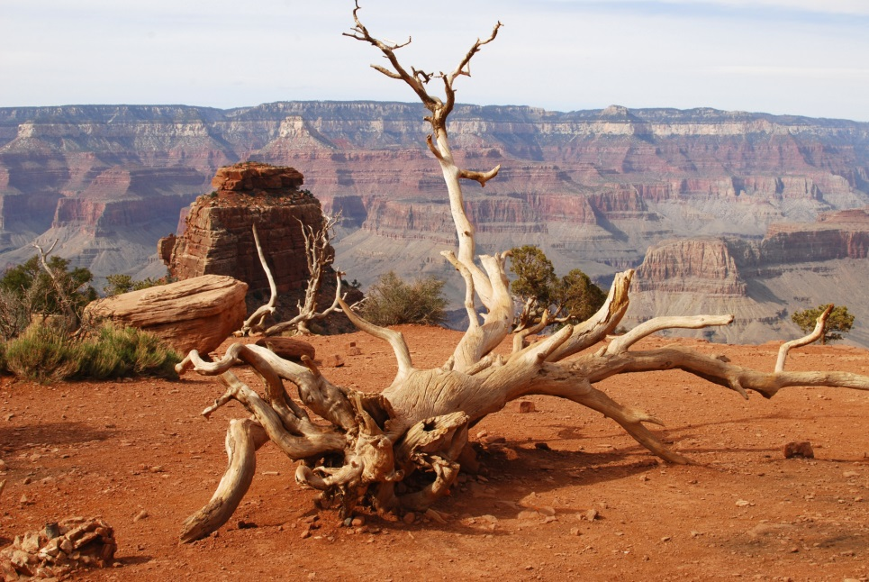
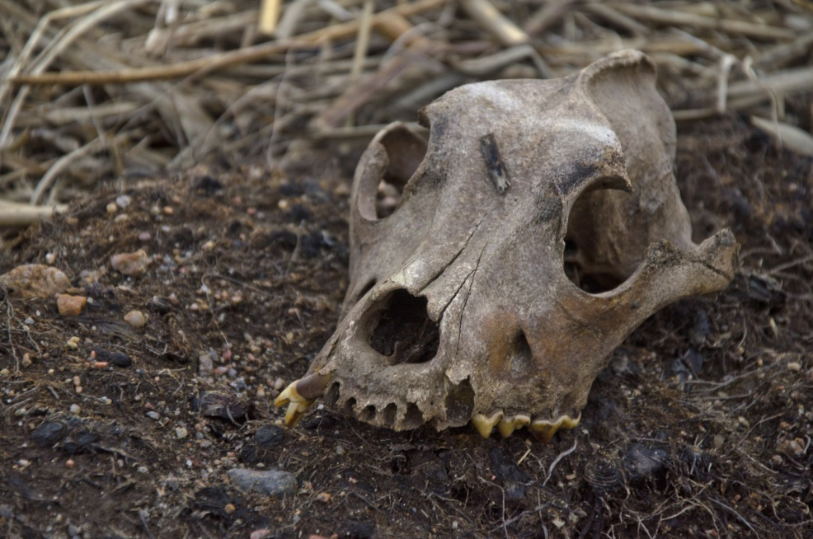
Radioactive Decay
C-14
N-14
Notes:
After the death of trees, animals, or people, wood and bones lose C-14 as it changes by beta decay back to N-14.

Slide 14
Tandem Accelerator
Mass Spectrometer
Notes:
Scientists can measure the number of C-14 atoms in a sample with a tandem accelerator mass spectrometer.

Slide 15
Radiocarbon Dating
C-12
C-14
Stays the
same
Half-Life | C-12 | : | C-14
1 | Stays the same | to | 1 part per trillion
2 | Stays the same | to | ½ part per trillion
3 | Stays the same | to | ¼ part per trillion
Notes:
By comparing the amount of C-12, / which continues to remain the same, / with the amount of C-14, / which is decreasing / and then comparing that ratio with the expected decrease in C-14 with time, scientists can calculate how long ago the living thing died.

Slide 16
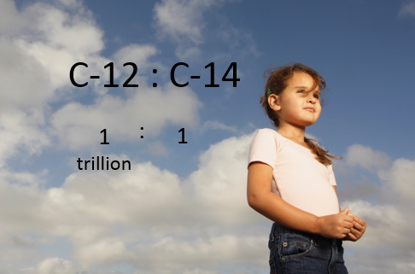

Half-Life | C-12 | : | C-14
1 | Stays the same | to | 1 part per trillion
2 | Stays the same | to | ½ part per trillion
3 | Stays the same | to | ¼ part per trillion
Notes:
Remember that to begin with, / there is only 1 carbon-14 atom for every trillion carbon-12 atoms. Detecting carbon-14 atoms after several half-lives is a little like trying to find one red grain of sand in an entire football stadium filled with sand!

Slide 17
Half-Life
Parent Isotope | Daughter Isotope | Half-Life
Uranium-238 | Lead-206 | 4.5 billion years
Rubidium-87 | Strontium-87 | 48.8 billion years
Potassium-40 | Argon-40 | 1.25 billion years
Samarium-147 | Neodymium-143 | 106 billion years
Carbon-14 | Nitrogen-14 | 5,730 years
Notes:
Carbon-14 has a relatively short half-life—/ only 5,730 years.

Slide 18
Radiocarbon Dating
1
2
3
4
5
6
7
8
9
All
< 50,000 years old
1/2
1/4
1/8
1/16
Notes:
Because it is so difficult to detect carbon-14 after 10 half lives, radiocarbon dating can only be used to date previously-living things that are less than about 50,000 years old.

Slide 19

Accuracy of Radiocarbon Dating
Assumptions:
Decay rate has always been constant
We can correct for different levels of C-14 at different times
Notes:
Like other forms of radiometric dating, the accuracy of carbon dating is dependent on the accuracy of certain assumptions. / Carbon dating assumes that the decay rate has always been constant. / We know the amount of C14 in the atmosphere has changed over time, but we believe we can correct for that.

Slide 20
Quaternary
Cenozoic
Neogene
Paleogene
65 Ma
Cretaceous
Mesozoic
Jurassic
Triassic
252 Ma
Phanerozoic
Permian
Pennsylvanian
Mississippian
Paleozoic
Devonian
Silurian
Ordovician
Cambrian
541 Ma
Precambrian
Notes:
Interestingly, even though dating methods suggest that the rock layers of the geologic column are many millions of years old…

Slide 21
Traces of C-14
Notes:
…trace amounts of C-14 have been found in fossils from those very same rock layers. If the fossils are really millions of years old, no C-14 should be left.

Slide 22

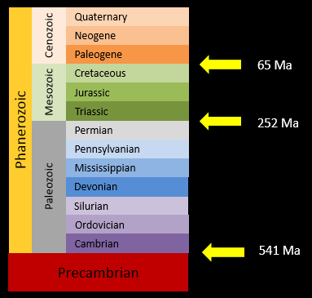

Conflicting Results
Notes:
In other words, the millions of years calculated for the rock layers conflicts with the thousands of years implied by the presence of C-14 found in the fossils.

Slide 23
What Does This Mean?
There are still things about radiometric dating that we don’t understand yet
Notes:
This just means that there are still things about radiometric dating that scientists don’t understand yet.

Slide 24
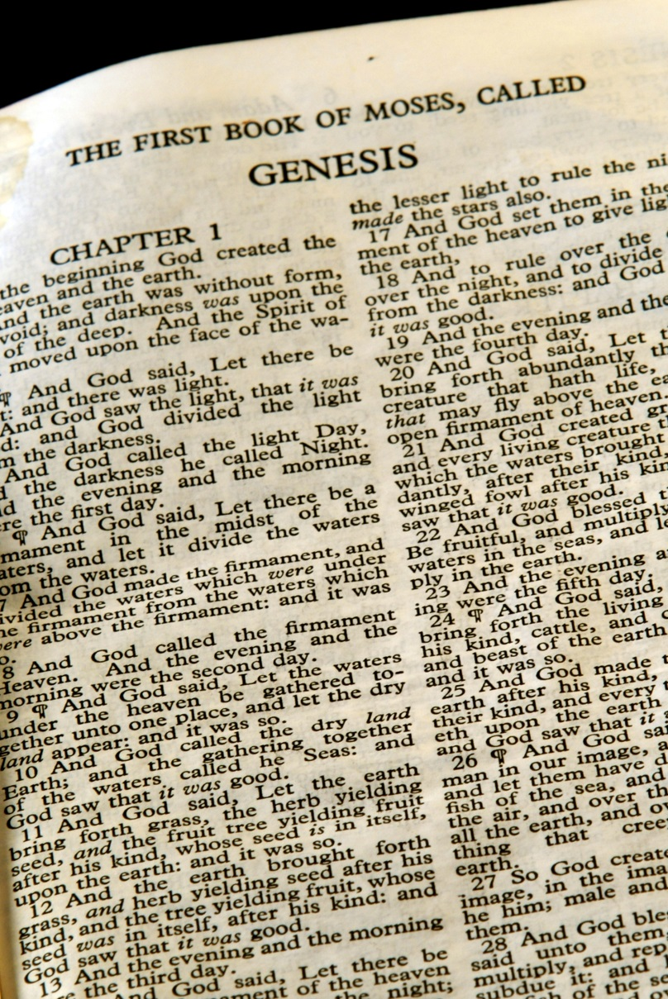
Alternate Explanations
Scientists who believe the Bible to be a reliable account of Earth’s origins are looking for alternate explanations for radiometric dates
Notes:
Scientists who believe the Bible to be a reliable account of Earth’s origins are looking for alternate explanations for radiometric dates.

Slide 25
Alternate Explanations
They predict that there are discoveries yet to be made that will explain the data in ways that are consistent with Scripture.
Notes:
They predict that there are discoveries yet to be made that will explain the data in ways that are consistent with Scripture.

Slide 26
Recorded at
Chattanooga Public RadioSM
Classical 90.5 WSMC

Slide 27
Images By
Images may appear on more than one slide. Citation is given on the first slide where each image appears.
[1a] Zion National Park 489588635, kaiborder, Thinkstock, Thinkstock Image Subscription Agreement
[1b] Folded rocks 24286621 Matauw, Getty Images (US), Inc. Subscription Agreement
[1c] Blue Mesa Petrified Forest National Park 479232619, estivillml, Thinkstock, Thinkstock Image Subscription Agreement
[1d] Bryce Canyon National Park, Keith Snyder
[1e] Folded rocks, Raul Esperante, used with permission
[1f] Grand Canyon, taken by Ed Chatelain, used with permission
[2a] Periodic Table of the Elements 487671929, Nerthuz, Thinkstock, Thinkstock Image Subscription Agreement
[2b] Rubidium material sign 180861989, nmcandre, Thinkstock, Thinkstock Image Subscription Agreement
[2c] Strontium material sign 180862867, nmcandre, Thinkstock, Thinkstock Image Subscription Agreement
[2d] Carbon material sign 178500628, nmcandre, Thinkstock, Thinkstock Image Subscription Agreement
[3a] Mammoth skeleton 186043, Escaflowne, Getty Images (US), Inc. Subscription Agreement
[3b] Saber-toothed cat skull 825334, pixeldigits, Getty Images (US), Inc. Subscription Agreement

Slide 28
Images By
[9a] Nitrogen material sign 178500631, nmcandre, Thinkstock, Thinkstock Image Subscription Agreement
[9c] Hydrogen material sign 178500618, nmcandre, Thinkstock, Thinkstock Image Subscription Agreement
[10a] Carbon dioxide molecular structure 483046621, ollaweila, Thinkstock, Thinkstock Image Subscription Agreement
[10b] Photosynthesis in Plant 450233561, snapgalleria, Thinkstock, Thinkstock Image Subscription Agreement
[11b] White-tailed Deer in a grassy field (Odocoileus Virginianus) 72968629, Purestock, Thinkstock, Thinkstock Image Subscription Agreement
[11c] Girl with vegetables 453988551, pat138241, Thinkstock, Thinkstock Image Subscription Agreement
[12] Girl under blue sky 81387617, Mark Edward Atkinson, Thinkstock, Thinkstock Image Subscription Agreement
[13b] Dead tree in the Grand Canyon 480618467, Gentiles, Thinkstock, Thinkstock Image Subscription Agreement
[13c] Skull 489083187, Tntk, Thinkstock, Thinkstock Image Subscription Agreement
[16b] Football ground 99356262, Victor Habbick, Thinkstock, Thinkstock Image Subscription Agreement
[24] Bible series--Genesis 92185968, Stephen Orsillo, Thinkstock, Thinkstock Image Subscription Agreement

Slide 29
Special Thanks
Chris Hansen, PhD
Physics Professor, Southern Adventist University
Ken Caviness, PhD
Physics Professor, Southern Adventist University
Foundation for Adventist Education

Slide 30

© Origins Curriculum Resources 2015

Slide 31

© Southern Adventist University 2015

Slide 32

© Seventh-day Adventist North American Division 2015

Slide 33

© General Conference of Seventh-day Adventists 2015

Slide 34

© SCORE Southern Center for Origins Research & Education 2015

