Slide 1
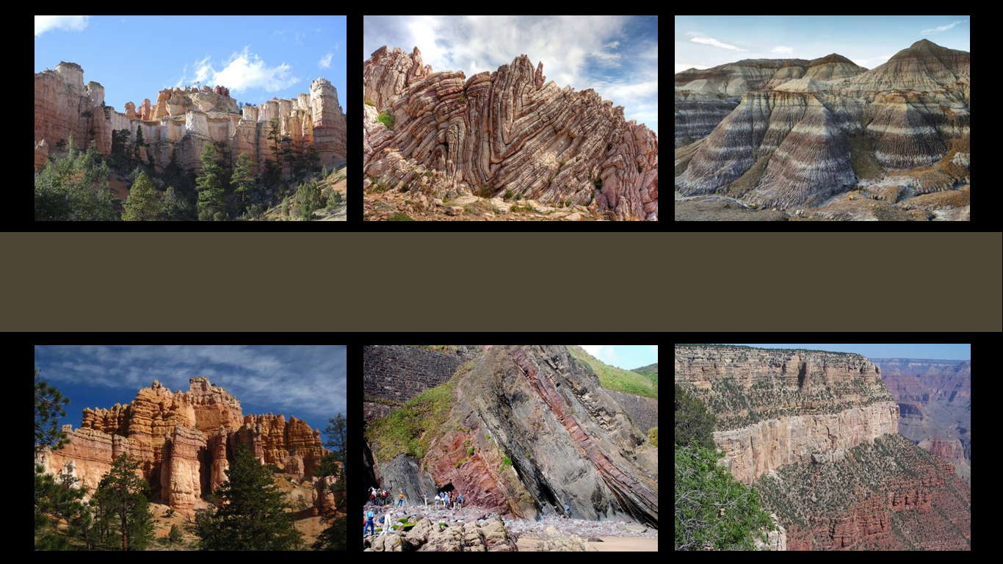
Geologic Column
Accuracy & Assumptions of Radiometric Dating
Notes:
Accuracy and assumptions of radiometric dating

Slide 2

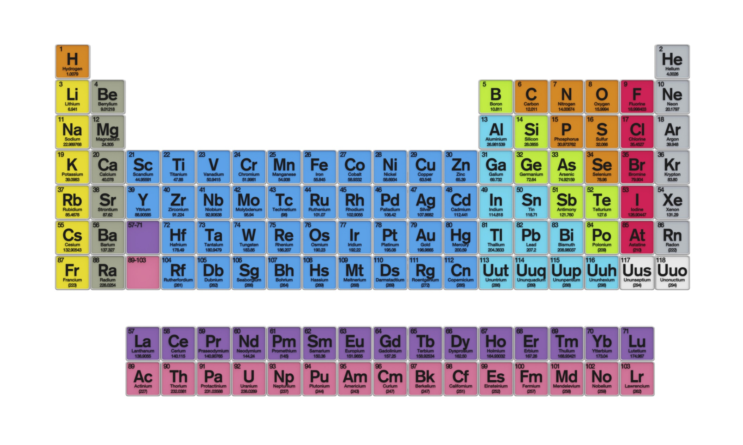


Radioactive Decay
Rubidium
Strontium
37
38
87
87
Notes:
Because scientists know that certain radioactive elements decay at consistent, known rates…

Slide 3
Radioactive Decay
1
2
3
4
5
6
7
8
9
All
Amount of Parent Isotope
1/2
1/4
1/8
1/16
Time
Notes:
They are able to compare the amount of parent isotope / to daughter isotope in a sample / and estimate its actual age.

Slide 4
Is radiometric dating accurate?
Notes:
But is this process accurate?

Slide 5
Quaternary
Cenozoic
Neogene
Paleogene
65 Ma
Cretaceous
Mesozoic
Jurassic
Triassic
252 Ma
Phanerozoic
Permian
Pennsylvanian
Mississippian
Paleozoic
Devonian
Silurian
Ordovician
Cambrian
541 Ma
Precambrian
Notes:
When they estimate that certain rock layers are 541 million years old, is that really true?

Slide 6

Accuracy
Careful procedures must be followed:
  When samples are collected
  When samples are prepared in the laboratory
  When parent and daughter isotopes are measured
Three other assumptions must be true
Notes:
In order for radiometric dating to be accurate, careful procedures must be followed when samples are collected, when samples are prepared in the laboratory, and when parent and daughter isotopes are measured. / In addition, at least three assumptions, which we will learn about in this presentation, must be true.

Slide 7
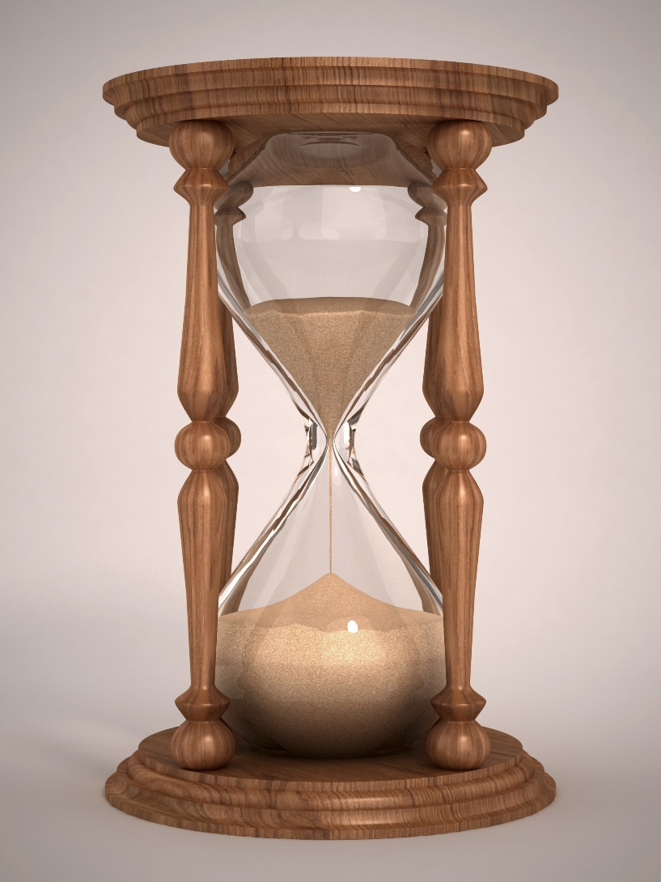
Hour Glass
Parent
Decay
Daughter
Notes:
To help us understand those assumptions, it may be helpful to look at another analogy sometimes used to illustrate radioactive decay./
Imagine that the sand in the top part of the hour glass is like the parent isotope. / The sand in the bottom is like the daughter isotope. Over time, the sand trickles from the top to the bottom, representing the radioactive decay that turns the parent isotope into the daughter isotope.

Slide 8

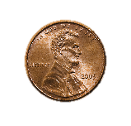
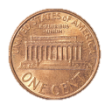
1. One group steadily increased while the other group steadily decreased.
2. Both groups changed steadily as we flipped the pennies every minute.
3. We could not know for sure whether any individual penny would be heads or tails, but we knew that about half the group would be heads and half tails.
Notes:
Think back to the three points we made about radioactive decay using our penny illustration. Two of the three points are made well by the hour glass illustration as well.

Slide 9

1. One group steadily increased while the other group steadily decreased.
2. Both groups changed steadily as we flipped the pennies every minute.
3. We could not know for sure whether any individual penny would be heads or tails, but we knew that about half the group would be heads and half tails.
Notes:
In number 1, it was easy to see one group of pennies steadily increasing, while the other group was steadily decreasing. / This point is easy to see in the hour glass illustration as well. We can see how the sand in top steadily decreases as the sand in the bottom steadily increases.
In number 3, we could not know for sure whether any individual penny would be heads or tails, but we knew that about half the group would be heads and half tails. / In the hour glass illustration, we don’t know exactly when one individual grain of sand will fall to the bottom, but we know how long it takes for all the sand to fall.
The hour glass analogy fails to illustrate point number 2. While the number of pennies being flipped got smaller each time, the amount of sand falling through the hour glass remains the same. But as long as we don’t expect the hour glass to accurately illustrate half-life, it will still be useful to us in understanding the assumptions of radiometric dating.

Slide 10
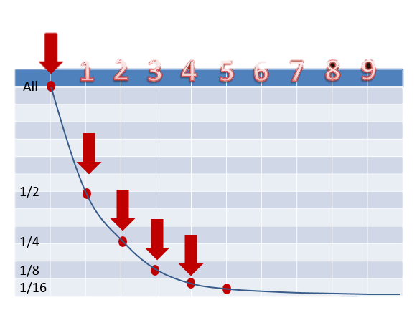
Assumptions
The decay rate (half-life) has always been constant.
Radioactive Decay
Notes:
With that in mind, we are ready to learn the three assumptions that must be true in order for radiometric dating to be accurate. / Number 1—we assume that decay rate has always been the same. Most scientists do not think there is reason to doubt the theory of the decay process.

Slide 11
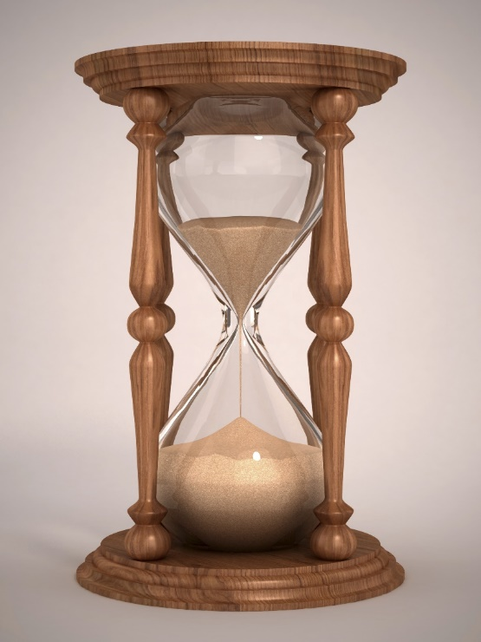
Assumptions
2. The rock has experienced no chemical exchange with the rocks around it (it is a closed system).
Closed System
Notes:
Number 2—we assume that the rock has experienced no chemical exchange with the rocks around it, In other words, nothing inside the rock has gotten out, and nothing outside the rock has gotten in. In the hour glass example, this would mean that here is not a hole in the bottom letting any of the sand escape, and that no additional sand is being added from the top.

Slide 12
Assumptions
3. The initial concentration of daughter product at the time of formation of the rock can be determined.
Notes:
Number 3—we assume that the initial concentration of daughter product can be determined, In our hour glass illustration, this would mean that if there was already some sand in the bottom when we turned the hour glass over, it is possible to determine how much was there so we could adjust our calculations.
If scientists did not know some old daughter product was leftover when a new rock formed, the rock would date as much older than it really is.

Slide 13
Accuracy
Some scientists have raised questions about accuracy.
Some individual dates have been shown to be inaccurate.
The overall pattern of dates suggested is generally quite consistent.
Notes:
Some scientists have raised questions about the accuracy of radiometric dating. Although some individual dates have been shown to be inaccurate, the overall pattern of dates suggested by radiometric dating is generally quite consistent.

Slide 14
Radiometric dating
An accurate theory?
A hypothesis to be tested?
The long ages suggested by radiometric dating conflict with the Word of God.
Notes:
While many scientists have accepted radiometric dating as an accurate theory, / other still consider it a hypothesis to be tested. Why?
Because the long ages suggested by radiometric dating conflict with what the Word of God teaches.

Slide 15
Word of God
Creation of life on Earth in six literal days with a seventh added for worship and rest (Genesis 1)
Several thousand—not million—years ago (Genesis 5 and 11)
Notes:
The Bible is very clear about the creation of life on Earth in six literal days with a seventh added for worship and rest. The chronogenealogies in Genesis 5 and 11 indicate that this happened several thousand—rather than million—years ago.

Slide 16
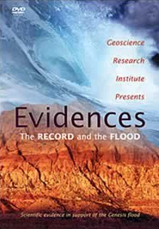
Geological Evidence
Widespread Deposits
Lack of Erosion/Flat Gaps
Turbidites
Notes:
Besides the concerns raised by the Bible about the accuracy of radiometric dates, / there are pieces of geological evidence that are difficult to explain if they were formed over millions of years. / We learned about some of these in video 11.

Slide 17
New Discoveries Expected
Believe the creation story to be a reliable history of Earth’s origins
Look for alternate explanations of radiometric dates
Predict that there are discoveries yet to be made that will shed light on this issue
Notes:
Although the creation story in Genesis is not something that science can prove or disprove, some scientists believe it to be a reliable history of Earth’s origins and have chosen to accept it as accurate. / These scientists look for alternate explanations of radiometric dates that would be consistent with the biblical record. More study is needed, / and scientists who believe in the biblical creation story predict that there are discoveries yet to be made that will shed light on this issue and see this as an exciting mystery to solve.

Slide 18
The Geologic Column
Radiocarbon Dating
Notes:
To learn about a specific kind of radiometric dating that scientists use to calculate the age of fossils, watch our next presentation.

Slide 19
Recorded at
Chattanooga Public RadioSM
Classical 90.5 WSMC

Slide 20
Special Thanks
Leonard Brand
Earth & Biological Sciences, Loma Linda University
Faith, Reason, & Earth History, Chapter 15
Chris Hansen, PhD
Physics Professor, Southern Adventist University
Ken Caviness, PhD
Physics Professor, Southern Adventist University
and the
Foundation for Adventist Education

Slide 21
Images By
Images may appear on more than one slide. Citation is given on the first slide where each image appears.
[1a] Zion National Park 489588635, kaiborder, Thinkstock, Thinkstock Image Subscription Agreement
[1b] Folded rocks 24286621 Matauw, Getty Images (US), Inc. Subscription Agreement
[1c] Blue Mesa Petrified Forest National Park 479232619, estivillml, Thinkstock, Thinkstock Image Subscription Agreement
[1d] Bryce Canyon National Park, Keith Snyder
[1e] Folded rocks, Raul Esperante, used with permission
[1f] Grand Canyon, taken by Ed Chatelain, used with permission
[2a] Periodic Table of the Elements 487671929, Nerthuz, Thinkstock, Thinkstock Image Subscription Agreement
[2b] Rubidium material sign 180861989, nmcandre, Thinkstock, Thinkstock Image Subscription Agreement
[2c] Strontium material sign 180862867, nmcandre, Thinkstock, Thinkstock Image Subscription Agreement

Slide 22
Images By
[7] Hourglass 494183657, koya79, Thinkstock, Thinkstock Image Subscription Agreement
[8a] Stopwatch 164473206, Ola-Ola, Thinkstock, Thinkstock Image Subscription Agreement
[8b] American Cent 177118056, Ligora, Thinkstock, Thinkstock Image Subscription Agreement
[16] Photo of Evidences DVD, Carol Raney

Slide 23

© Origins Curriculum Resources 2015

Slide 24

© Southern Adventist University 2015

Slide 25

© Seventh-day Adventist North American Division 2015

Slide 26

© General Conference of Seventh-day Adventists 2015

Slide 27

© SCORE Southern Center for Origins Research & Education 2015

