Slide 1
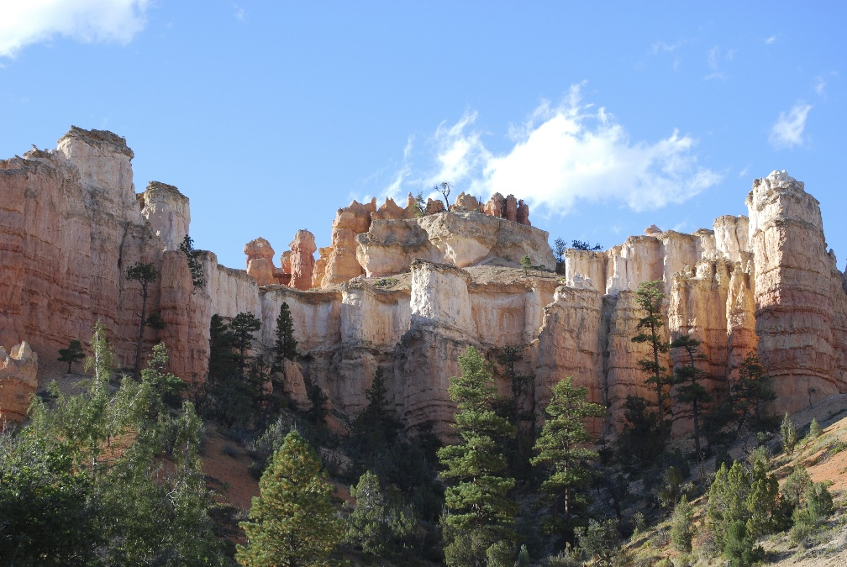
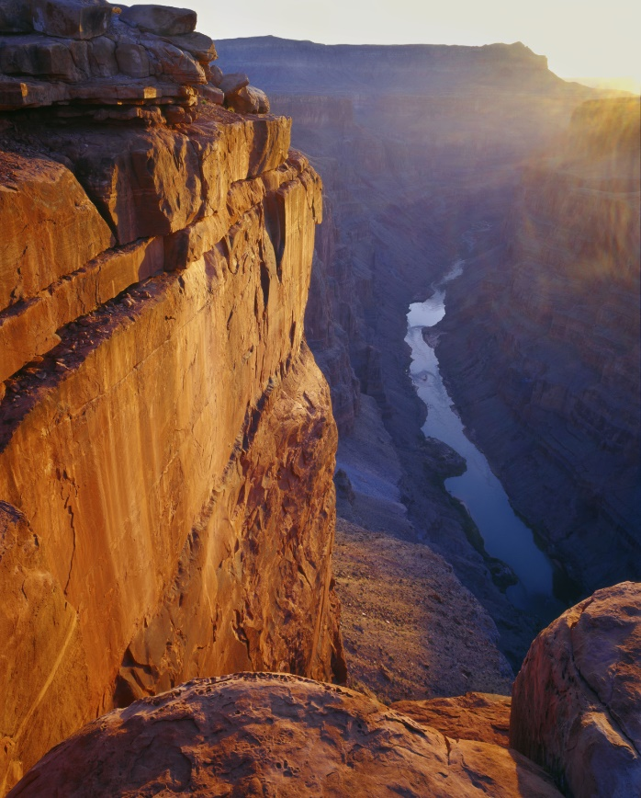
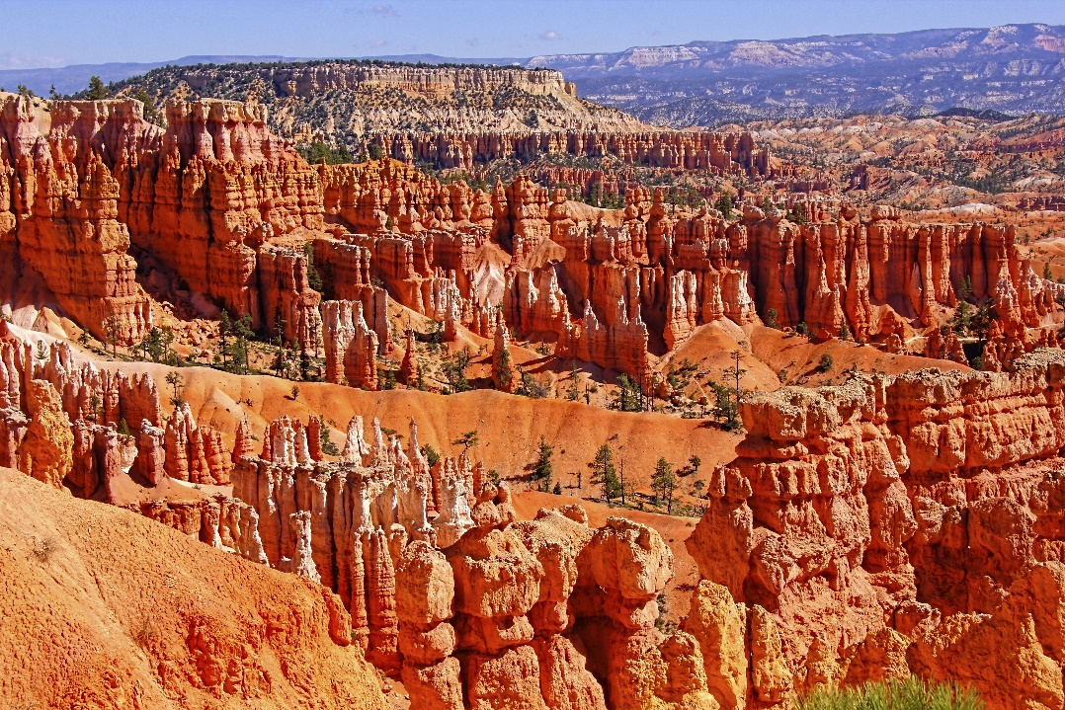
The Geologic Column (A4 How Did the Layers Form?)
Notes:
The Geologic Column—How Did the Layers Form? We’ve learned a lot about the geologic column so far…

Slide 2
Quaternary
Cenozoic
Neogene
Paleogene
Cretaceous
Mesozoic
Jurassic
Triassic
Phanerozoic
Permian
Pennsylvanian
Mississippian
Paleozoic
Devonian
Silurian
Ordovician
Cambrian
Precambrian
Notes:
The names of some of its layers…

Slide 3
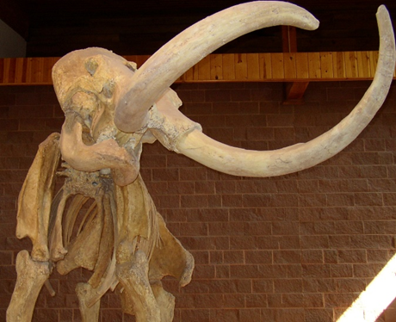
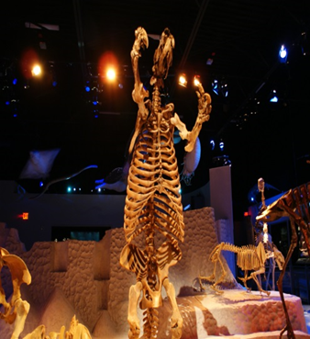
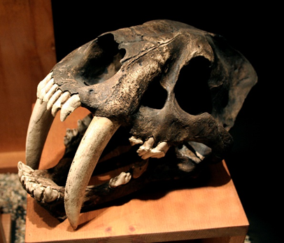
Notes:
The kinds of fossils buried in the rocks

Slide 4
Newest
Relative Age
Oldest
Notes:
The relative age of the layers…

Slide 5
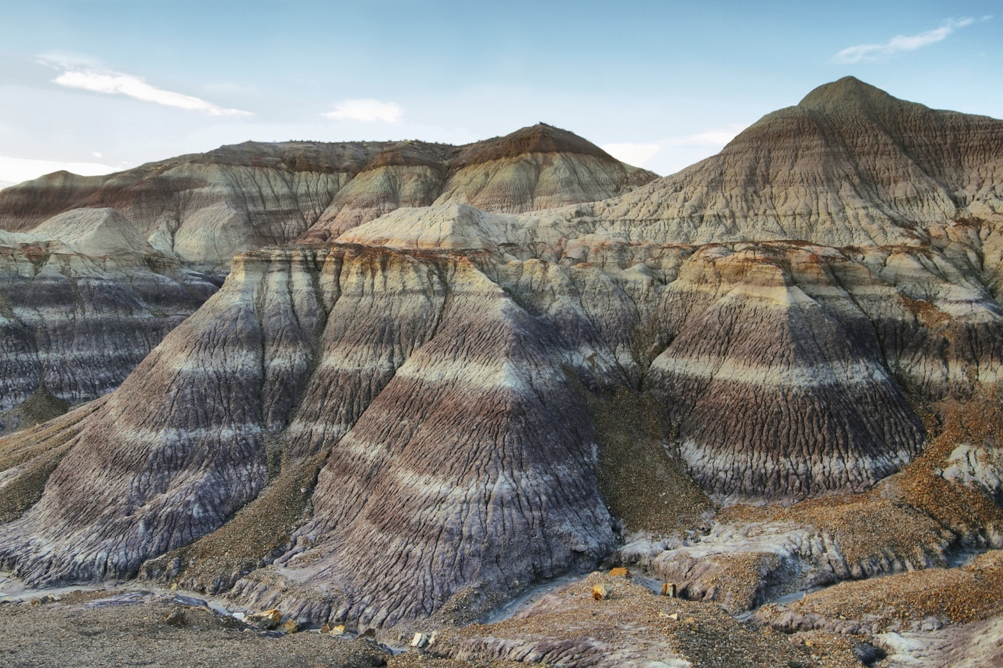
How did the layers form?
Notes:
But how did the strata get there? / How were they formed?

Slide 6
Notes:
Rock layers start out as some combination of stones, sand, and clay being carried along by water. Usually the stones, sand, and clay, are being carried along by water. As the water slows down, the biggest pieces—like gravel--settle to the bottom first. Then the smaller pieces—like sand--begin to settle. Finally the smallest pieces—like clay—settle to the bottom.

Slide 7
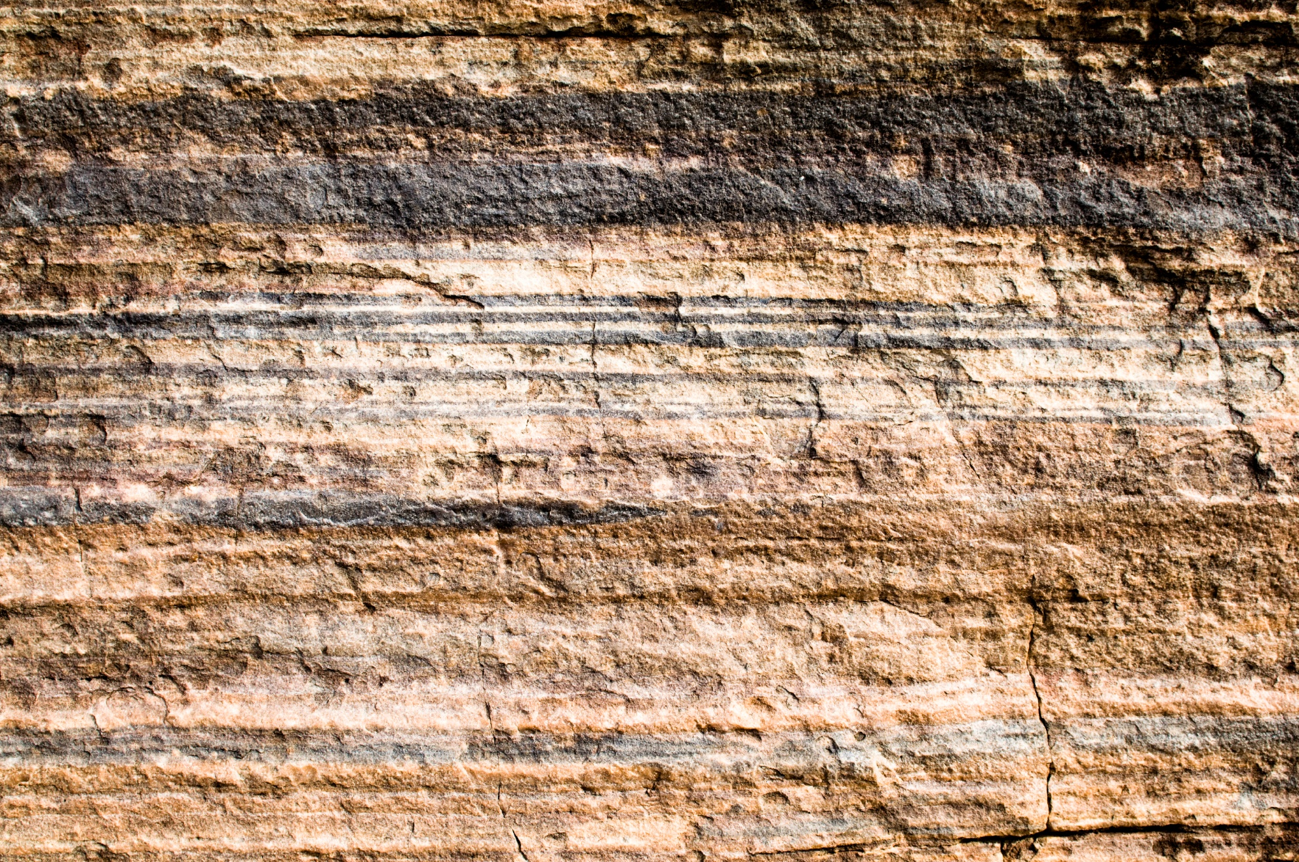
Rock layers are laid down horizontally
Notes:
Sometimes these loosely deposited sediments become cemented together and harden into rock layers. / These rock layers are usually laid down horizontally. In other words, they are laid down flat.

Slide 8
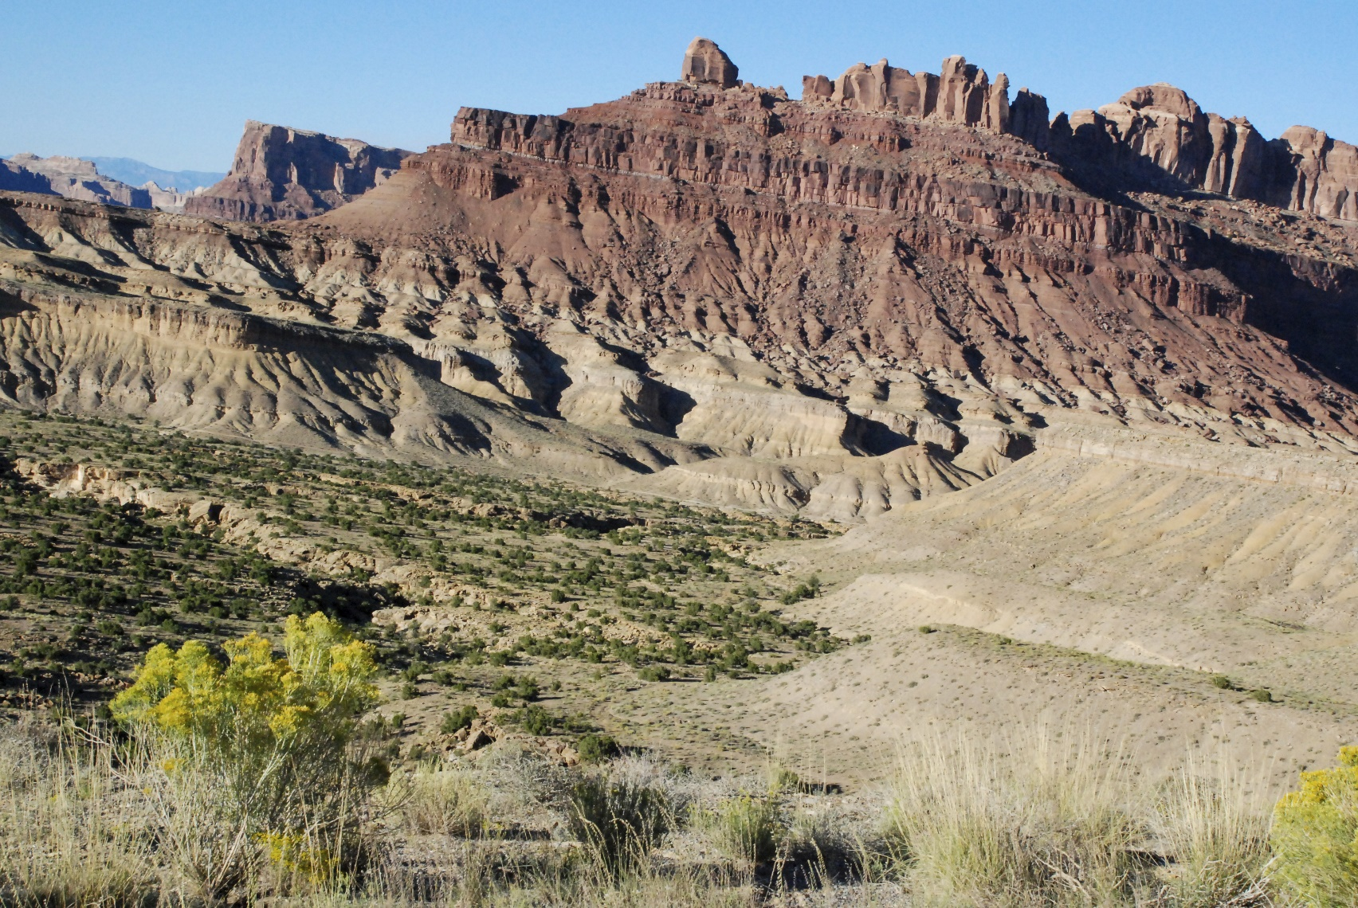
Formation
Notes:
One or more rock layers that cover the same, large area and have some similar characteristics are called formations.

Slide 9
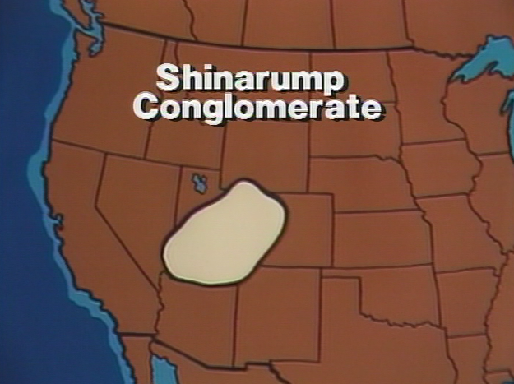
Shinarump
Formation
Notes:
Sometimes the same formation can go on for miles and miles.
The Shinarump Formation covers most of the whole state of Utah, plus parts of states around it.

Slide 10
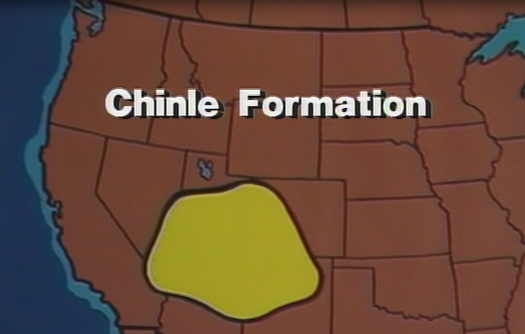
Chinle Group
Notes:
The Chinle Group is even bigger.

Slide 11
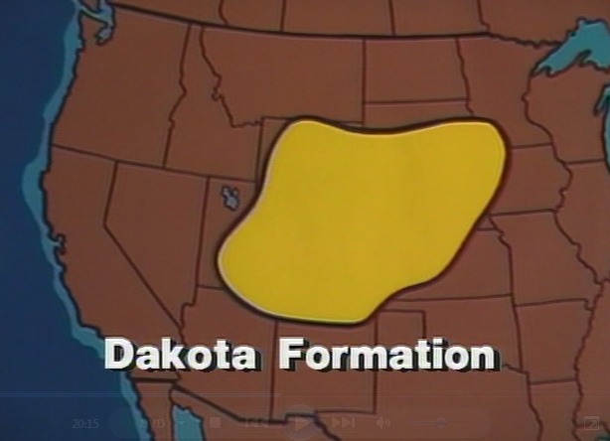
Dakota Formation
Notes:
The Dakota Formation is bigger still.

Slide 12
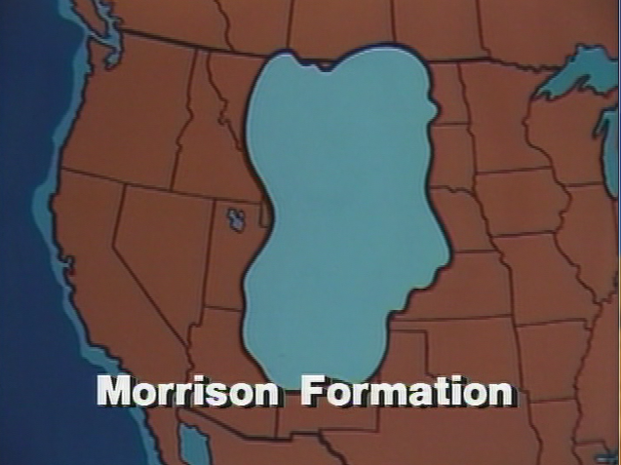
Morrison Formation
Notes:
And the Morrison Formation, which is famous for having lots of dinosaurs in it, is EVEN bigger! It covers almost all of Montana, all of Wyoming, all of Colorado, and parts of 10 other states and some provinces in Canada! The state of Tennessee could fit inside it more than 15 times!

Slide 13
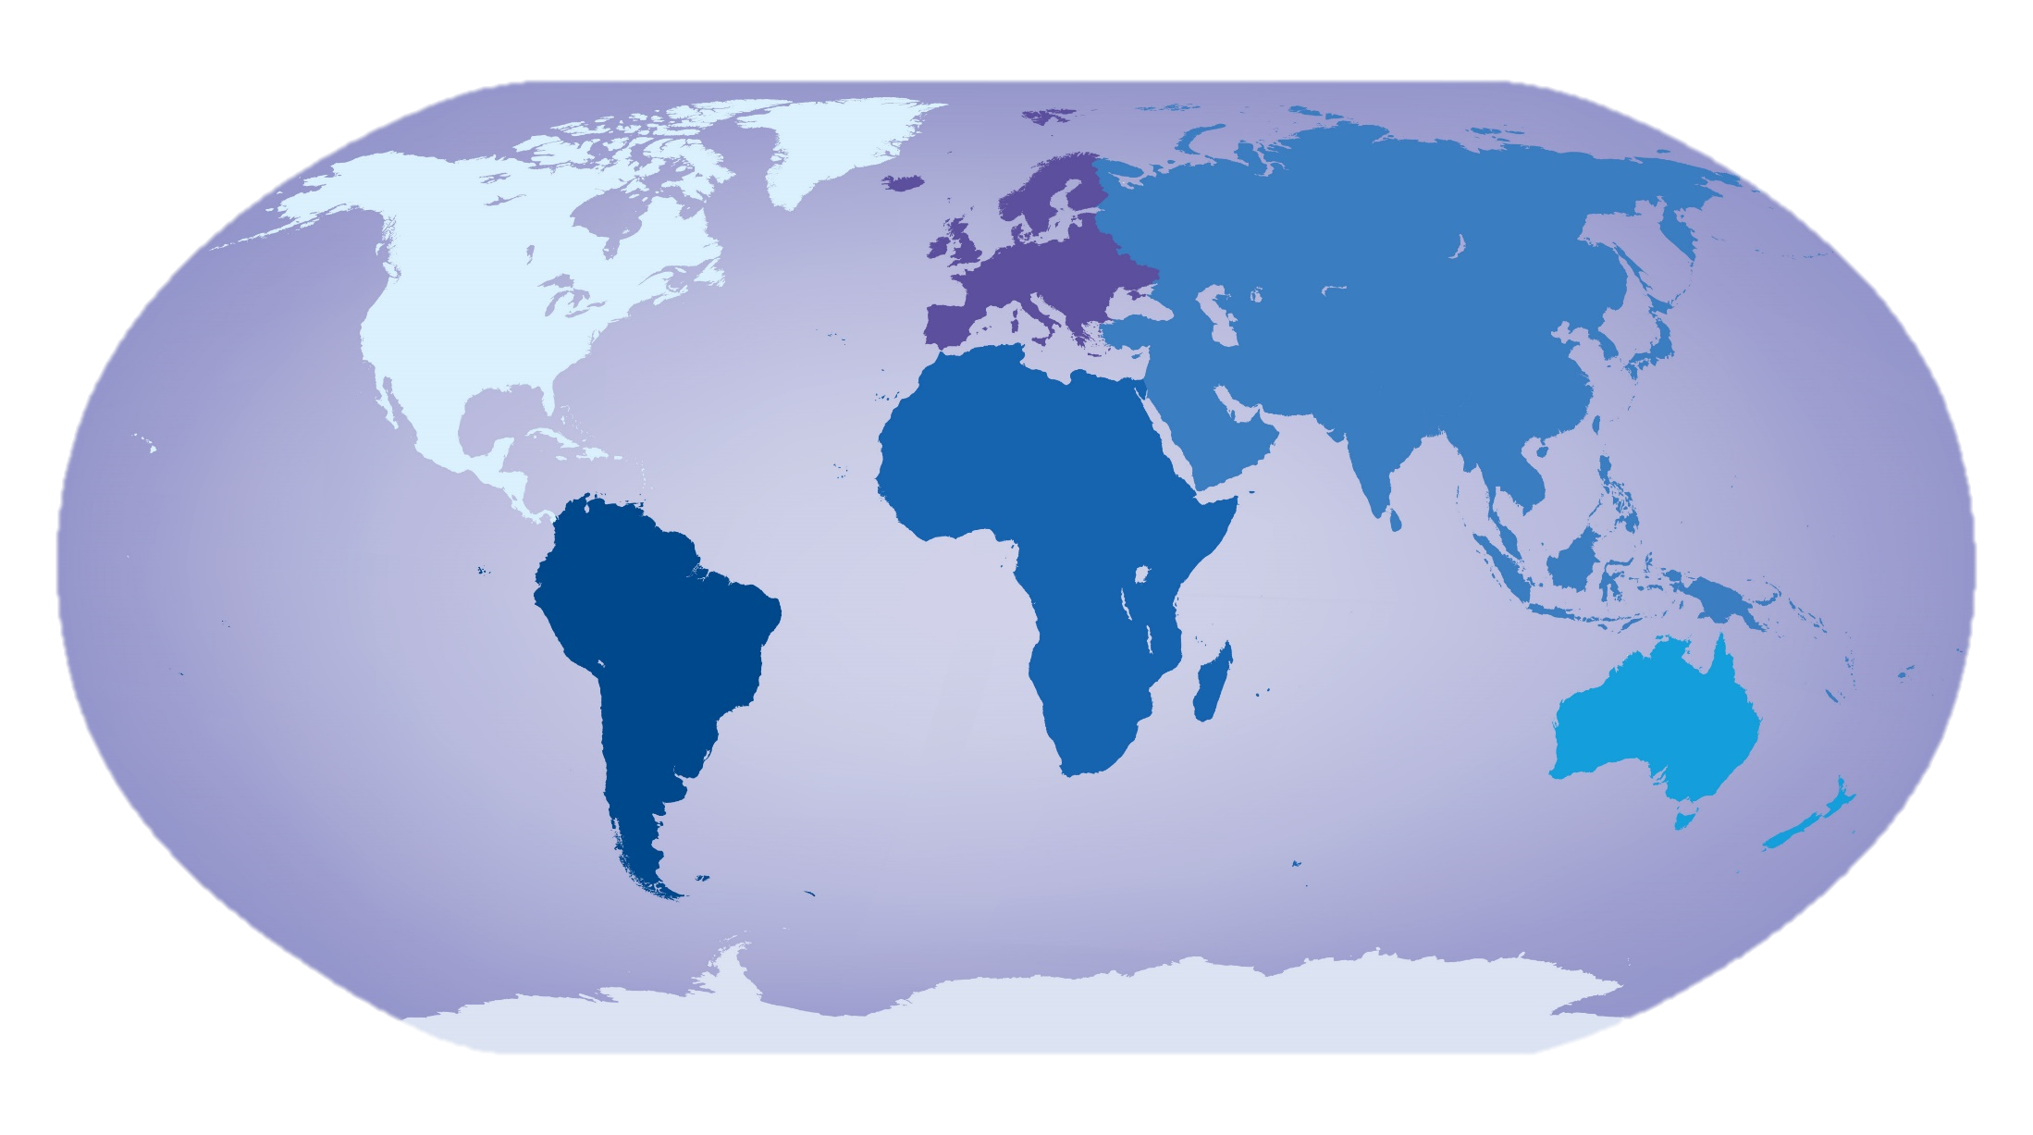
Notes:
Large rock layers like these, that cover thousands of square miles, are found on every continent of the world.

Slide 14
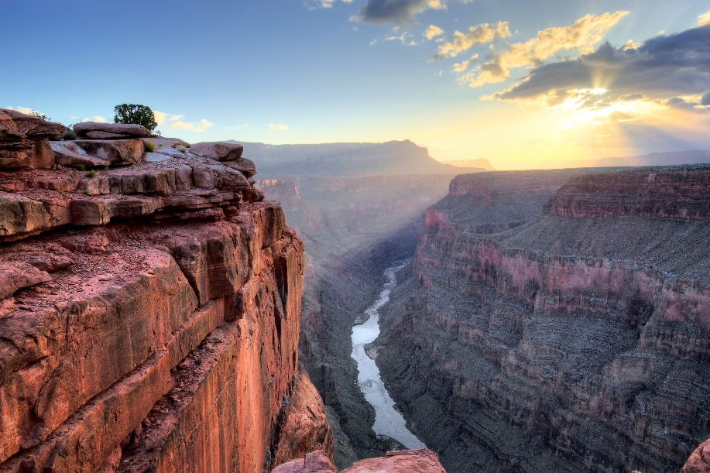
Data
Notes:
These rock layers can be seen, touched, and measured, and they provide us with all kinds of data.

Slide 15
?
Notes:
When scientists try to understand how the rock layers got here,

Slide 16
Interpretation
Notes:
They are interpreting the data.

Slide 17
Morrison Formation
Notes:
Think about the fact that the rock layers were laid down by water. Imagine how much water there would have to have been to create a rock layer THAT big!

Slide 18
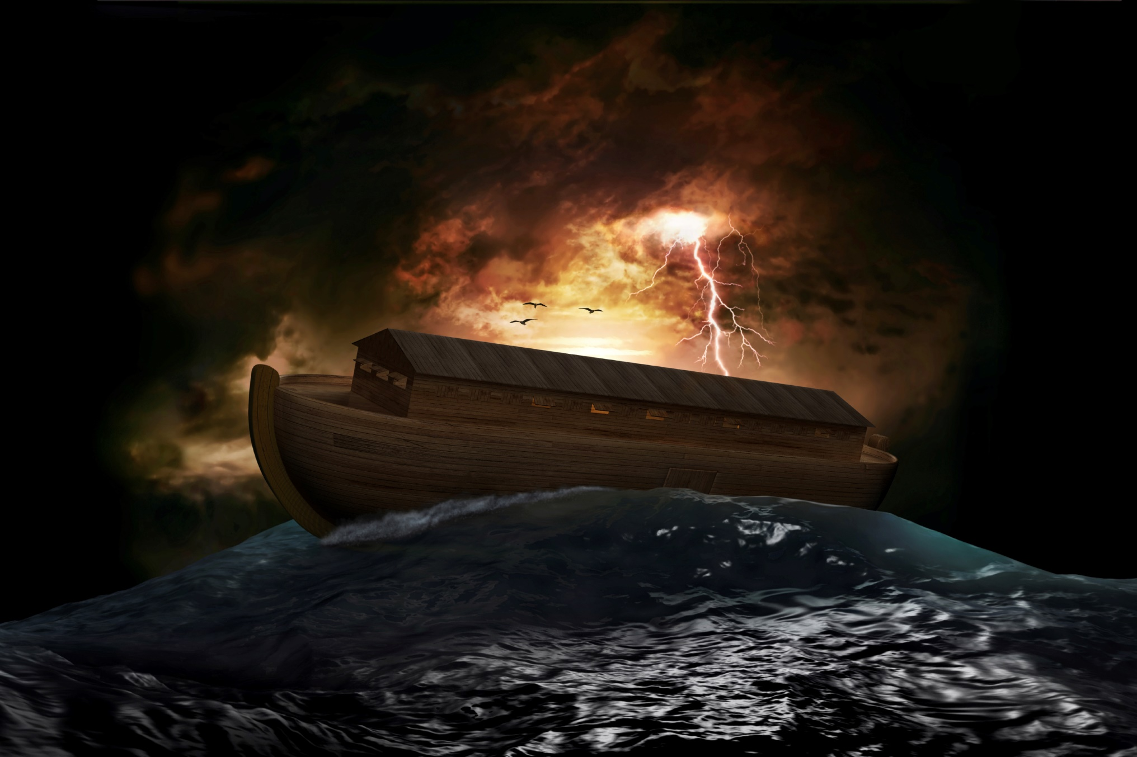
Notes:
Can you think of a time when there might have been that much water around?

Slide 19
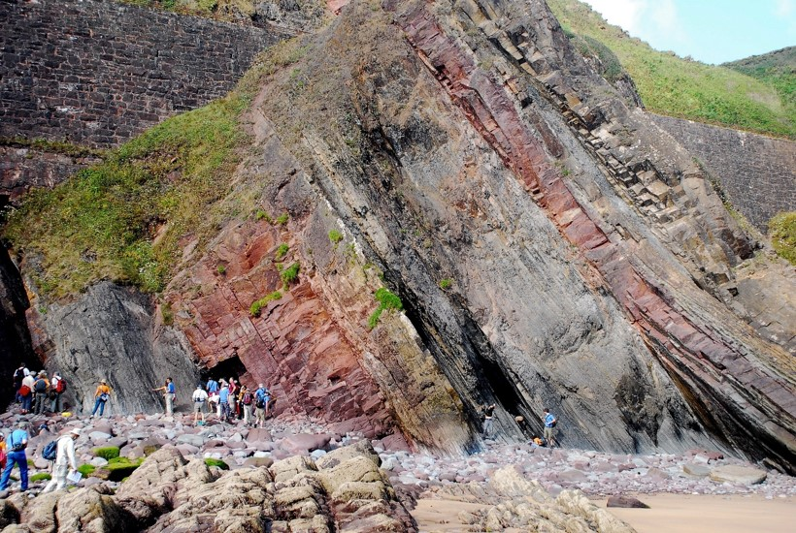
What happened here?
Notes:
Let’s look at some more data. If layers are laid down flat, what happened here? After the rock layers were formed, something must have happened to make the layers tilted instead of flat.

Slide 20
Notes:
Our earth may seem like it has a smooth, connected surface,

Slide 21
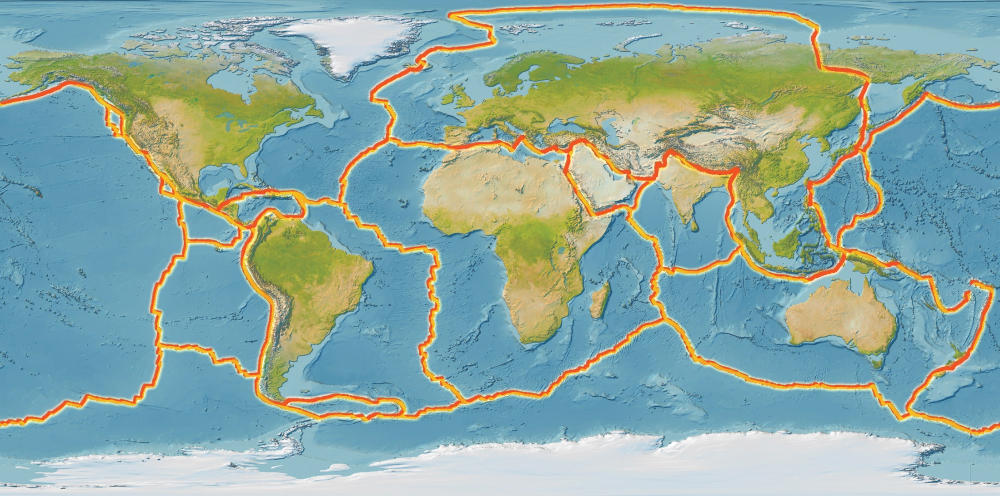
Notes:
but actually the earth’s crust is broken up into many different plates that basically float on top of earth’s mantle.

Slide 22
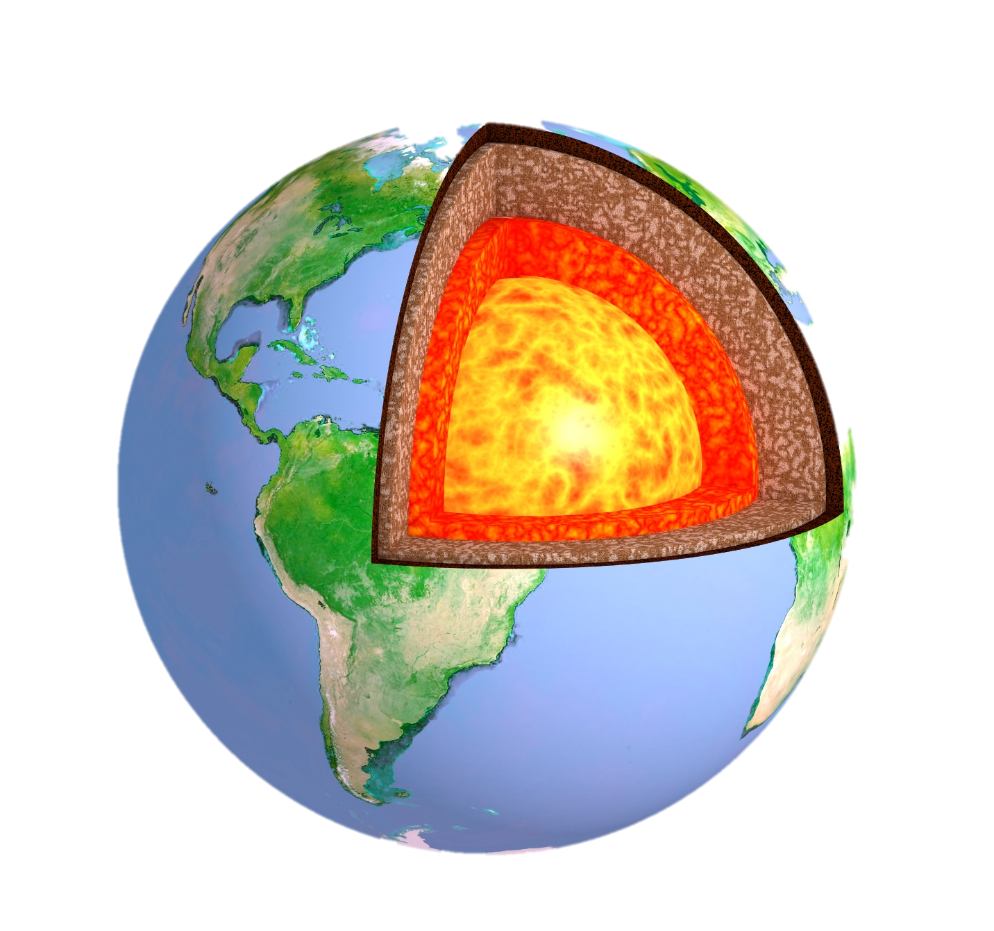
Crust
Mantle
Outer Core
Inner Core
Earth’s Layers
Notes:
Because of the heat in the center of the earth, / these plates are constantly moving—just a little bit.

Slide 23
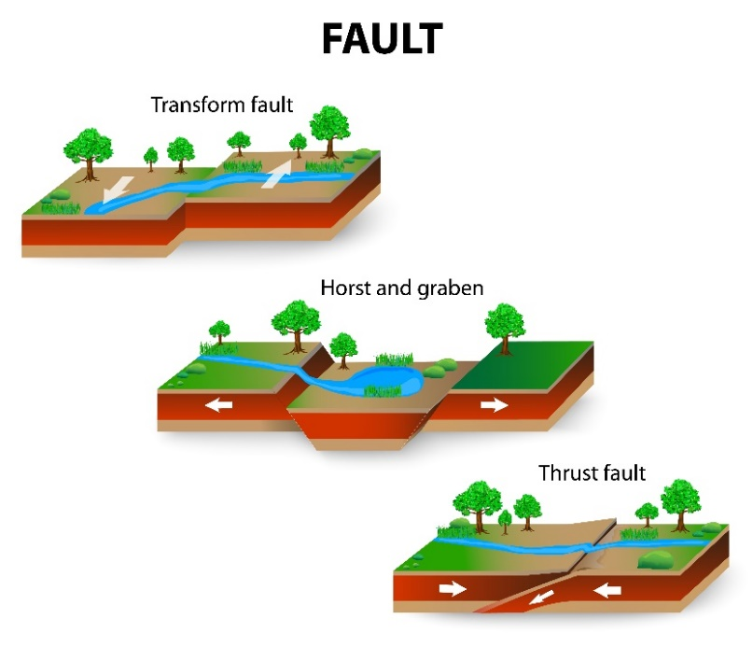
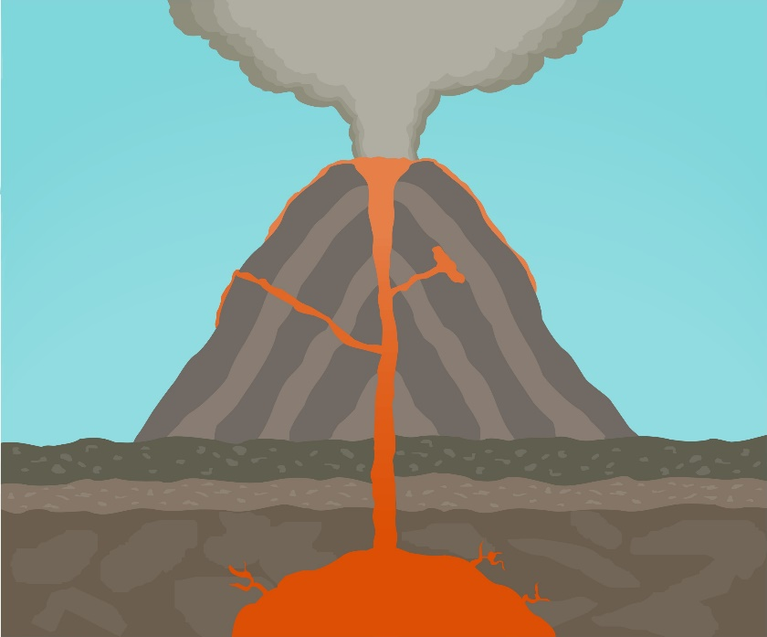
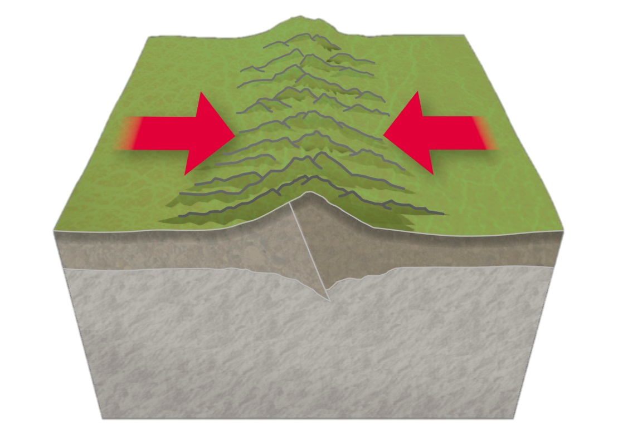
Notes:
Earthquakes, / volcanic activity, /and mountain building happen where these plates come together.

Slide 24
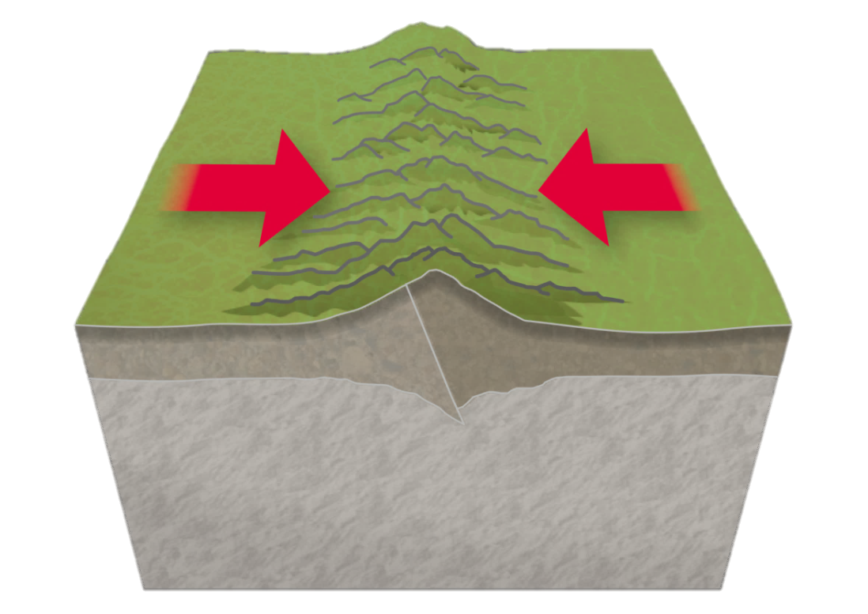
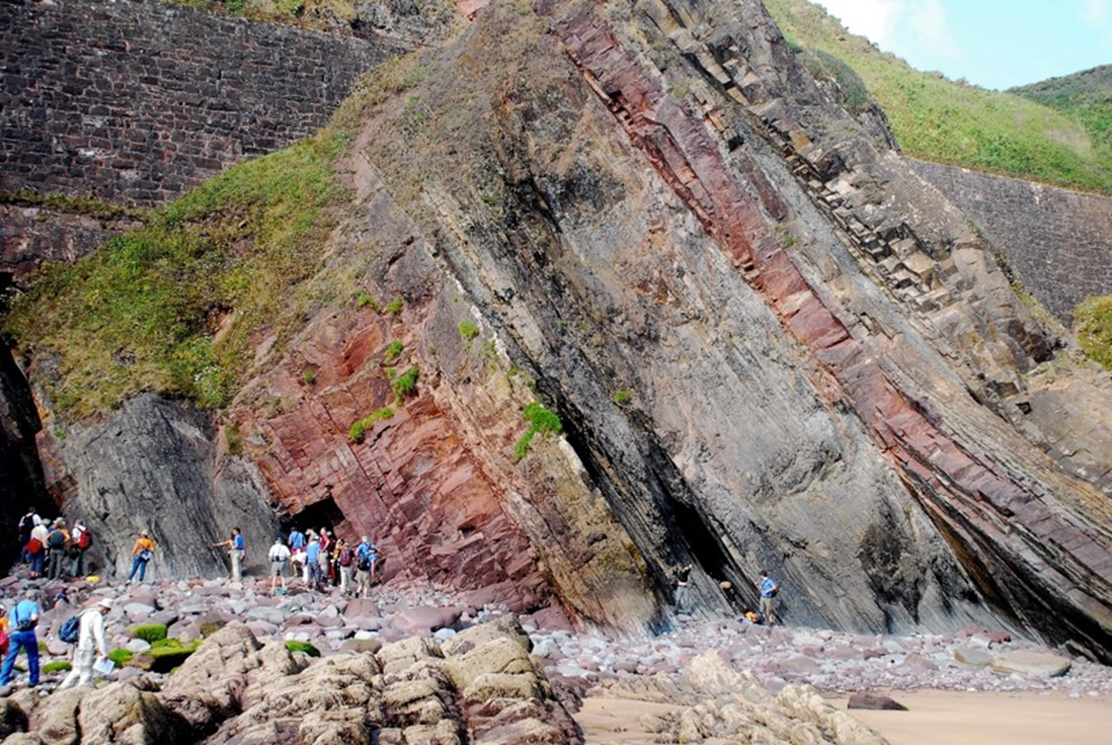
Notes:
When two plates crash into each other, rock layers that were horizontal / can be thrust up like this.

Slide 25
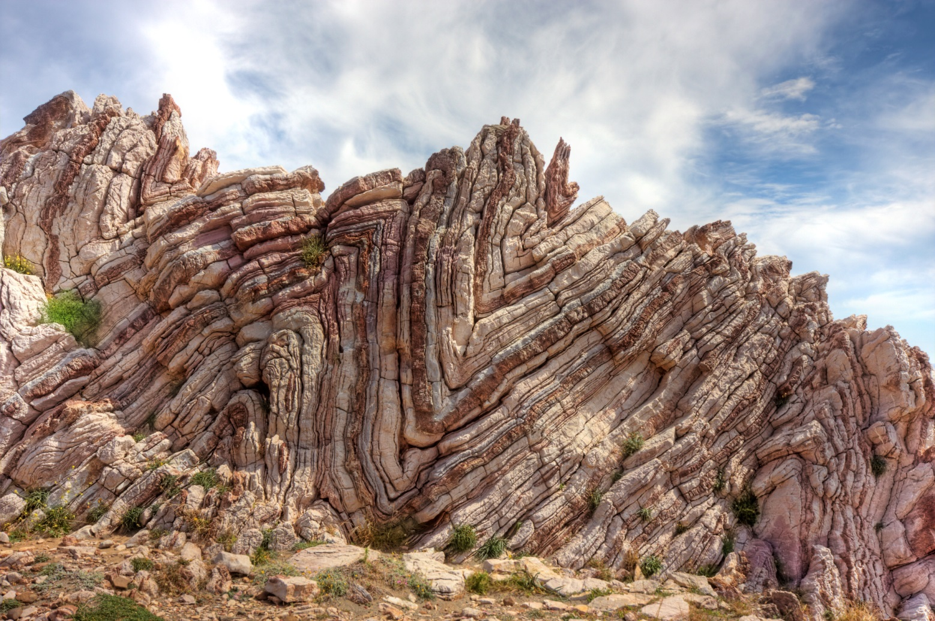
Notes:
Or layers can be squeezed in between two plates and fold like this.

Slide 26
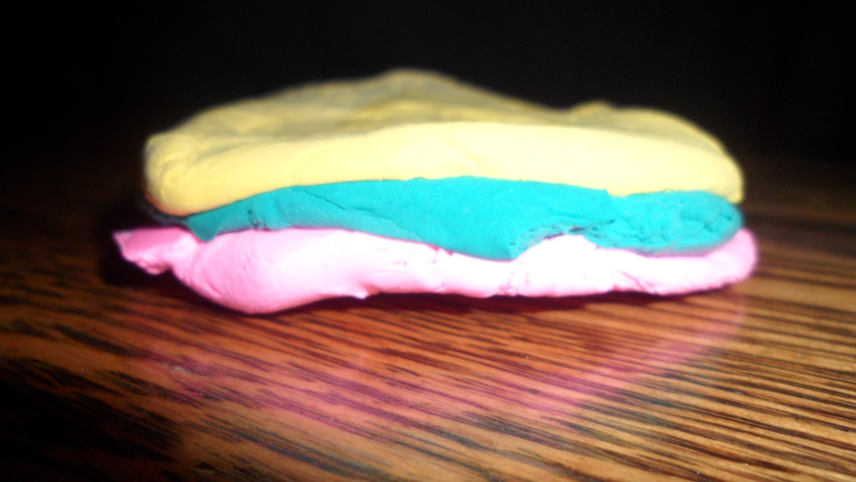
Notes:
These layers of play-doh may help you understand how that could happen. Layers that are flat to begin with

Slide 27
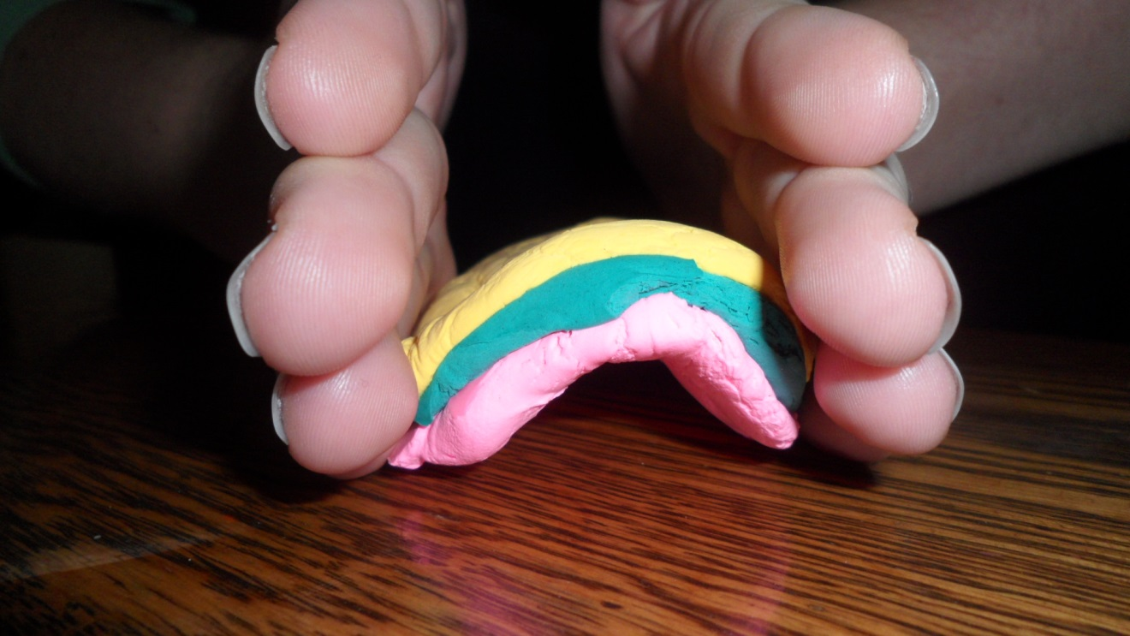
Notes:
…can be bent if they are pushed in from one or both sides before they harden.

Slide 28
Notes:
If the layers harden after they bend, they can look like this. This folding is believed to happen after hardening also, if it happens slowly.

Slide 29
Data
Notes:
These rock layers—the horizontal ones, / the ones that have been thrust up, / and the ones that are bent all provide us with data. / These data are consistent with the story of an event recorded in the Bible.

Slide 30
Genesis 7-9
http://commons.wikimedia.org/wiki/File:Holy_Bible.JPG
Notes:
Genesis 7-9 tells the story of a worldwide flood.

Slide 31
Genesis 7:11
“…all the fountains of the great deep burst open, and the floodgates of the sky were opened.”
Notes:
The story says that “All the fountains of the great deep burst open, and the floodgates of the sky were opened.

Slide 32
Genesis 7:12
“The rain fell upon the earth for 40 days and 40 nights.”
Notes:
Then the rain fell upon the earth for forty days and forty nights.”

Slide 33
Genesis 7:12
The fountains of the great deep burst open
Rain fell for 40 days and nights
Notes:
Notice there are two important things mentioned in these verses: (1) The fountains of the great deep burst open and (2) rain fell for 40 days and 40 nights. The one we usually hear about is the second one—the rain.

Slide 34
Genesis 7:17-18
“For 40 days the floodwaters grew deeper, covering the ground and lifting the boat high above the earth. As the waters rose higher and higher above the ground, the boat floated safely on the surface.”
Notes:
For 40 days the floodwaters grew deeper, covering the ground and lifting the boat high above the earth. As the waters rose higher and higher above the ground, the boat floated safely on the surface

Slide 35
Genesis 7:19-20
“Finally, the water covered even the highest mountains on the earth, rising more than 22 feet above the highest peaks!”
Notes:
Finally, the water covered even the highest mountains on the earth, rising more than 22 feet above the highest peaks!

Slide 36
Genesis 7:24
“And the floodwaters covered the earth for 150 days.”
Notes:
The water covered the earth for 150 days. That is 5 whole months!

Slide 37
Genesis 8:1
“God…sent a wind to blow across the earth, and the floodwaters began to recede.”
Notes:
Then God sent a wind to blow across the earth, and the floodwaters began to recede. Have you ever seen wind blow water around during a bad storm? Sometimes when it rains really hard, water begins to collect along the edges of the road. If it’s really windy at the same time, the wind can blow the water along the road.

Slide 38
Genesis 8:3, 4
“So the floodwaters gradually receded from the earth. After 150 days…the boat came to rest on the mountains of Ararat.”
Notes:
The water receded gradually until the Ark finally came to rest on the mountains of Ararat.

Slide 39
Notes:
It is possible that water flowing during the flood, created the conditions necessary to lay down the kind of rock layers we find all around the world.

Slide 40
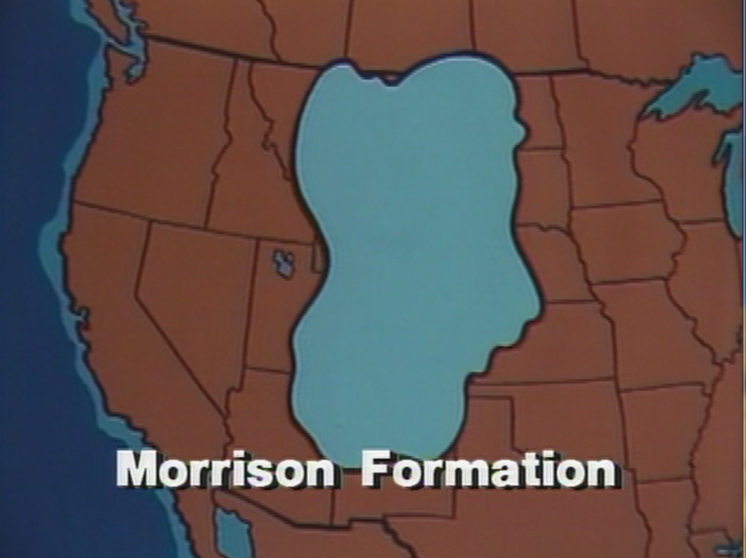
Chinle Group
Shinarump
Formation
Morrison Formation
Dakota Formation
Notes:
Including these huge rock layers that cover thousands of square miles and are found on every continent.

Slide 41
Genesis 7:11
“All the fountains of the great deep burst open, and the floodgates of the sky were opened.”
Notes:
Now let’s go back and look at the first part of that verse: “All the fountains of the great deep burst open. Although we don’t know exactly what that means, it like some pretty violent stuff happened to the earth itself!

Slide 42
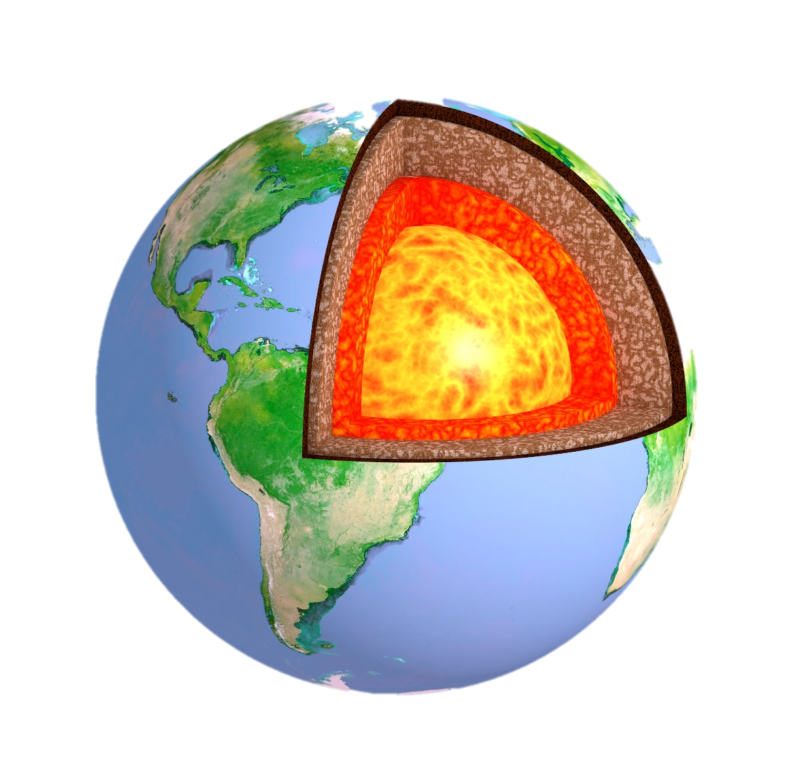
Notes:
Apparently something down in the earth broke which allowed water--and probably lava—to come shooting up!

Slide 43
Notes:
It sounds like there could have been earthquakes and volcanoes.

Slide 44
Genesis 8:2
After the 150 days (7:24 & 8:3)
“Also the fountains of the deep and the floodgates of the sky were closed, and the rain from the sky was restrained.”
Notes:
And since the fountains of the great deep and the floodgates of the sky were closed only after the 150 days who knows how many separate ones might have happened during that time!

Slide 45
Notes:
Scientists who believe in the story of the Flood think that all those geologic processes probably didn’t stop all at one time. Earthquakes and volcanoes probably became less frequent over time, slowing to the rate at which they happen now.

Slide 46
1.
Collect
Data
2.
Interpret
Data
Notes:
Remember that scientists collect data and interpret data.

Slide 47
Notes:
The rock layers around the world and the fossils we find buried in them provide us with lots of data.

Slide 48
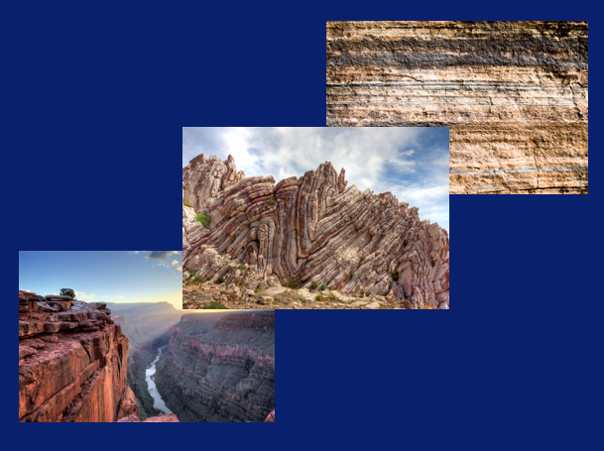
1.
Collect
Data
Notes:
They are evidence that something happened in the past to create these rock formations.

Slide 49
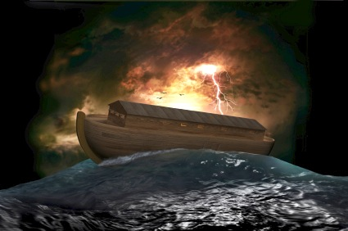
1.
Collect
Data
2.
Interpret
Data
Notes:
As we try to make sense of—or interpret—this data, our knowledge of the worldwide flood in Genesis can help us understand what happened.

Slide 50
Notes:
The evidence we see in the rocks

Slide 51
Notes:
…makes sense in light of the story of the worldwide flood described in the Bible.

Slide 52
Scripture quotations are from the
New Living Translation

Slide 53
Deposition Animation by
Joaquin Hernandez

Slide 54
Stock Images By
[1a] Zion National Park 489588635, kaiborder, Thinkstock, Thinkstock Image Subscription Agreement
[1b] Grand Canyon – Toroweap Point 480297321, Scott_Walton, Thinkstock, Thinkstock Image Subscription Agreement
[1c] Bryce Canyon landscape 497280819, jenifoto, Thinkstock, Thinkstock Image Subscription Agreement
[3a] Mammoth skeleton 186043, Escaflowne, Getty Images (US), Inc. Subscription Agreement
[3b] Giant Ground Sloth, Dallas Krentzel, http://www.flickr.com/photos/31867959@N04/3824332169, CC BY 2.0
[3c] Sabertooth Tiger Skull 825334, pixeldigits, Getty Images (US), Inc. Subscription Agreement
[5] Blue Mesa Petrified Forest National Park 479232619, estivillml, Thinkstock, Thinkstock Image Subscription Agreement
[6] Deposition animation, Joaquin Hernandez
[7] Australian cliff face 6968905, georgeclerk, Getty Images (US), Inc. Subscription Agreement
[8] Moss Back Cliffs 487584715, Robert_Ford, Thinkstock, Thinkstock Image Subscription Agreement
[9] Shinarump Formation, Evidences, The Record and the Flood, ©Geoscience Research Institute 1990. Used with permission.
[10] Chinle Group, Evidences, The Record and the Flood, ©Geoscience Research Institute 1990. Used with permission.
[11] Dakota Formation, Evidences, The Record and the Flood, ©Geoscience Research Institute 1990. Used with permission.
[12] Morrison Formation, Evidences, The Record and the Flood, ©Geoscience Research Institute 1990. Used with permission.
[13] World map 1074111, RonTech2000, Getty Images (US), Inc. Subscription Agreement

Slide 55
Stock Images By
[14a] Toroweap Overlook 26663946, kojihirano, Getty Images (US), Inc. Subscription Agreement
[14c] Sedimentary rocks, Mike Beauregard, https://www.flickr.com/photos/31856336@N03/4718776101/, CC BY 2.0
[18] Noah's Ark 12550737, jgroup, Getty Images (US), Inc. Subscription Agreement
[19] Folded rocks, Raul Esperante, used with permission
[20] White ball 178754775, Emrahguzel, Thinkstock, Thinkstock Image Subscription Agreement
[21] Earth’s tectonic plates 11706609, Dorling Kindersley, Thinkstock, Thinkstock Image Subscription Agreement
[22a] Structure of the Earth 17591752, frentusha, Getty Images (US), Inc. Subscription Agreement
[23a] Geological faults 42472678, ttsz, Getty Images (US), Inc. Subscription Agreement
[23b] Volcano during eruption 4600789, jeremkin, Getty Images (US), Inc. Subscription Agreement
[23c] Tectonic plates moving together 96168934 Dorling Kindersley, Thinkstock, Thinkstock Image Subscription Agreement
[25] Folded rocks 24286621 Matauw, Getty Images (US), Inc. Subscription Agreement
[26] Play doh layers, Carol Raney
[27] Bent Play doh layers, Carol Raney
[30b] Vintage old book, 95272278, Sharon Bronte, Thinkstock, Thinkstock Image Subscription Agreement

Slide 56
Special Thanks
Foundation for Adventist Education

Slide 57
© Origins Curriculum Resources 2015

Slide 58
© Southern Adventist University 2015

Slide 59
© Seventh-day Adventist North American Division 2015

Slide 60
© General Conference of Seventh-day Adventists 2015

Slide 61
© SCORE Southern Center for Origins Research & Education 2015

